Slide 1

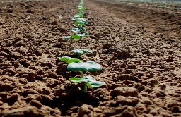
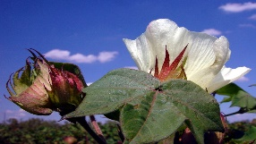

Monday May 28
4 - 6 pm Badge Pickup JMCC Foyer
7 - 9 pm Welcome Reception
Tuesday May 29
7:30 am Breakfast JMCC Café
Applied Genomics and Breeding
8:30 am Welcome
8:45 am John Hickey (Plenary)
9:15 am Peng Chee (Plenary)
9:45 am Washington Gapare
10:00 am Xianlong Zhang
10:15 am coffee and tea
10:45 am Paul Chomet
11:00 am Jodi Scheffler, Shuli Fan
Kari Hugie, Zhongxu Lin
Duke Pauli, Jenny Koebernick
Furong Wang, Jingxia Zhang,
12:00 pm Lunch JMCC Café
Structural Genomics
1:00 pm Jeff Chen (Plenary)
1:30 pm Tianzhen Zhang (Plenary)
2:00 pm Wangzhen Guo
2:15 pm Youlu Yuan
2:30 pm Xiaoguang Shang
2:45 pm coffee & tea
3:15 pm Xinlian Shen, Guoli Song
David Fang, Ishwarappa Katageri
Zhikun Li, Hongmei Wang
Daigang Yang, Youlu Yuan
Yan Zhang
4:00 pm Business Meeting
6:30 pm The Caves Group Dinner
12 Niddry Street South
Wednesday May 30
7:30 am Breakfast JMCC Café
Germplasm and Genetic Stocks
8:30 am Josh Udall (Plenary)
9:00 am Todd Campbell (Plenary)
9:30 am Xiongming Du
9:45 am Zhiying Ma
10:00 am Baoliang Zhou
10:15 am coffee & tea
10:45 am Wuwei Ye, Steve Hague
Awais Farooq, Ramesh Buyyarapu
11:05 am Posters
12:00 pm Lunch JMCC Café
Functional Genomics
1:00 pm Shuangxia Jin (Plenary)
1:30 pm Yuxian Zhu (Plenary)
2:00 pm Qian-Hao Zhu
2:15 pm Dayong Zhang
2:30 pm Tayyab Husnain
2:45 pm coffee & tea
3:15 pm Lili Tu, Longfu Zhu,
Qi Guo, Xingfen Wang,
Yuan-yuan Yan, Jun Yang
Feng Zhang, Min Ling, Xueying Guan
4:00 pm Posters
Dinner on your own
Thursday May 31
7:30 am Breakfast JMCC Café
Comparative Genomics
and Bioinformatics
8:30 am Jonathan Wendel (Plenary)
9:00 am Dorrie Main (Plenary)
9:30 am Maojun Wang
9:45 am Jing Yu
10:00 am Daniel Peterson
10:15 am coffee & tea
10:45 am Chun-Huai Cheng
Amanda Hulse-Kemp, Ping Zheng
Katheryn Buble, Zhenzhen Xu
Tianlun Zhao, Guozhong Zhu
11:20 am Posters
12:00 pm Lunch JMCC Café
Afternoon on your own
to explore Edinburgh
Friday June 1
7:00 am Breakfast JMCC Café
Bus Tour
7:30 am Load buses
9:15 am James Hutton Institute
Gaynor Mackenzie & Robbie Waugh
12:00 pm Edradour Distillery
1:00 pm Blair Athol Distillery
2:30 pm Blair Castle (lunch)
6:00 pm Arrive in Edinburgh
Dinner on your own

Slide 2


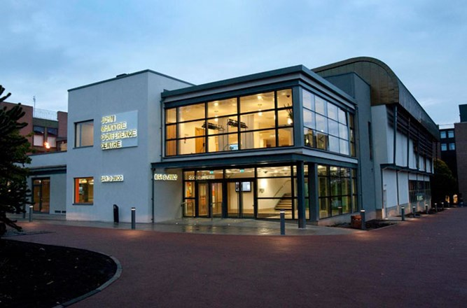





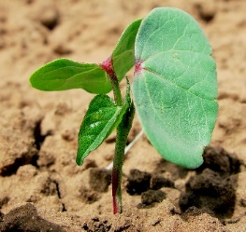
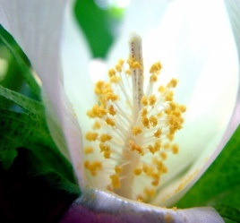

John McIntyre
Conference Center (JMCC)
Presentations
Pentland Suite
Posters
Prestonfield Room
Sponsors
2018 ICGI Conference
Edinburgh, Scotland
May 28 – June 1
Organizing Committee
Todd Campbell
Peng Chee
Steve Hague
Don Jones
Dorrie Main
Josh Udall
Jing Yu
John Yu
Tianzhen Zhang

