Slide 1
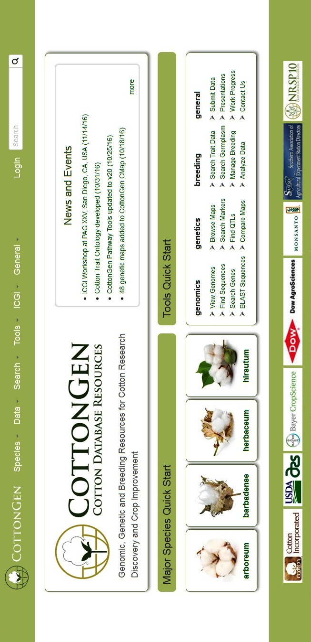
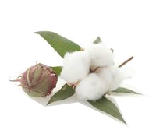
Membership
Login/sign in
Function overview, work progress, usages, and CottonGen presentations
FUTURE WORK
ICGI home, membership & mailing list achieves
Add 63K SNP array genotype data and make it searchable
Add more curated QTL and trait data
Release the comprehensive Breeding Information Management System (BIMS)
Add the National Cotton Variety Test (NCVT) data
Further develop data-mining resources for both basic and translational scientists
Browse or search data
via implemented tools
Genomic, Genetic and Breeding Resources for Cotton Research Discovery and Crop Improvement
Search database
PROJECT SUPPORT
WWW.COTTONGEN.ORG
For more information contact:
www.cottongen.org/contact
Dorrie Main (dorrie@wsu.edu)
Jing Yu (jing.yu@wsu.edu)
Links to major species &
Species specific summaries
The Cotton Community The CottonGen Steering Committee
The Tripal Developers Community
The Bioinformatics Community
Click to return
Home Page
Data downloads & submissions,
Or browse Data in CottonGen
@CottonGen_news

Slide 2
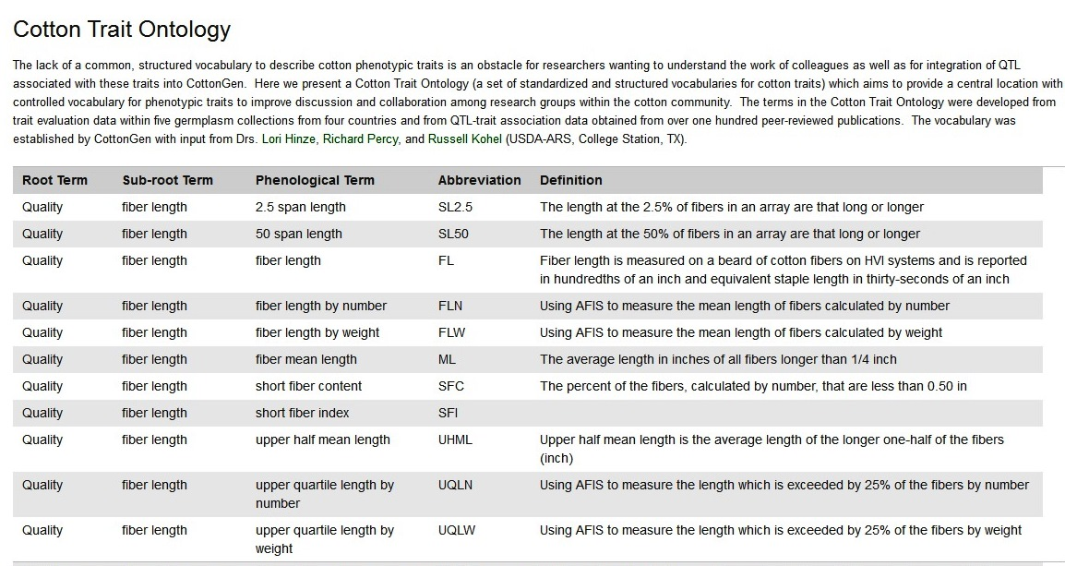
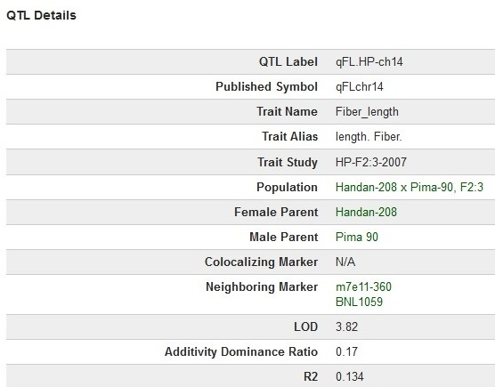
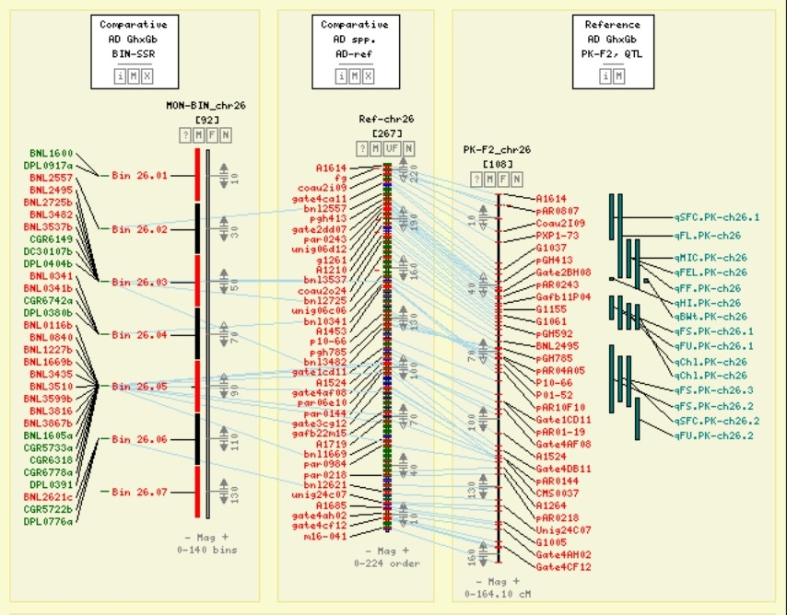
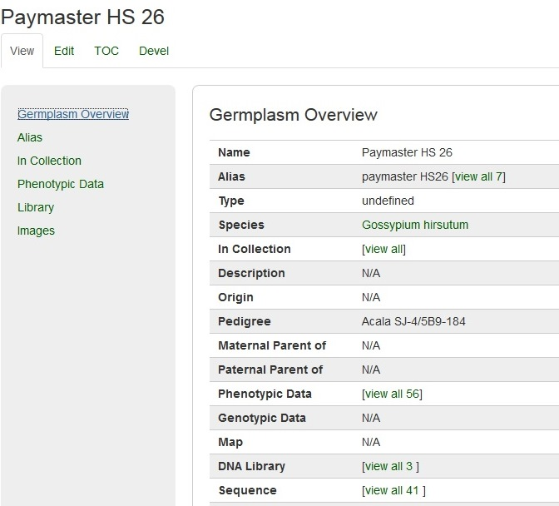
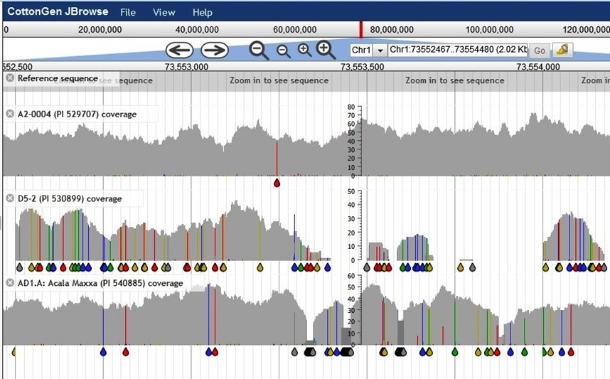
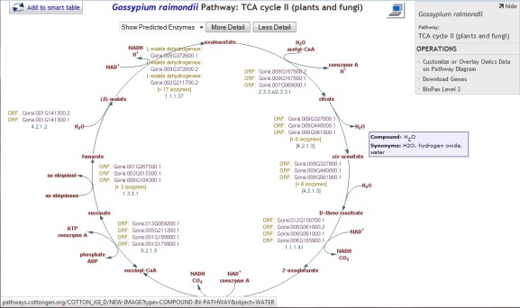
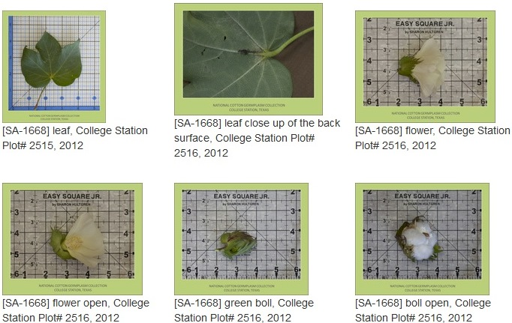
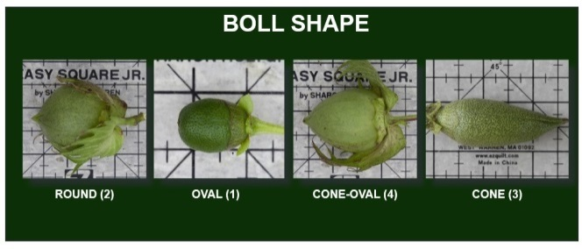
Web Site
www.cottongen.org
Cotton Trait Ontology
QTL Overview
Maps
Germplasm Overview Page
CottonCyc
Genome
Germplasm Images
Germplasm Images
Trait Descriptors
Trait Descriptor Standard Images

