Slide 1




Available Data
Genomes of G. arboreum, G. barbadense, G. hirsutum, and G. raimondii
404,228 markers
80 genetic maps
1,026 QTLs
12,337 images
16,640 germplasm
383,594 phenotype trait scores
CottonGen Features:
Easy-to-use search interfaces for retrieving data on markers, genes, transcripts, sequences, and traits
MapViewer for interactive map viewing
Searchable marker and trait databases
Assembled and annotated reference transcriptome (RefTrans) which is searchable using BLAST
PathwayCyc G. raimondii and G. hirsutum genomes
www.cottongen.org
Genomic, Genetic and Breeding Resources for Cotton Research Discovery and Crop Improvement
Available Tools
BLAST
JBrowse and GBrowse
CottonCyc
MapViewer and CMap
Supported by:
Cotton Incorporated
USDA National Research Support Project (NRSP10)
Bayer
Monsanto
Southern Association of Agricultural Experiment Station Directors
Dow
USDA-ARS
For more information contact:
www.cottongen.org/contact
Dorrie Main (dorrie@wsu.edu)
Jing Yu (jing.yu@wsu.edu)
@CottonGen_news

Slide 2
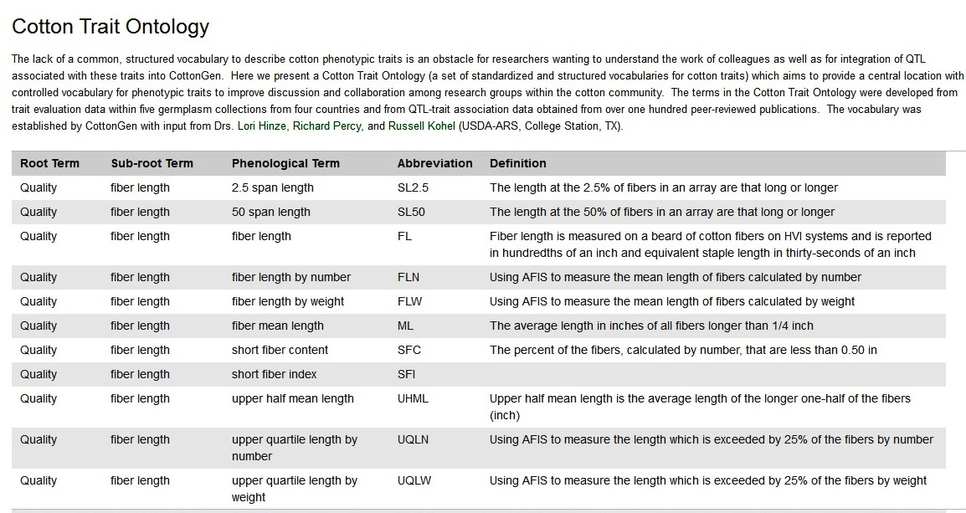
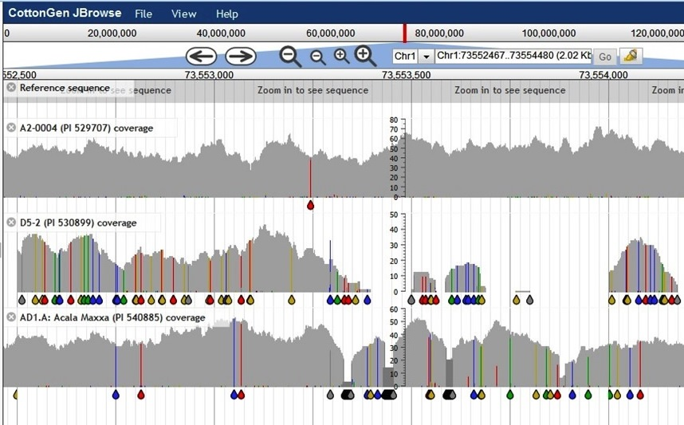
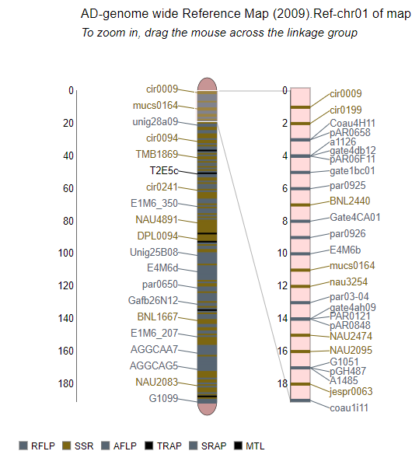
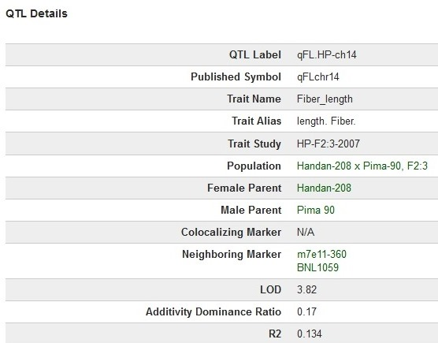
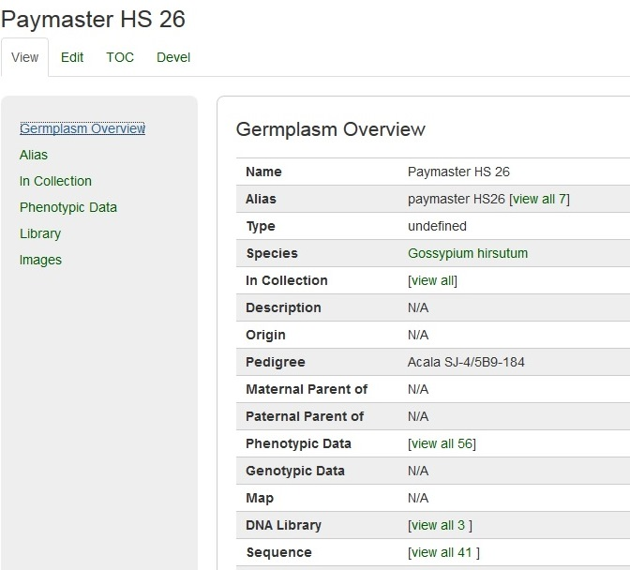
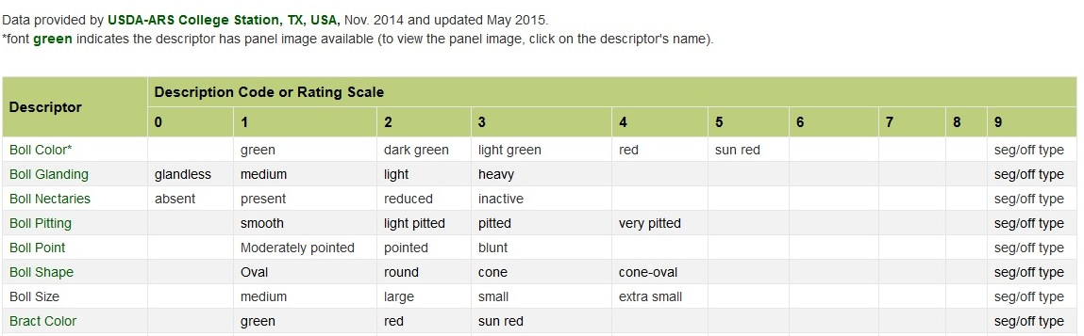
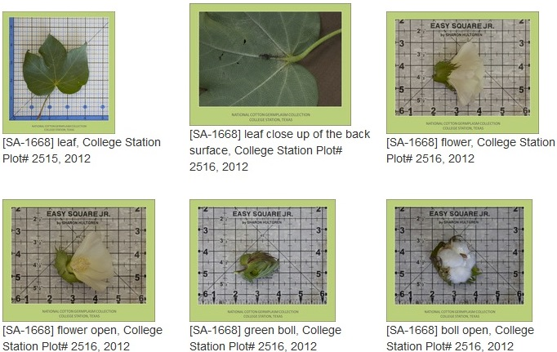
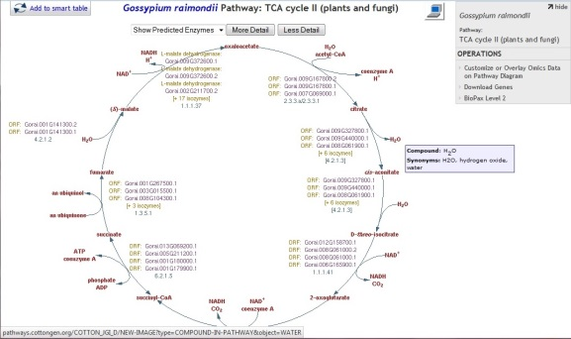
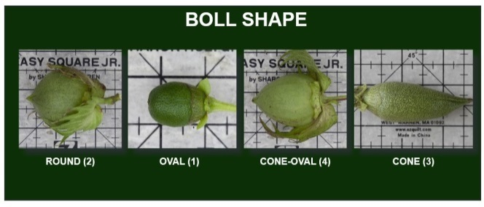
Cotton Trait Ontology
Genomes
MapViewer
QTL Overview
Germplasm Overview Page
Trait Descriptors
Germplasm Images
Trait Descriptors Standard Images
CottonCyc

