Slide 1

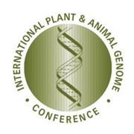


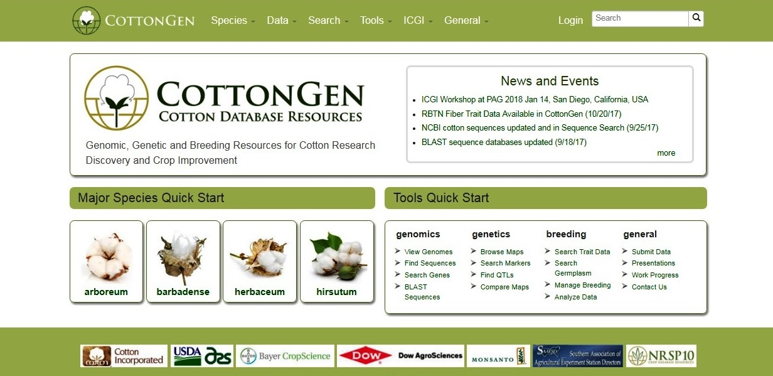
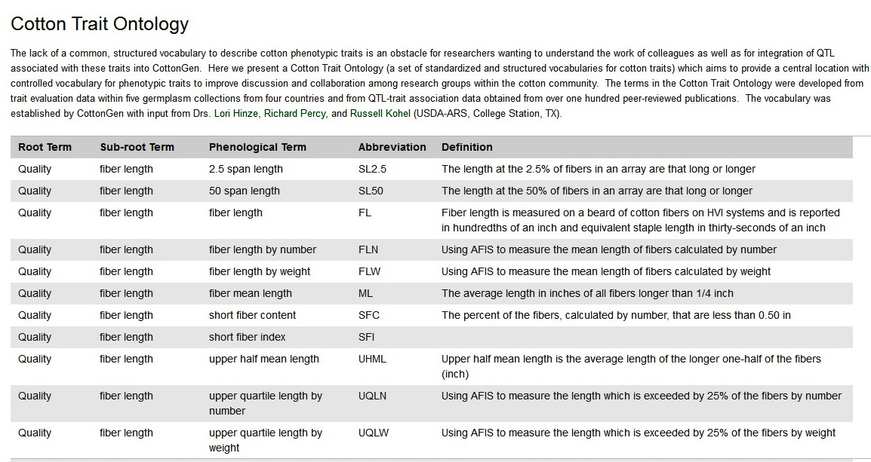
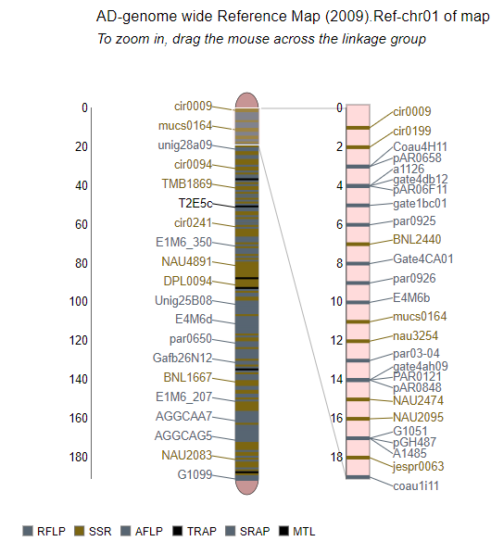
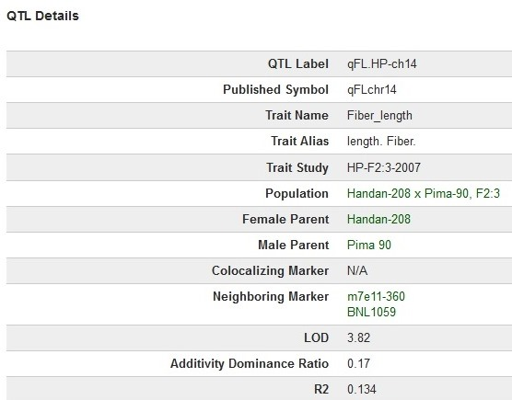
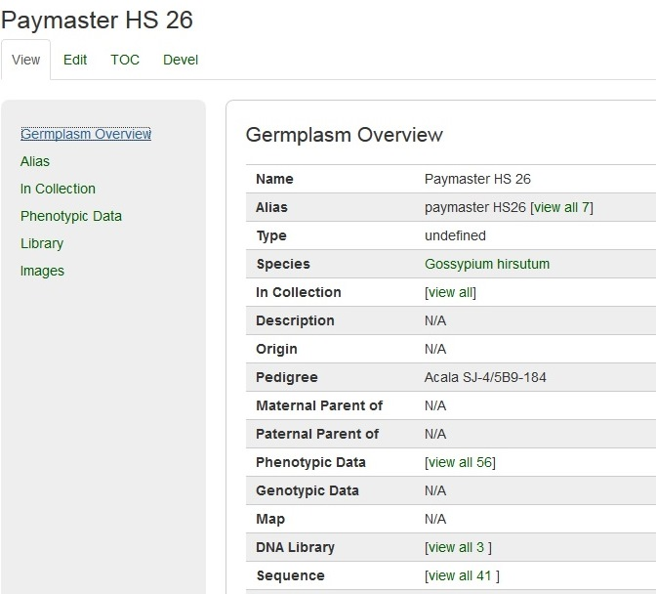
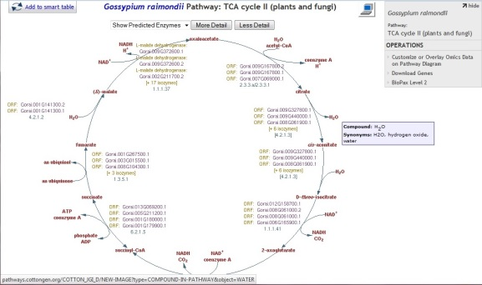
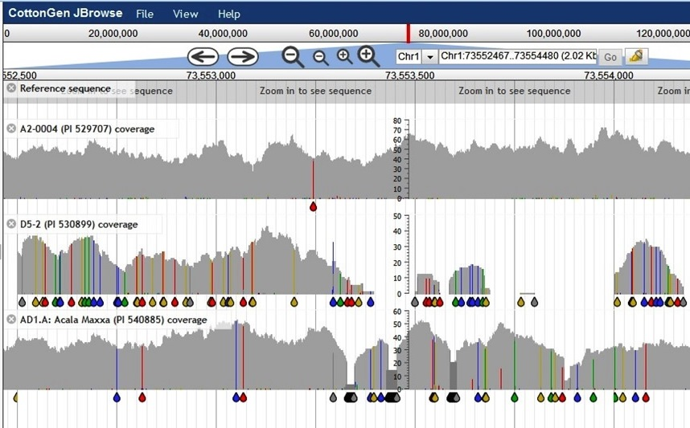
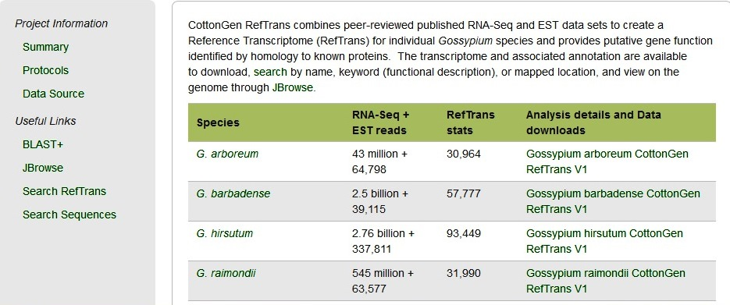
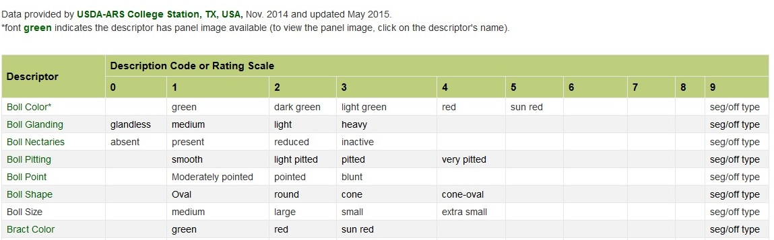
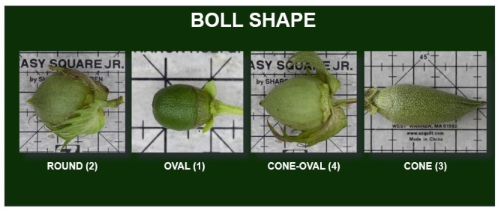







CottonGen
An Online Resource for the Cotton Community
Plant and Animal Genome Conference XXVI
Jing Yu¹, Sook Jung¹, Chun-Huai Cheng¹, Taein Lee¹, Katheryn Buble¹, Ping Zheng¹, Jodi L. Humann¹, Deah McGaughey¹, Heidi Hough¹, Stephen P. Ficklin¹, B. Todd Campbell², Richard G. Percy³, Don C. Jones⁴ and Dorrie Main¹
Washington State University, Pullman, WA, 2. USDA-ARS, Florence, SC, 3. USDA-ARS, Southern Plains Agricultural Research Center, College Station, TX, 4.Cotton Incorporated, Cary, NC
Abstract
CottonGen (www.cottongen.org) is an informatics resource for cotton researchers that facilitates research discovery and cultivar improvement by providing a genomics, genetics and breeding database that serves as the central data repository for the cotton community. In addition to curated data, integrated analysis and visualization tools such as JBrowse and GBrowse, BLAST+, CottonCyc, MapViewer and CMap, CottonGen recently released a Cotton Trait Ontology, CottonGen Reference Transcriptomes (RefTrans). The Breeders Information Management System (BIMS) is in the final stages of development for release in 2018. CottonGen will continue to support the cotton research community by providing useful research data and tools. CottonGen is directly supported by Cotton Incorporated, USDA-ARS, the cotton industry, NIFA USDA NRSP10 and US Land Grant Universities.
Data Overview
Resources
New Cotton Trait Ontology online available
Annotated A2, D5, AD1, and AD2 genome seq. and synteny
CottonCyc built using the JGI-D5 and BGI-AD1 gene models
63K and 80K SNP arrays and 548K genetic markers
92 maps cover cotton genome groups AD, A, D, and G
1861 QTL loci of 200 QTL trait data from 30 QTL datasets
16K germplasm and 16 collections include US, UZ and China.
492K trait scores from 4 germplasm evaluation projects
12K digital images of 2K germplasm, from USDA-ARS NCGC
WWW.COTTONGEN.ORG
@CottonGen_news
Click to return
Home Page
Membership
Log in / Sign in
Links to major
species & species
specific summaries
Function overview, .Work
progress, Database usages
CottonGen Newsletters,
Presentations, etc.
Further Development Plan in 2018
Data Overview,
Download & Submission,
Cotton Trait Ontology
Community Projects, etc.
ICGI Home, membership,
& mailing list archives
Release of the comprehensive Breeding Information Management System (BIMS)
Release of Tripal MapViewer with physical/sequence maps
Current with all public breeding data
Add the National Cotton Variety Test (NCVT) data
Further data-mining tools for basic and translational scientists
Search genes, germplasm,
markers, publications, QTLs,
sequences, traits, etc.
Browse or Search Data
via implemented Tools
Cotton Trait Ontology
Maps
QTL Overview
Germplasm Overview Page
CottonCyc
Genomes
CottonGen RefTrans
Trait Descriptors
Trait Descriptor Standard Images
Acknowledged with Thanks
The Cotton Research
Community

