Slide 1


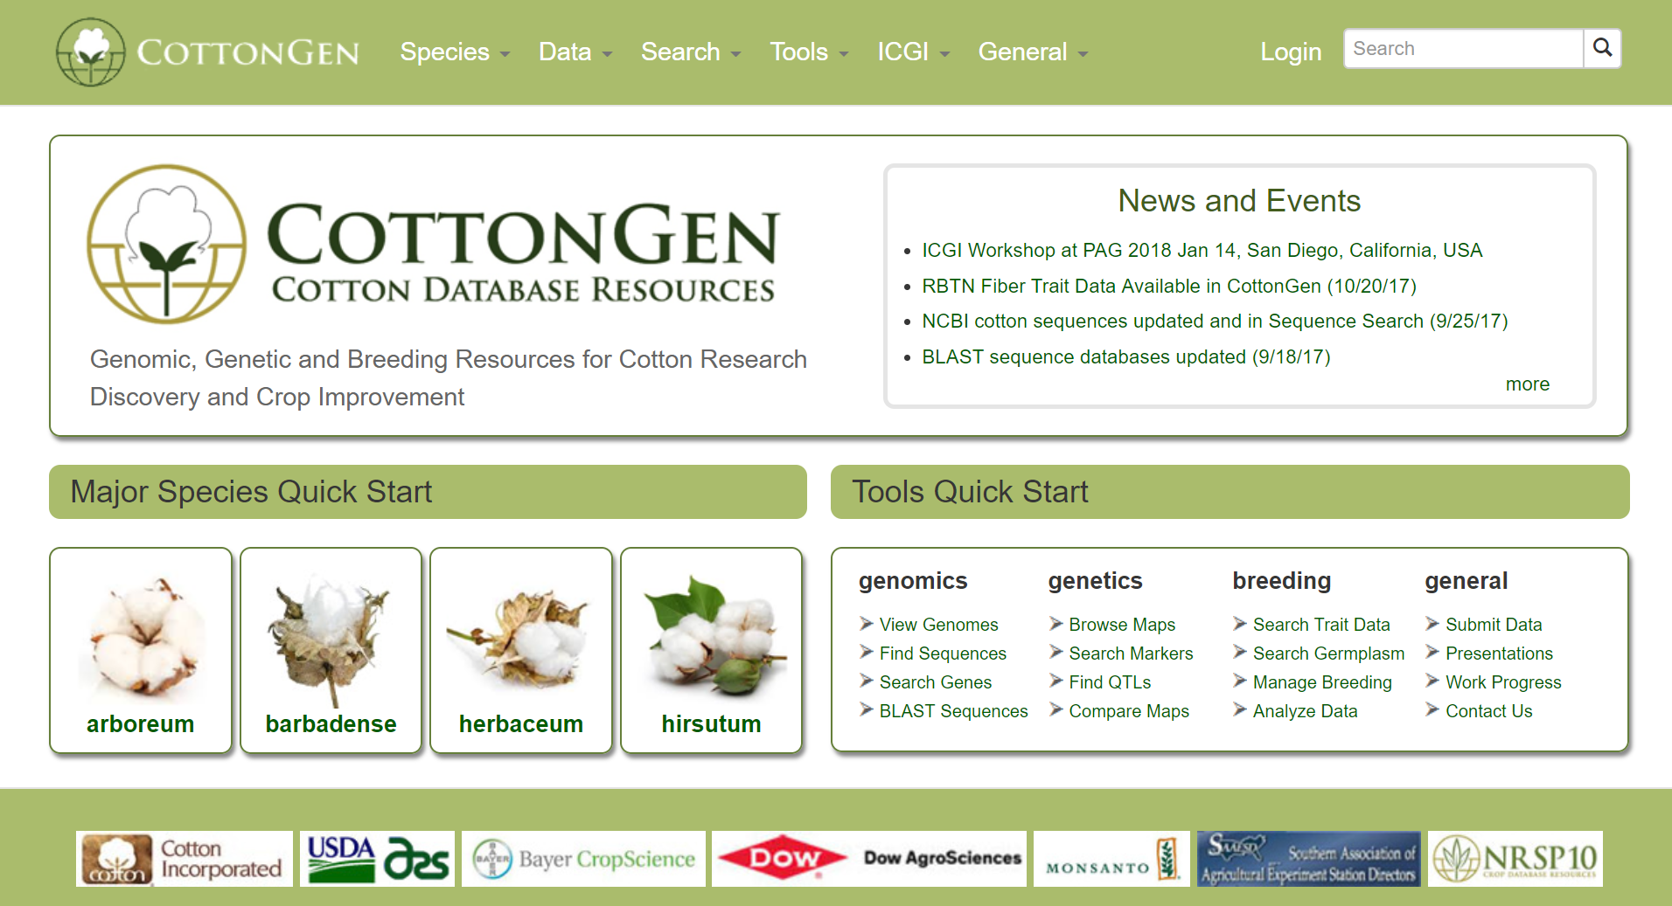
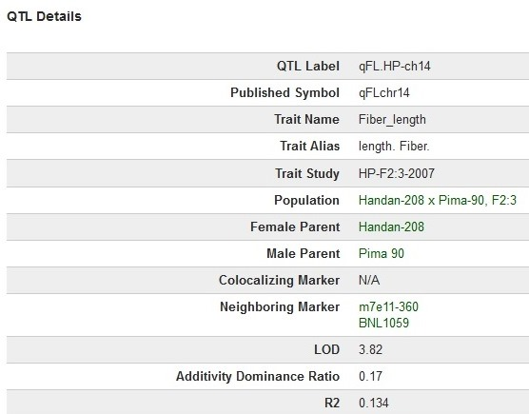
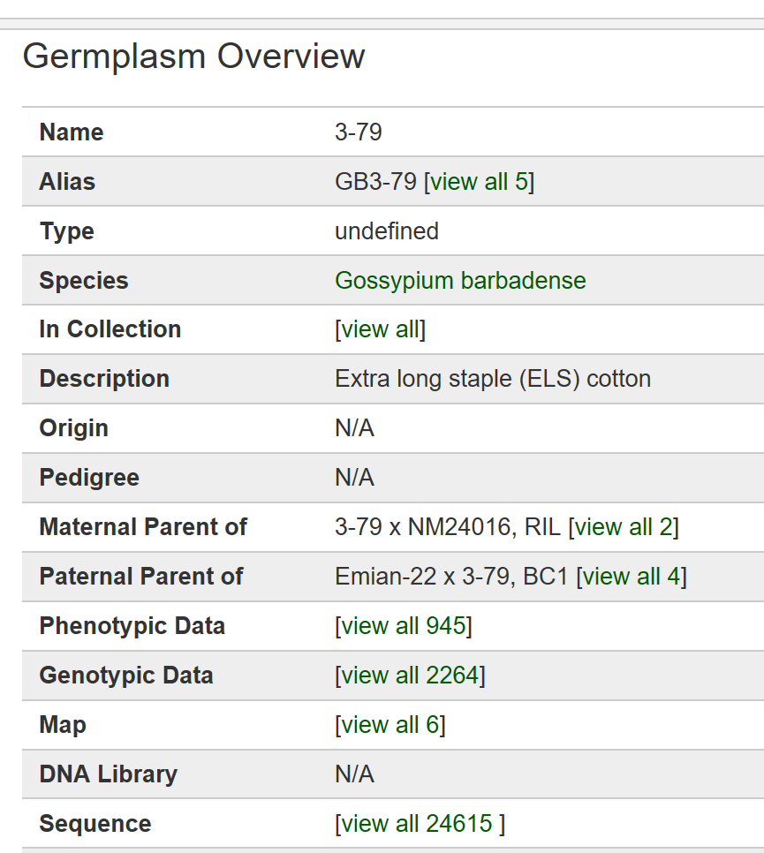
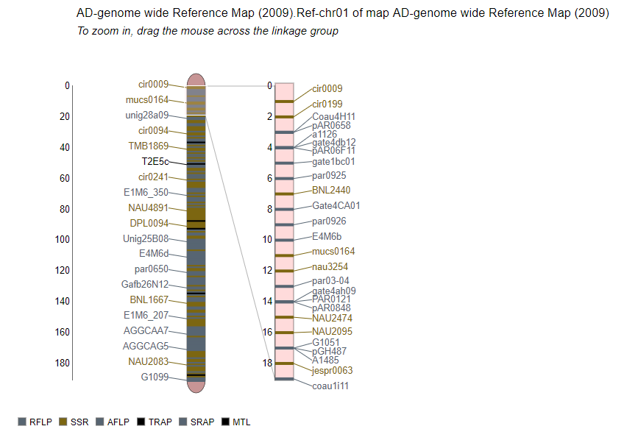
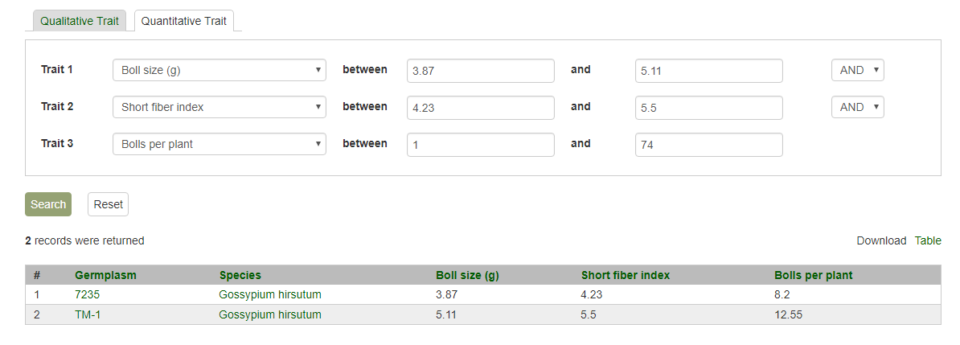
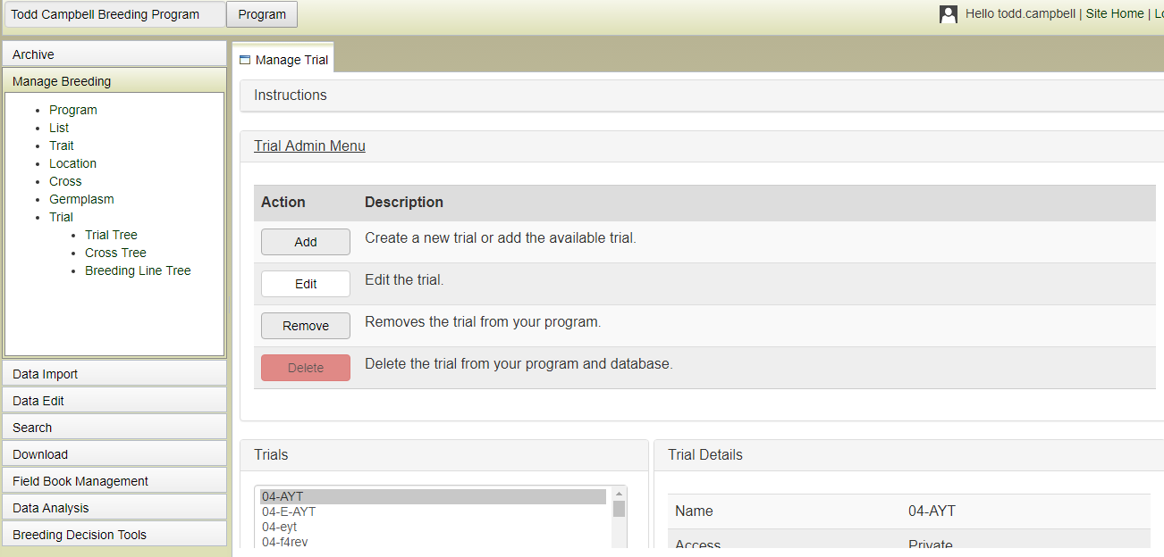
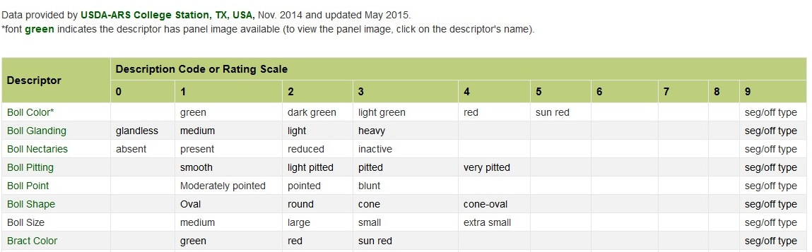
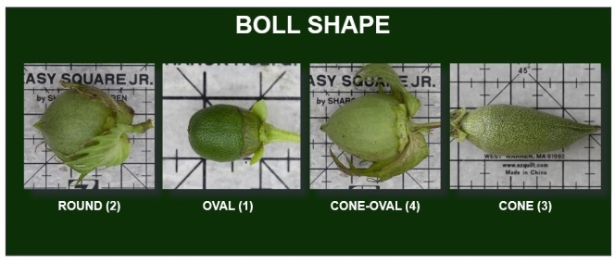









Using CottonGen for Crop Improvement
Jing Yu¹, Sook Jung¹, Chun-Huai Cheng¹, Taein Lee¹, Katheryn Buble¹, Ping Zheng¹, Jodi L. Humann¹, Deah McGaughey¹,
Heidi Hough¹, Amita Mohan¹, Josh Udall¹, B. Todd Campbell², Richard G. Percy³, Don C. Jones⁴ and Dorrie Main¹
1. Washington State University, Pullman, WA, 2. USDA-ARS, Florence, SC, 3. USDA-ARS, Southern Plains Agricultural Research Center, College Station, TX, 4.Cotton Incorporated, Cary, NC
WWW.COTTONGEN.ORG
Abstract
Resources
CottonGen is an established, dedicated online community database resource facilitating research discovery and crop improvement in cotton. It provides curated and integrated publicly available cotton genomics, genetics and breeding (GGB) data, accessible through easy-to-use web pages where data can be readily searched, filtered and downloaded or viewed through a suite of commonly used visualization tools. In this poster we highlight data and tool of use for breeders and showcase the latest functionality of the Breeding Information Management System (BIMS), a private and secure site within CottonGen that individual breeders can use to manage and analyze their breeding program data in a high performance computing environment while also leveraging the publicly available GGB data in their decision-making. CottonGen is funded by Cotton Incorporated, USDA-ARS, the cotton industry, NIFA USDA NRSP10, US Land Grant Universities and indirectly by NSF and USDA SCRI awards.
Membership/Private BIMS
Log in / Sign in
Function Overview, Work in
Progress and Completed,
Database Usage, Newsletters,
Presentations, etc.
ICGI Home, Membership,
& Mailing List Archives
Browse or Search Data
via Implemented Tools
Links to Major
Species & Species
Specific Summaries
Data Overview,
Download & Submission,
Cotton Trait Ontology
Community Projects, etc.
Search Genes, Germplasm,
Markers, Publications, QTLs,
Sequences, Traits, Genotype etc.
Data Summary
Search QTLs by Name , Label, Symbol
r
Search Germplasm by Name, Parentage, Collection
r
View Genetic Maps and Shared Markers using the new MapViewer
Genomes | 7 (A2, D5, AD1, AD2)
Genes/mRNAs | 258,459/503,017
Transcripts | 5.6 billion
Maps | 80
Markers | 548,744
QTLs | 1,861
Trait scores | 486,310
Germplasm | 16,693
Images | 12,337
Publications | 16,770
Search Traits by Descriptor, View Standard Descriptors, Access Germplasm with Trait Thresholds
r
Breeding Information Management System
Version 1.0
  All data loaded from Todd Campbells Breeding Program
  FieldBook App being used to collect phenotypic data
  Tools implemented to allow breeder and staff to upload, edit and perform basic data analysis
  Adding access to public breeding data
  Currently being tested by breeder
Data Usage
Funding Acknowledged with Thanks
The Cotton Research Community
US Land Grant Universities

