Slide 1
CottonGen BIMS
Breeding Information Management System
Dorrie Main, Sook Jung, Taein Lee, Chun-Huai Chen, Jing Yu
Cotton Breeders Workshop January 3, 2015 Cotton Beltwide Conference 2016

Slide 2
Outline
Vision for BIMS
Why BIMS for CottonGen?
Components of BIMS
Demo of BIMS
Future Development and Discussion

Slide 3
Vision
To provide individual breeders with a secure and comprehensive online breeding management system which will allow them to:
Store, manage, archive and analyze their private breeding program data
Fully integrate their data with publicly available genomic, genetic and breeding data
Manage data from the Field Book App, an android app for collecting phenotype data in the field

Slide 4
Value of BIMS in CottonGen
Data is backed up daily – Data Safety
Breeding data fully integrated with data in CottonGen – Enhanced Data Utility
CottonGen is continuously updated with genomic data, QTL data, publicly available cultivar evaluation data and molecular genotypic data
New and better marker development
From markers that breeders use -> marker page in CottonGen -> genome browser
-> sequence and polymorphism data
From traits (linked to trait ontology) -> QTL page in CottonGen -> genome browser -> sequence and polymorphism data
Compare trait data between private germplasm and publically available germplasm
Aids in breeding decision making and it’s free! ☺

Slide 5
Components of BIMS in CottonGen
Archive
Manage Breeding
Data Import
Search/Download
Field Book App Management
Data Analysis Tools
Breeding Decision Tools

Slide 6
Archive
Notes:
The Archive function in BIMS allows you at any time to save your data to your local device (computer, tablet, phone etc.) You will be able to select all the data, some of the data, between dates and in requested format.

Slide 7
Manage Breeding
Notes:
The BIMS will show only public datasets (publicly available cultivar evaluation data) if you have not created your own program. You can view the description of the public datasets and also the trait descriptors that they used.

Slide 8
Manage Breeding: View Descriptors
Notes:
The BIMS will show only public datasets (publicly available cultivar evaluation data) if you have not created your own program. You can view the description of the public datasets and also the trait descriptors that they used.

Slide 9
Manage Breeding: Creating a New Program
Notes:
You need to ask for a breeder account before you can create your own program. Within your program you can create multiple trials and make multiple crosses in multiple locations. You do not need to create multiple programs unless you need to create a collaborative breeding program with which you do not want to share your own private breeding data. Once you create your program you can add members and give them privilege to read or read/write.

Slide 10
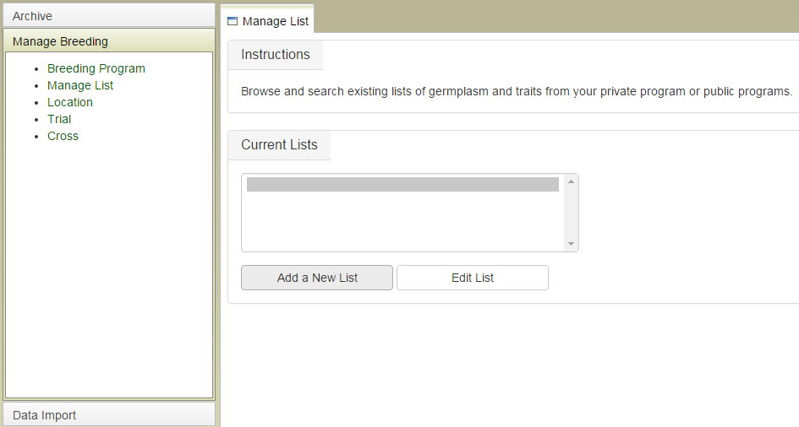
Manage Breeding: Manage List
You can create lists of germplasm and traits to make phenotypic data collection sheets, download phenotypic or genotypic data in ‘Download page’ or any other future BIMS tools. The lists is accessed in your account page.
Notes:
You need to ask for a breeder account before you can create your own program. Within your program you can create multiple trials and make multiple crosses in multiple locations. You do not need to create multiple programs unless you need to create a collaborative breeding program with which you do not want to share your own private breeding data. Once you create your program you can add members and give them privilege to read or read/write.

Slide 11
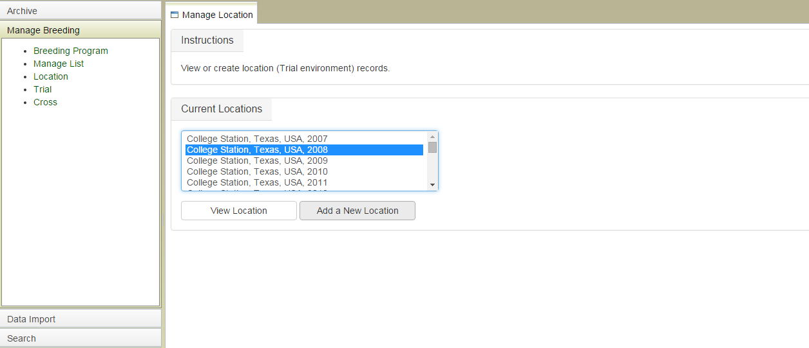
Manage Breeding: Manage Locations
View existing locations or create new locations for trials

Slide 12
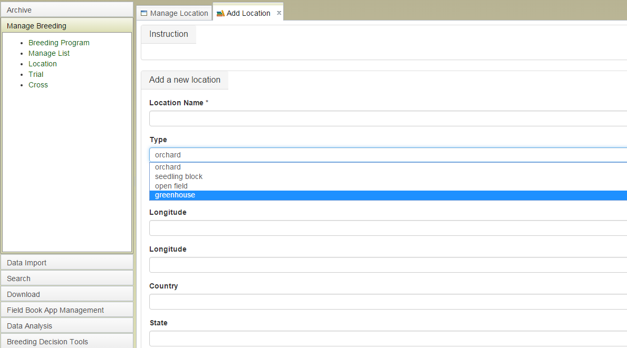
Manage Breeding: Create a New Location

Slide 13
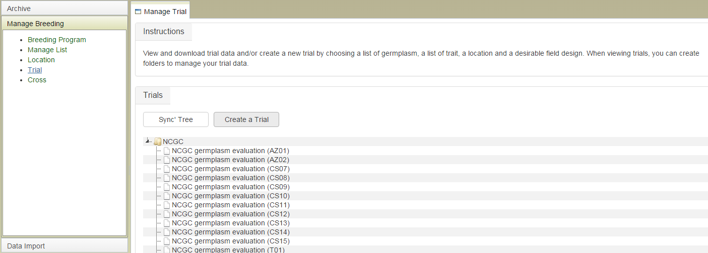
Manage Breeding: Manage Trials
View and download trial data When viewing trials, you can create folders to manage your trial data. We will add a functionality to create a new trial by choosing a list of germplasm, a list of trait, a location and a desirable field design.

Slide 14
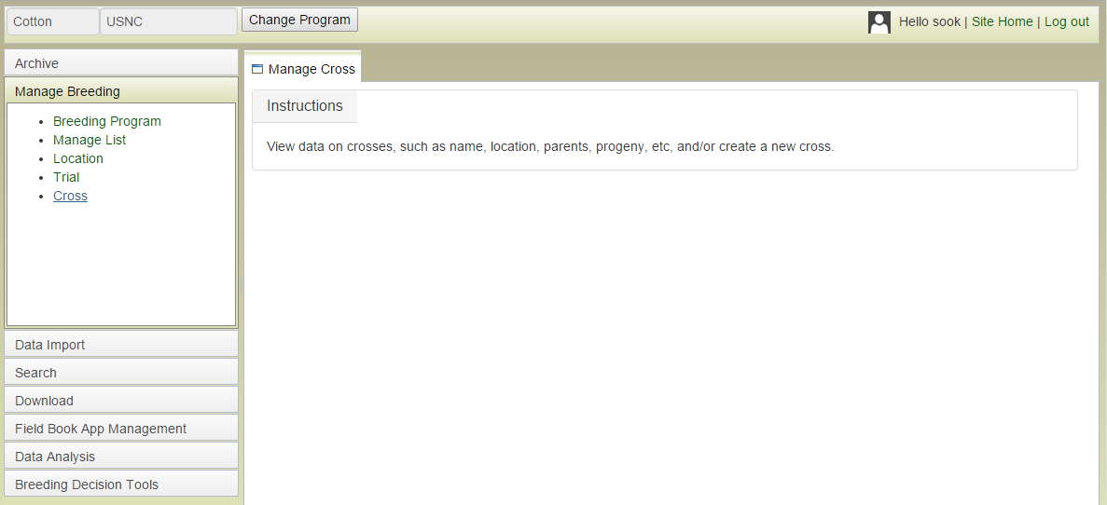
Manage Breeding: Manage Crosses
View data on crosses, such as name, location, parents, progeny, etc, and/or create a new cross.

Slide 15
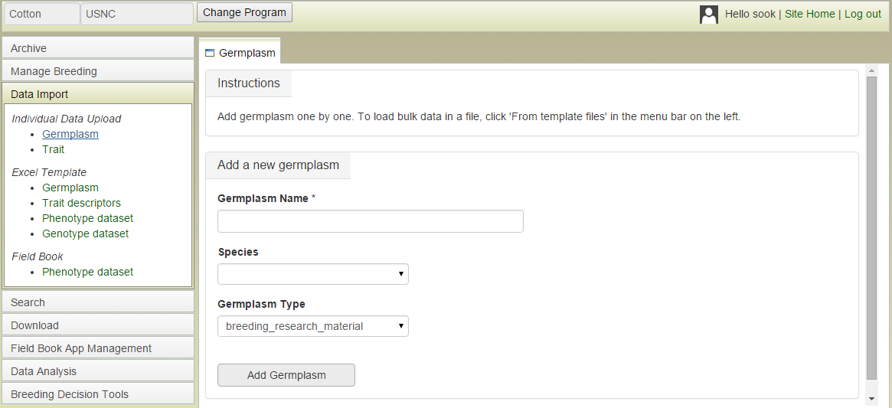
Data Import: Individual Data Upload - Germplasm

Slide 16
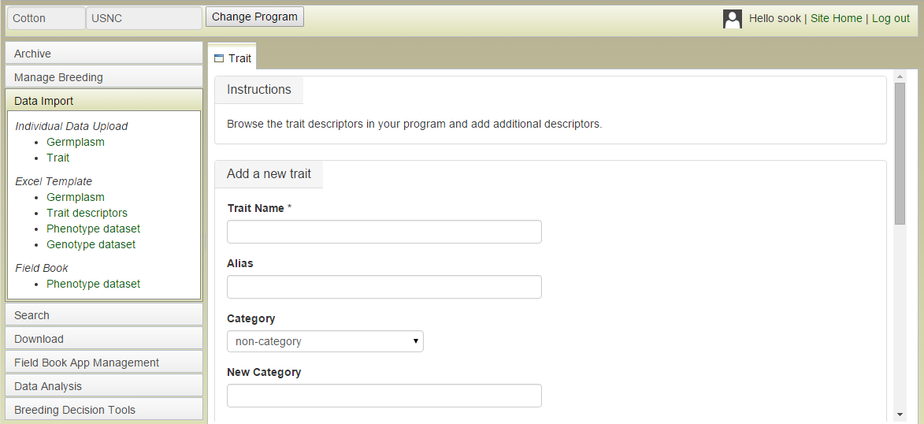
Data Import: Individual Data Upload - Traits

Slide 17
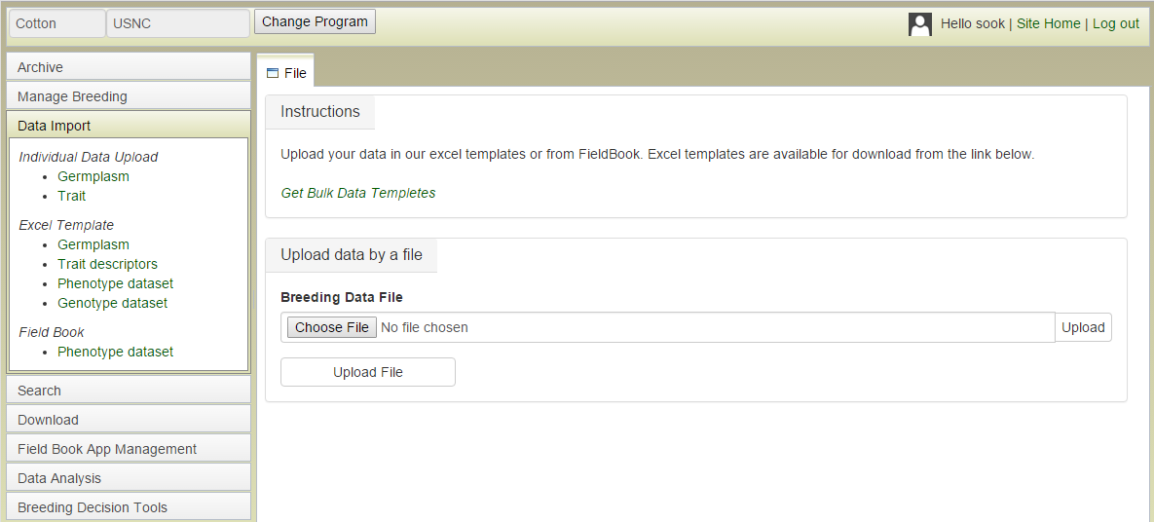
Data Import: Templates

Slide 18
Search: By Germplasm Name

Slide 19
Search: By Parentage

Slide 20
View trials in your program and download the data.
Download: By Trial

Slide 21
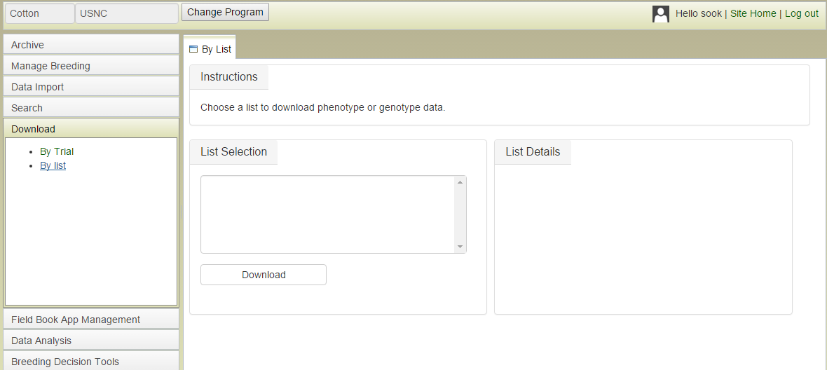
Download: By List
View lists in your account and choose to download the phenotypic and genotypic data for the list of germplasm

Slide 22
Field Book App Management
Upload trait evaluation data collected with Field Book App to BIMS
Download trait data collection files in Field Book Format

Slide 23
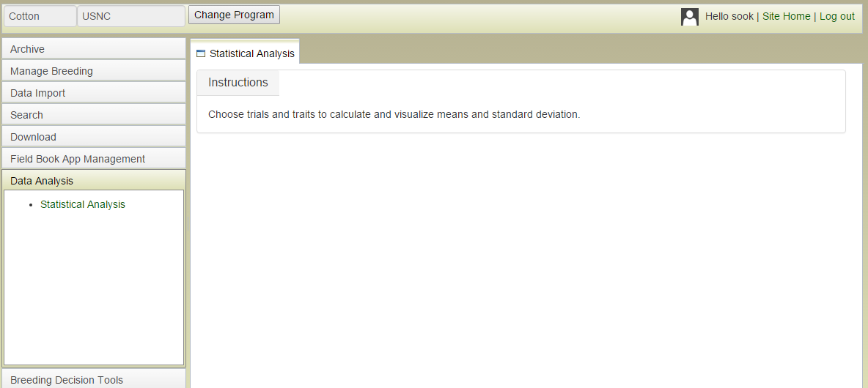
Data Analysis: Statistical Analysis
Choose trials and traits to calculate and visualize means and standard deviation for the dataset.

Slide 24
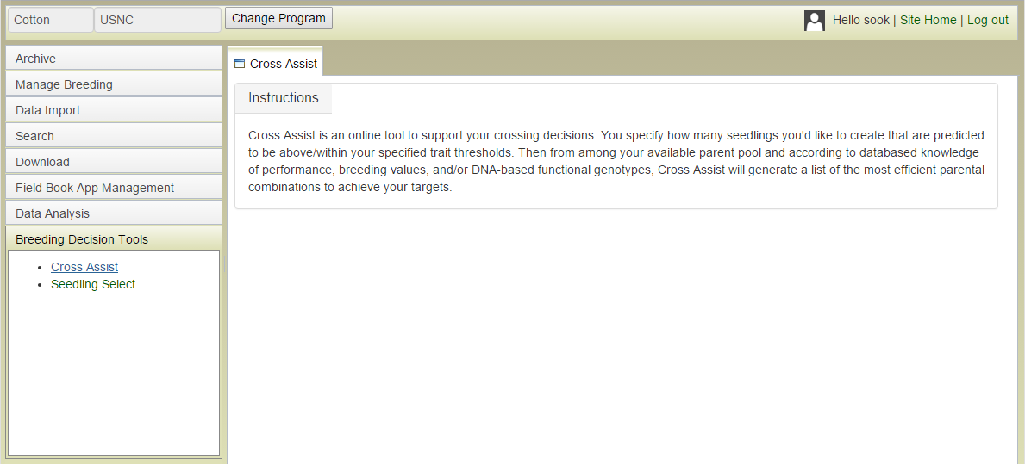
Breeding Decisions: Cross Assist
You specify how many seedlings you'd like to create that are above your specified trait thresholds. Cross Assist will generate a list of the most efficient parental combinations to achieve your targets.

Slide 25
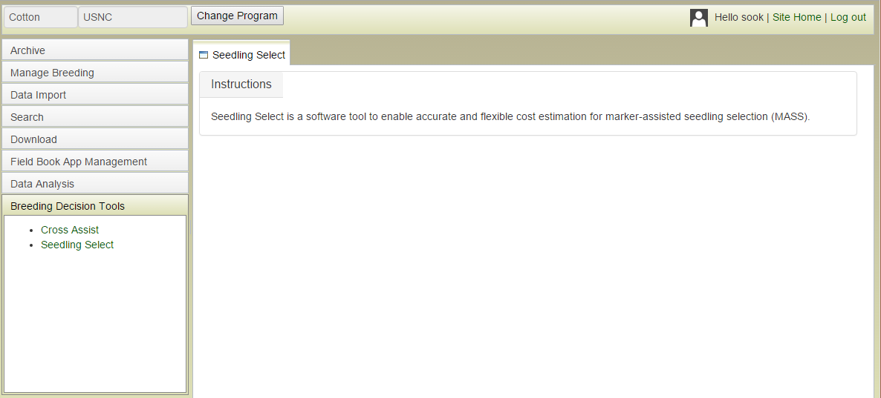
Breeding Decisions: Seedling Assist
A tool to enable accurate and flexible cost estimation for marker-assisted seedling selection (MASS)

Slide 26
Step by Step Guide
Create program
Create location (for existing trials)
Import data files (germplasm, trait descriptors, existing trial data)
Create a new trial
Create trait collection file
If you will be using Field Book App, create trait collection file for Field Book App
Record traits in trait collection file
Upload your trait data
Search and analyze your data!
Archive your data periodically

Slide 27
Future Development
Adding real breeding program data (Todd Campbell) and test functionality
Add more statistical analysis and decision tools
What would you like?
QTL discovery tools?
Further development
Import data in the format of software you are using (eg. AgroBase)
Any other suggestions?
Notes:
Future development other than we showed in the previous slides (the * ones)

Slide 28
Acknowledgements
Funding Sources
The CottonGen Steering Committee
The Cotton Community
The Tripal Developers Community
The Bioinformatics Community

Slide 29
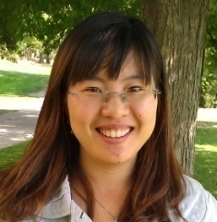
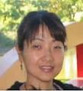
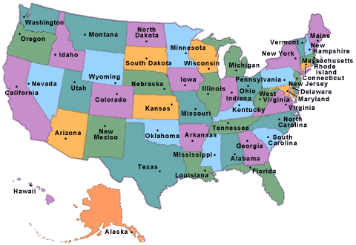
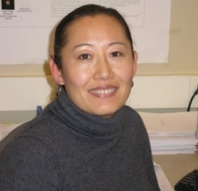
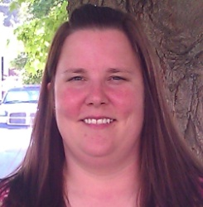
The C Team

