Slide 1
Updates in CottonGen An Integrated Web-Database for Cotton Genomics, Genetics and Breeding Data
Jing Yu¹, Sook Jung¹, Chun-Huai Cheng¹, Stephen Ficklin¹, Taein Lee¹, Ping Zheng¹, Don Jones², Richard Percy³, Dorrie Main¹
1. Washington State University, 2. Cotton Incorporated, 3. USDA-ARS
2014 PAG Computer Demo
San Diego, California

Slide 2
About CottonGen
A community database to further enable basic, translational and applied cotton research.
Built using the open-source, user-friendly, Tripal database infrastructure used by several other databases
Consolidates and expand CottonDB and CMD to include transcriptome, genome sequence and breeding data, and data mining tools

Slide 3
CottonGen’s First Year Progress
Setting Queries
Web page development
Add Tools
CottonDB data in Chado
CottonGen
Released
Develop ICGI website
Tripal instance created
CottonDB on WSU servers

Slide 4
CottonGen’s Second Year
<New Features and New Data>
China & UZ germplasm evaluations
ARS digital images
New SSR and SNP markers
Data download, submission, FAQ,
Tutorials
Trait, QTL, Publication searches
CottonGen published in Nucl. Acids Res.
ICGI election system & website
D5 genome assemblies & annotations

Slide 5
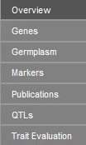
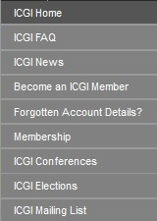
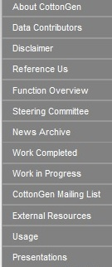
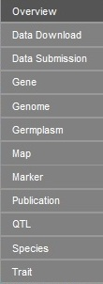
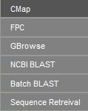
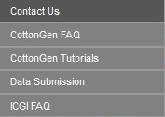
http://www.cottongen.org/

Slide 6
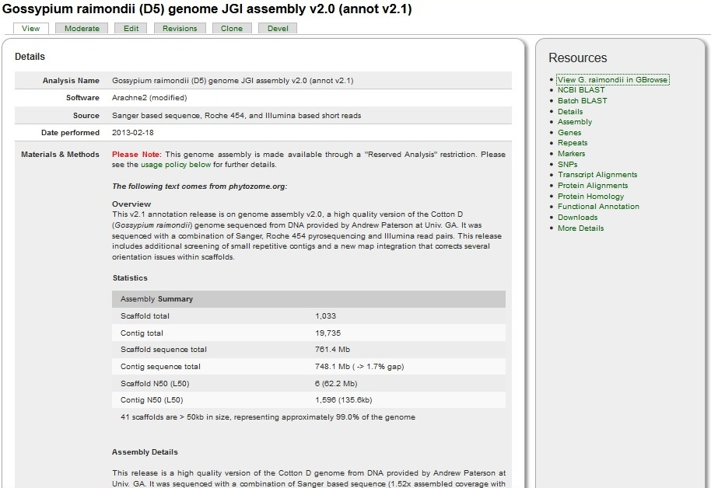
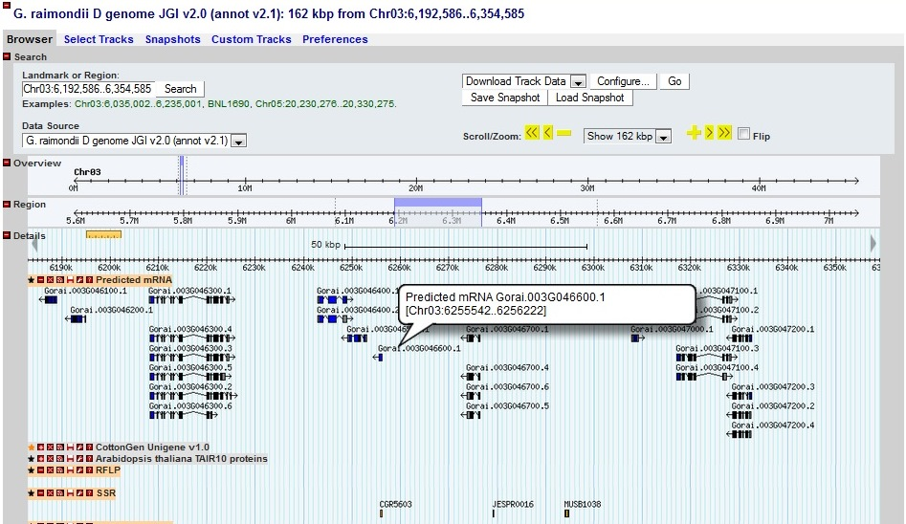
Genome Sequencing Data

Slide 7
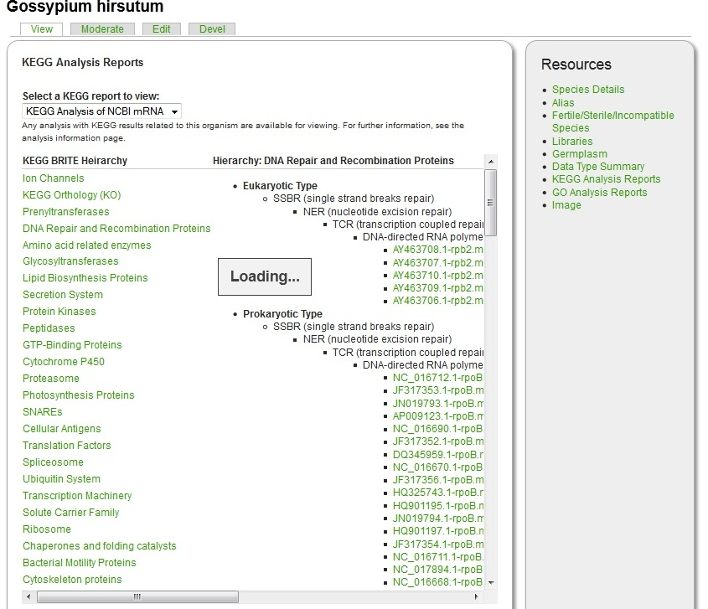
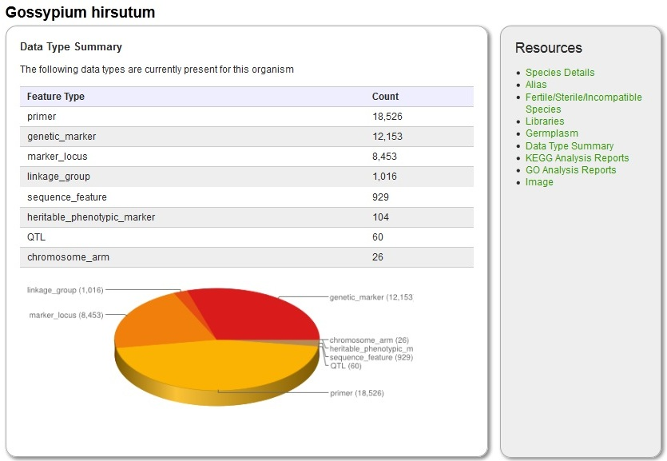
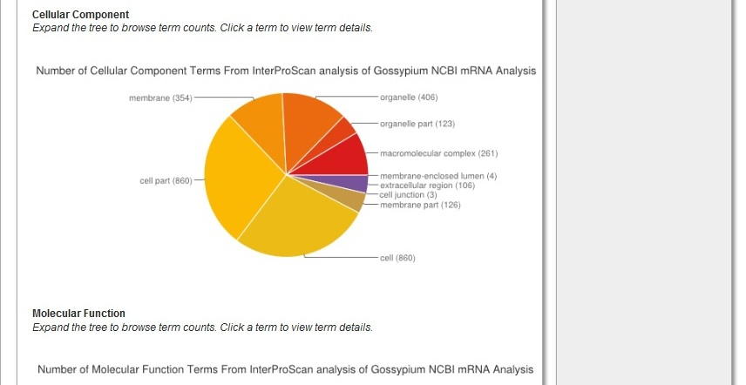
Species

Slide 8
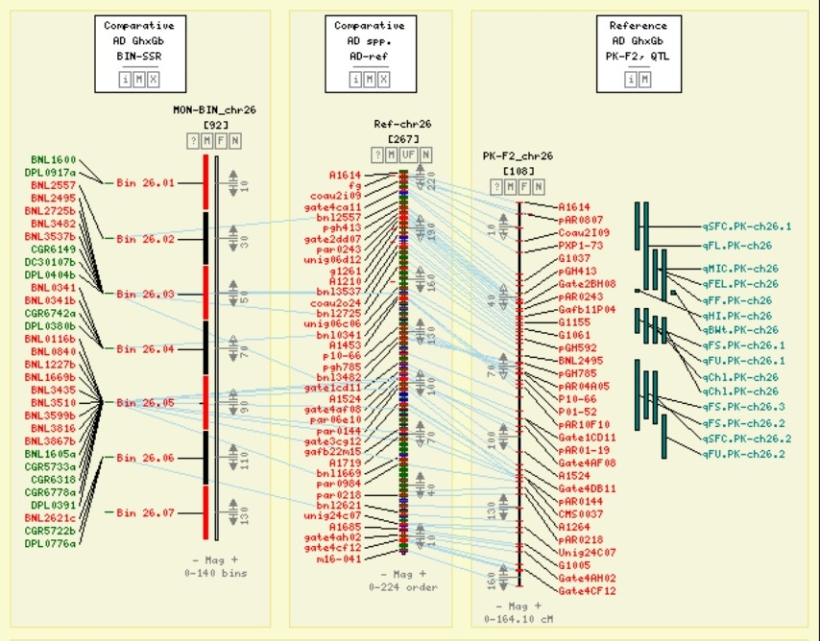
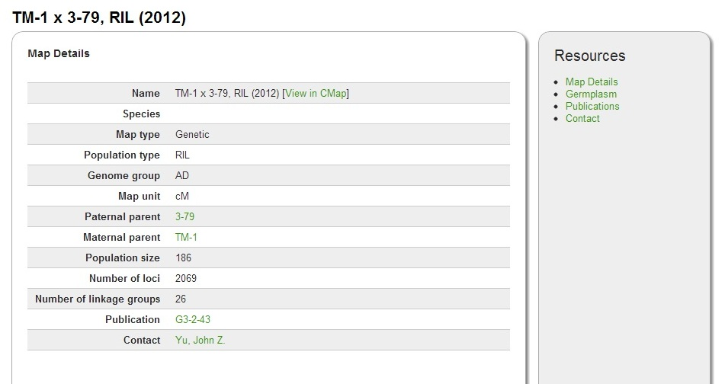
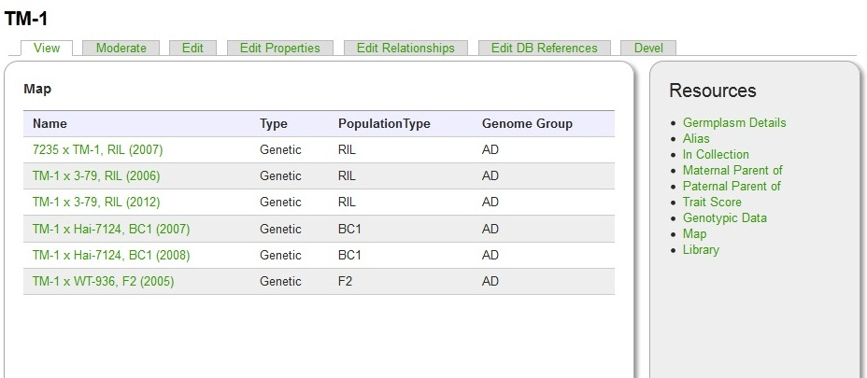

Slide 9
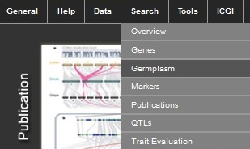
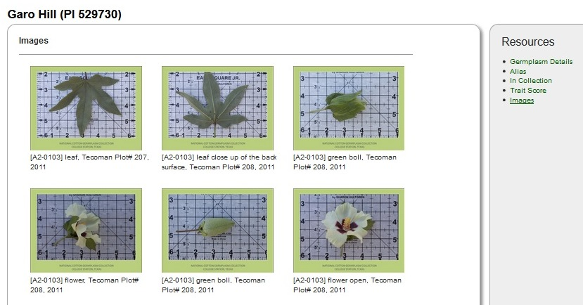
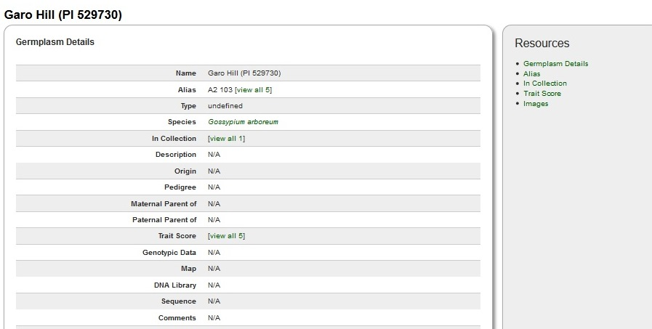
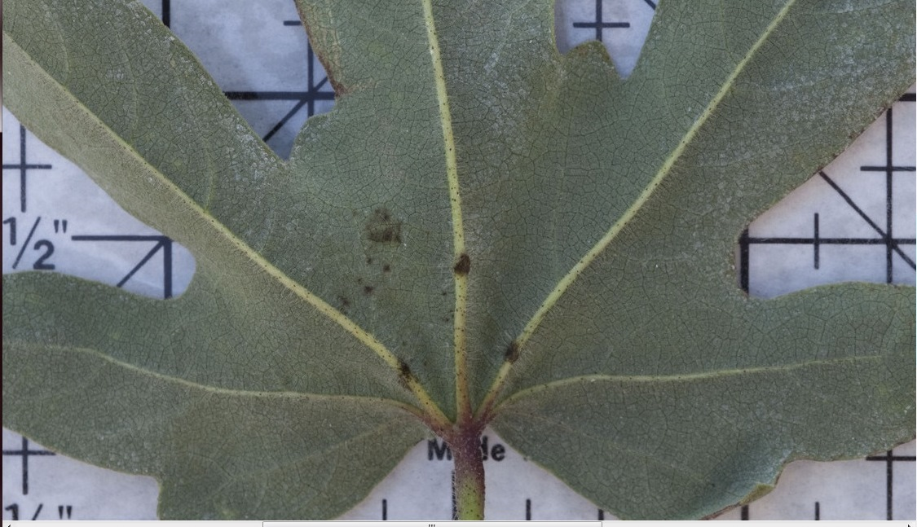
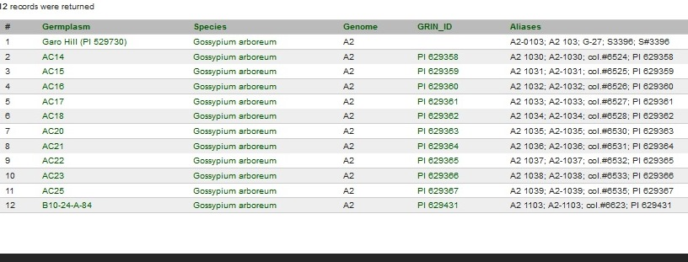
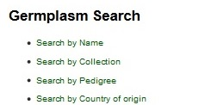
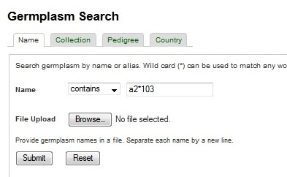
Germplasm Images
How can I find images for ‘A2 103’?

Slide 10
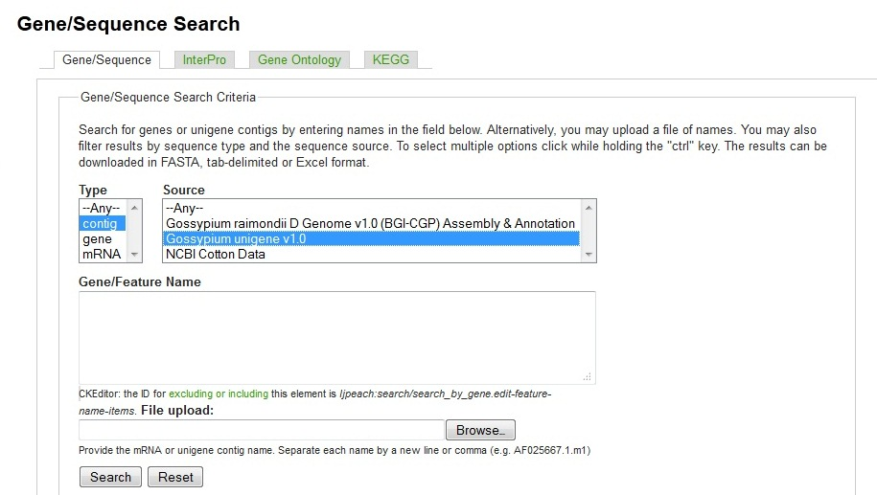
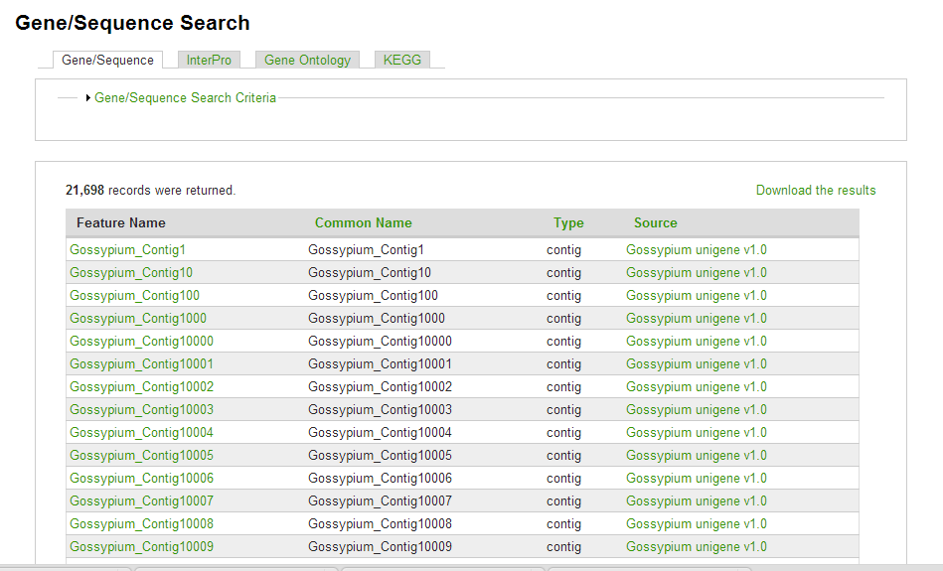
Gene/Sequence Search

Slide 11
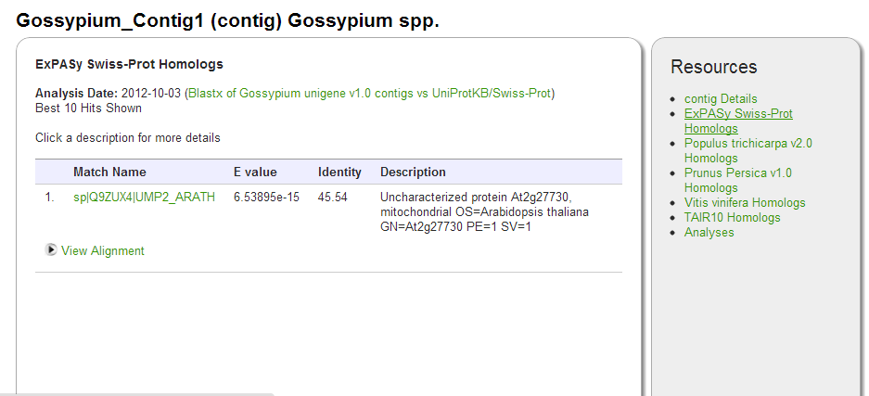
Gene/Sequence Page

Slide 12
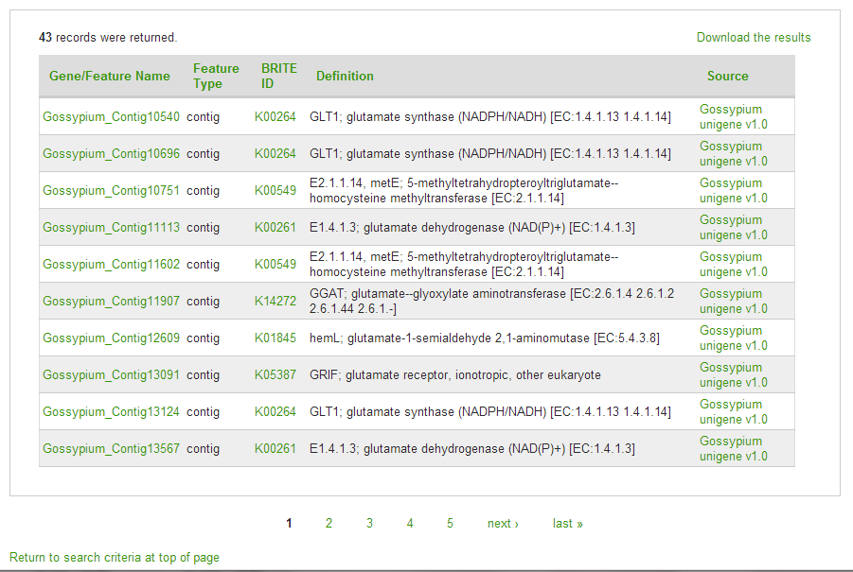
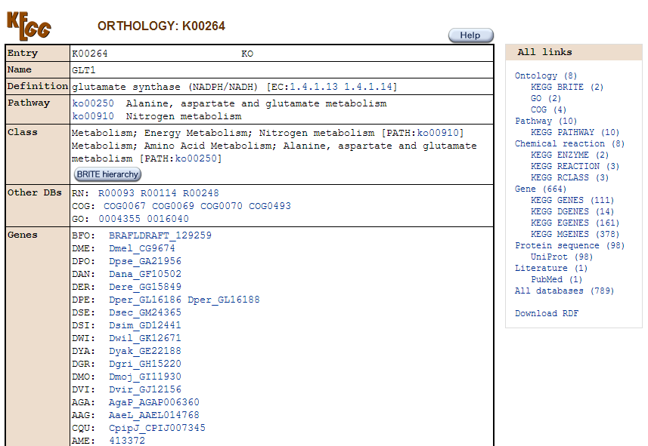
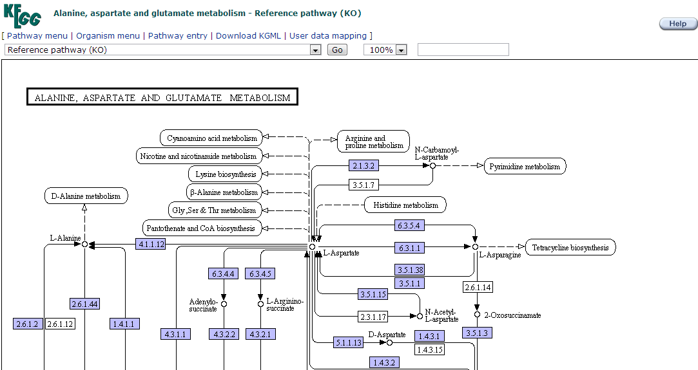
Gene/Sequence Search cont.

Slide 13
Trait Search Examples
Sample Question:
I would like to select parents with
a) 2.5% span length >= 1.2
b) Micronaire between 4-4.3
c) maximum genetic diversity

Slide 14
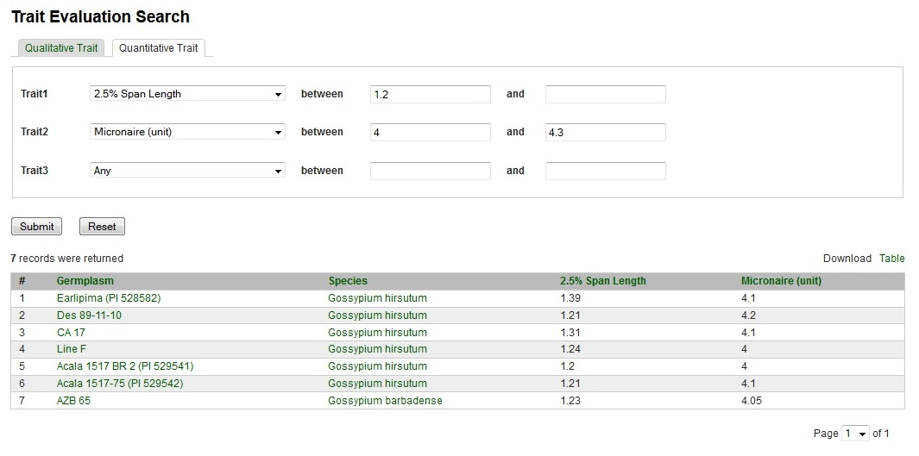
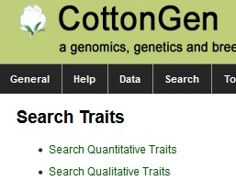
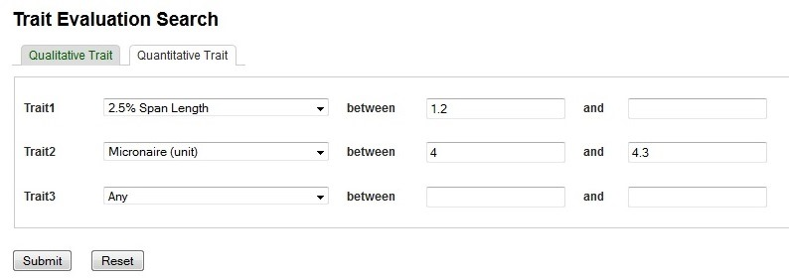
Search Steps
From Navigation Bar, click “Search”, then select “Trait Evaluation”
From new window, select “Quantitative Traits”
3. Select “2.5% Span Length”, set minimum value =1.2
4. Select “Micronaire” , set value between 4 and 4.3, then “Submit” query
Search criteria:
2.5% span length >= 1.2
Mirconaire btw 4 - 4.3

Slide 15
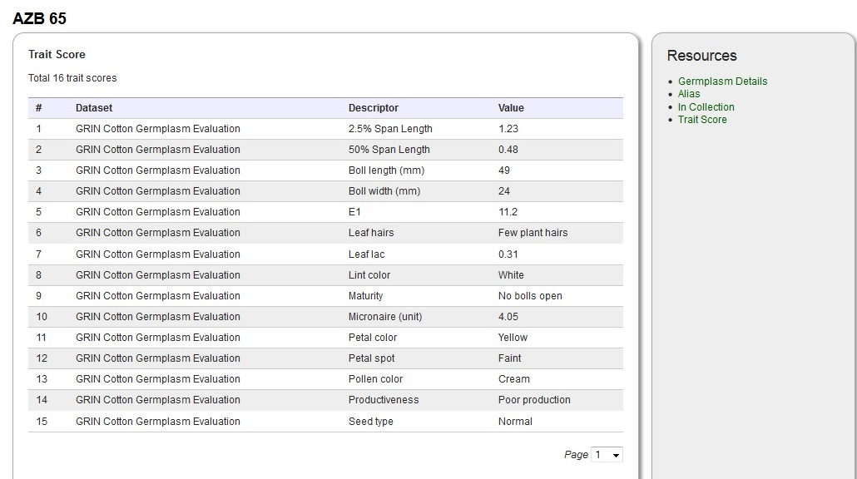
Find out more information from links

Slide 16
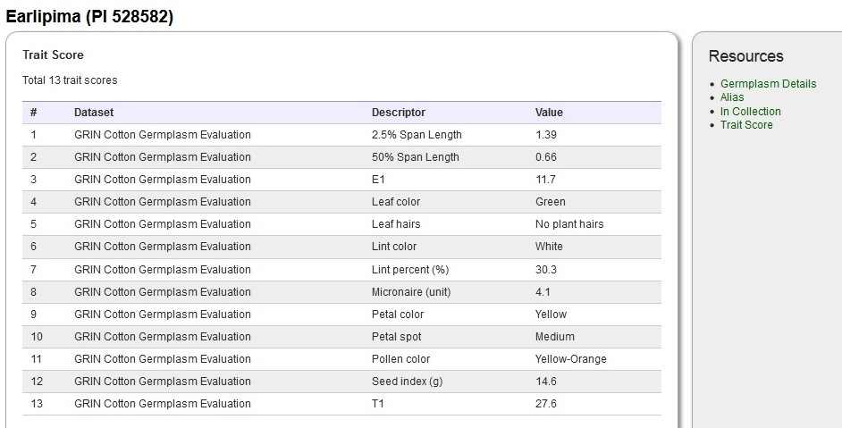
Find out more information from links

Slide 17
Germplasm Search
Sample Question:
Find all germplasm with
Deltapine 90 in their pedigree

Slide 18
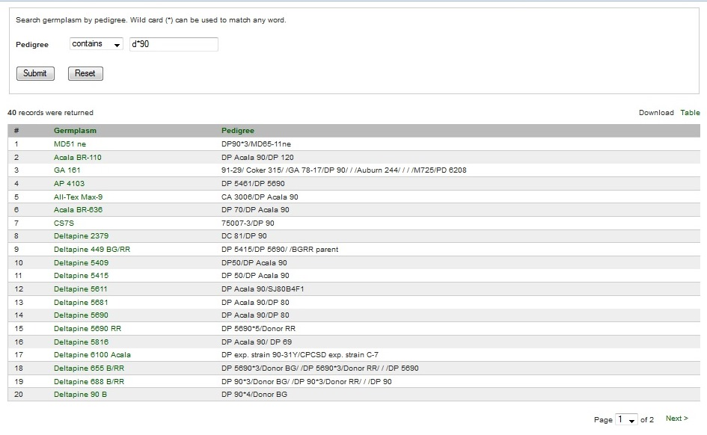
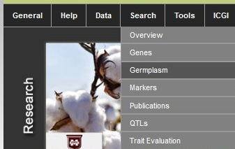
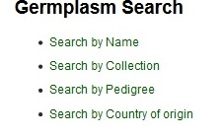
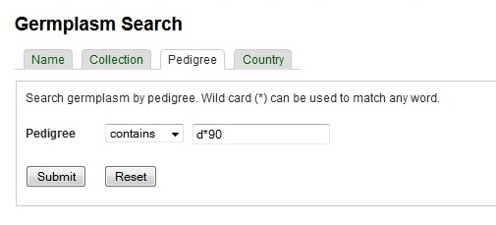
Search Steps

Slide 19
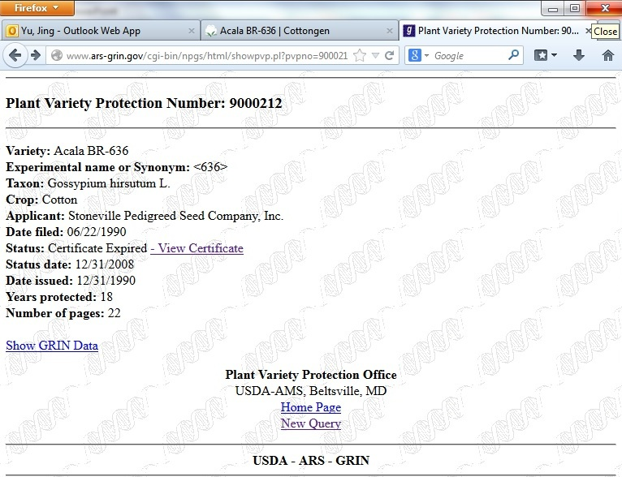
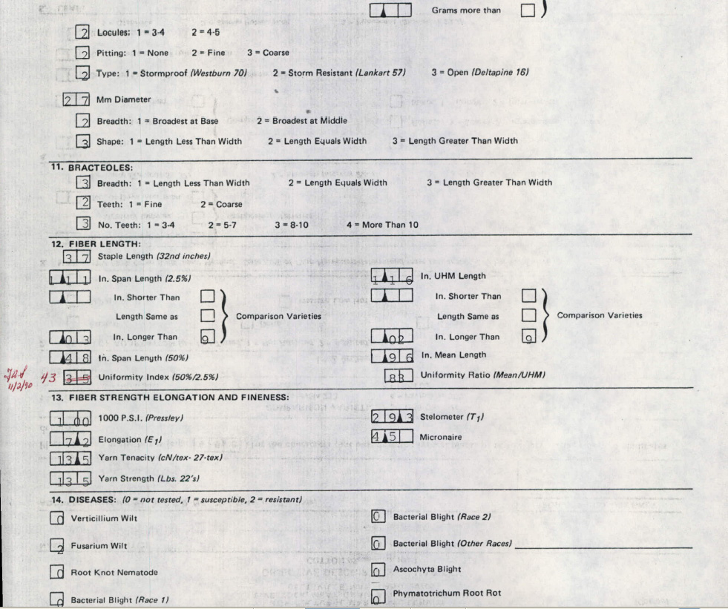
Find out more information by clicks

Slide 20
Future Work
2nd set of digital images from ARS College Station, TX
New germplasm evaluation data from ARS College Station, TX
Implement more tools for genome annotation and breeder communities.
Implement GBrowse-Syn, a GBrowse-based synteny browser.

Slide 21
Acknowledgements
Industry Funding
Cotton Incorporated, Bayer CropScience, Dow/Phytogen, Monsanto, Association of Agricultural Experiment Station Directors
Government Funding
USDA ARS
USDA NIFA AFRI and SCRI programs (funding Mainlab Tripal and GenSAS Development)
University Support
Washington State University, Texas A&M, Clemson University
Community of Cotton Researchers

Slide 22
THANKS FOR YOUR ATTENTION!
Questions?

