Slide 1
CottonGen for Breeders
Dorrie Main, Jing Yu, Sook Jung, Chun-Huai Cheng,
Stephen Ficklin, Ping Zheng, Taein Lee,
Richard Percy and Don Jones
2013 Cotton Breeders’ Tour
September 15, 2013
Lubbock, Texas

Slide 2
Outline
Introduction
  What is CottonGen
  Data Integration
Demo of CottonGen
  Database Overview
  Current Data, Tools, and Searches for Breeders
Future Work
  Examples from the Genome Database for Rosaceae
  Toward a complete information management system for breeding

Slide 3
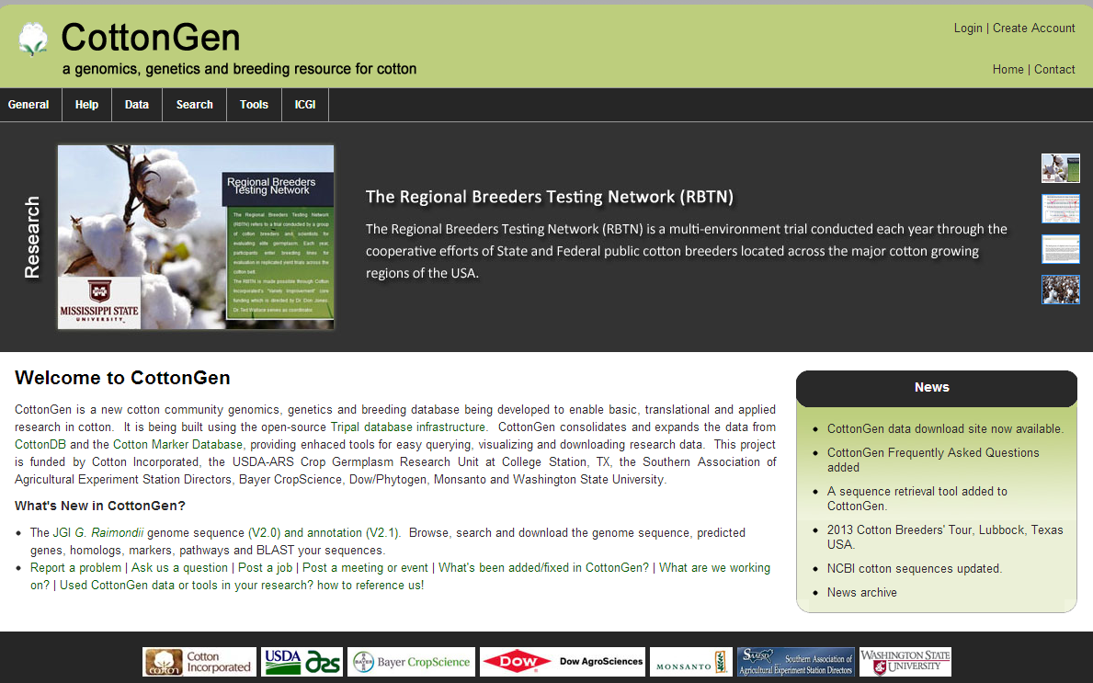
www.cottongen.org

Slide 4
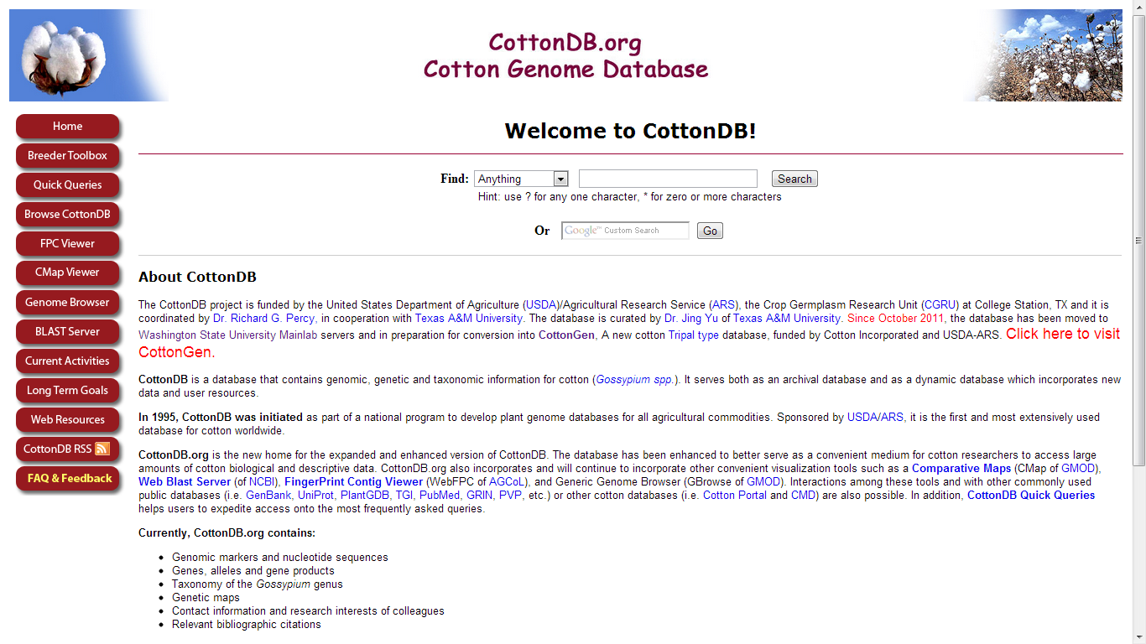

Slide 5
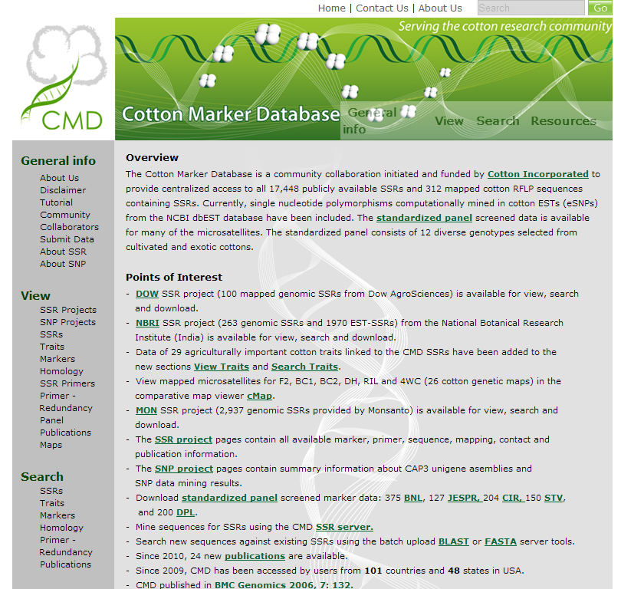

Slide 6
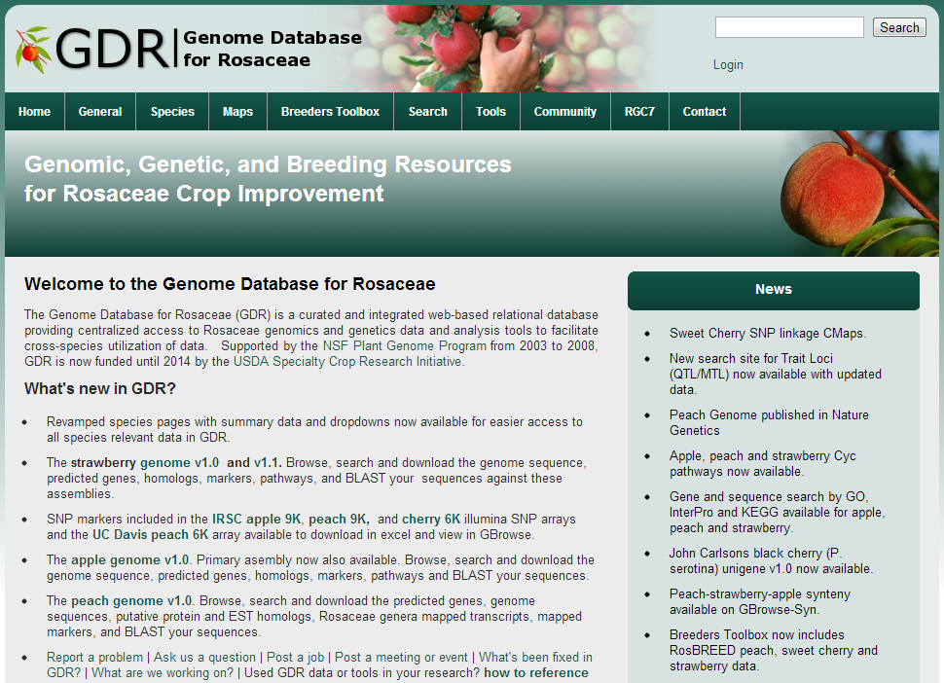
www.rosaceae.org
www.rosaceae.org

Slide 7
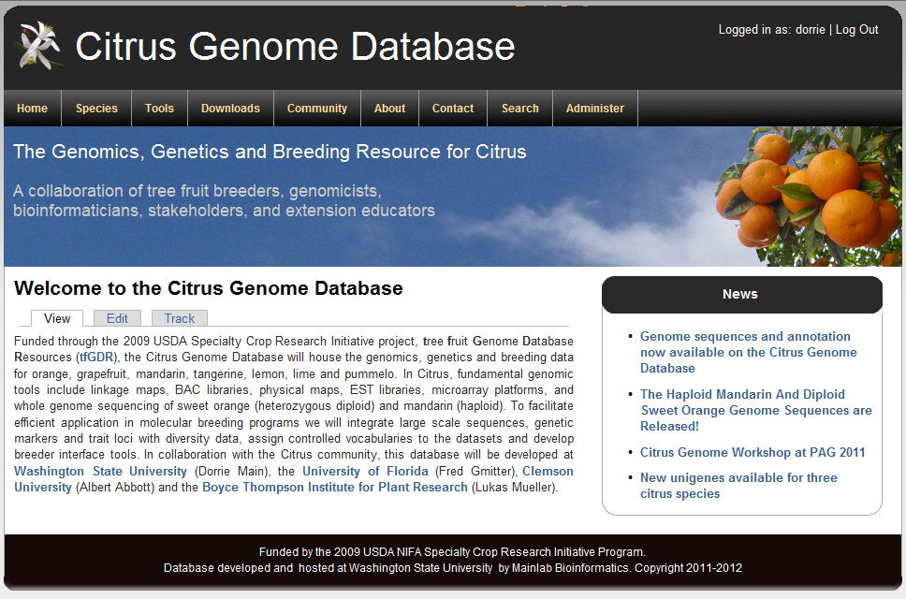
www.citrusgenomedb.org

Slide 8
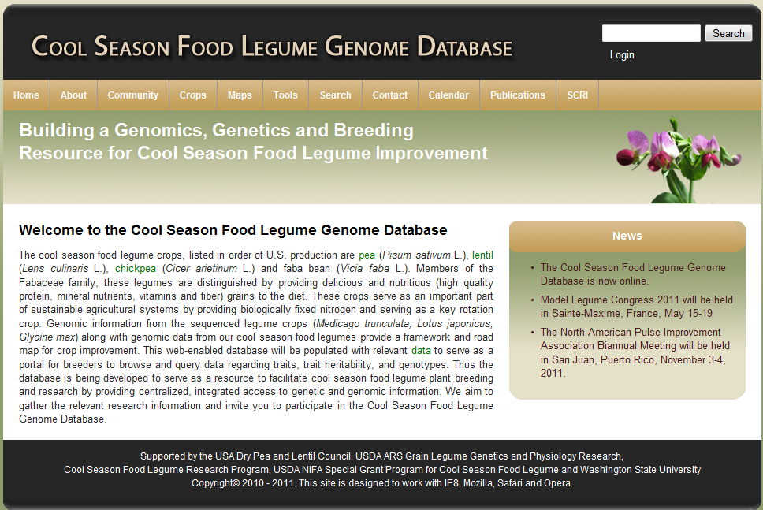
www.coolseasonfoodlegume.org

Slide 9
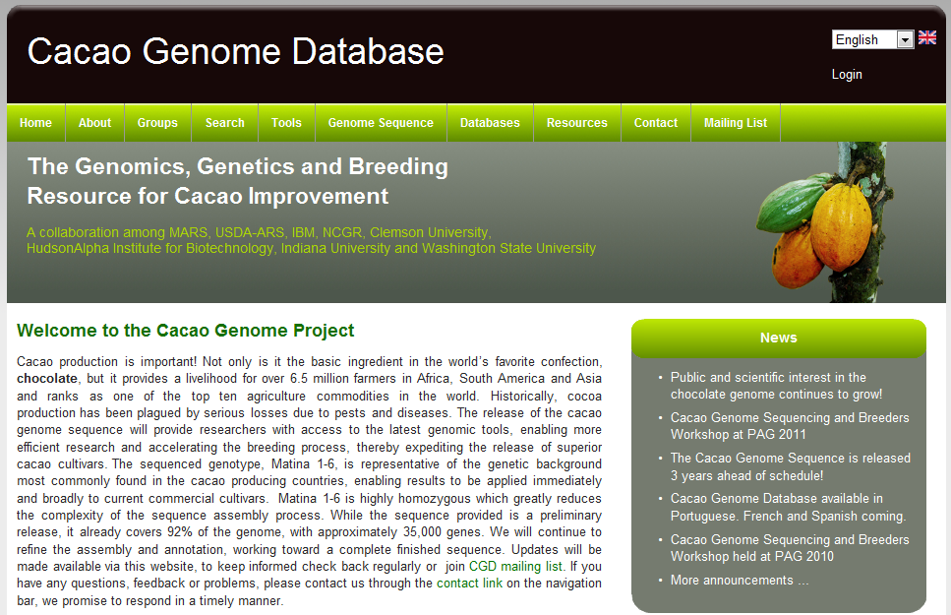
www.cacaogenomedb.org

Slide 10
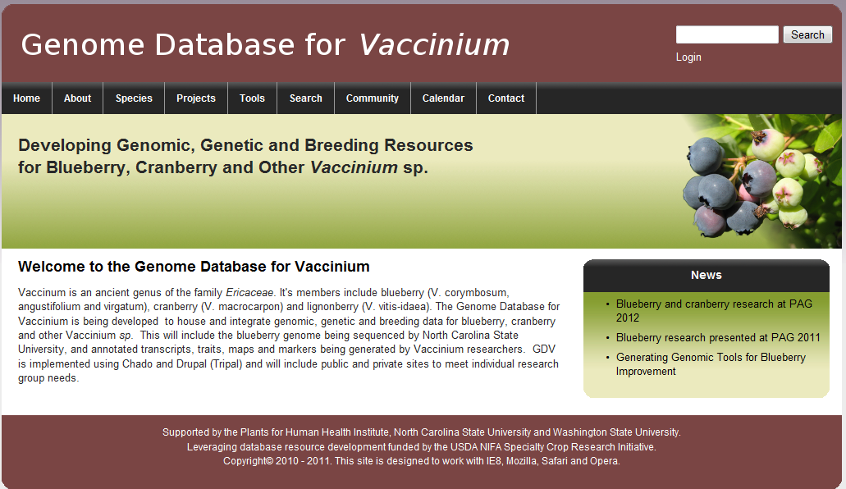
www.vaccinium.org

Slide 11
What is CottonGen?
A new cotton community database enabling
basic, translational and applied cotton research.
Consolidates and expands CottonDB and CMD to include transcriptome, genome sequence and breeding data.
Built using the new open-source, user-friendly, Tripal database infrastructure used by several other databases.

Slide 12
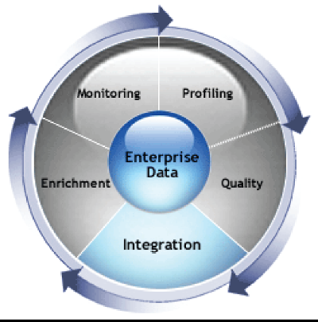
Integrated Data Facilitates Discovery
Genomics
Genetics
Basic Science
Structure and evolution of genome, gene function, genetic variability, mechanism underlying traits
Translational Science
QTL /marker discovery,
genetic mapping,
Breeding values
Integrated Data & Tools
Diversity
Germplasm
Breeding
Applied Science
Management of breeding data
Selection performance comparisons
Utilization of DNA information in breeding decisions
Notes:
12

Slide 13
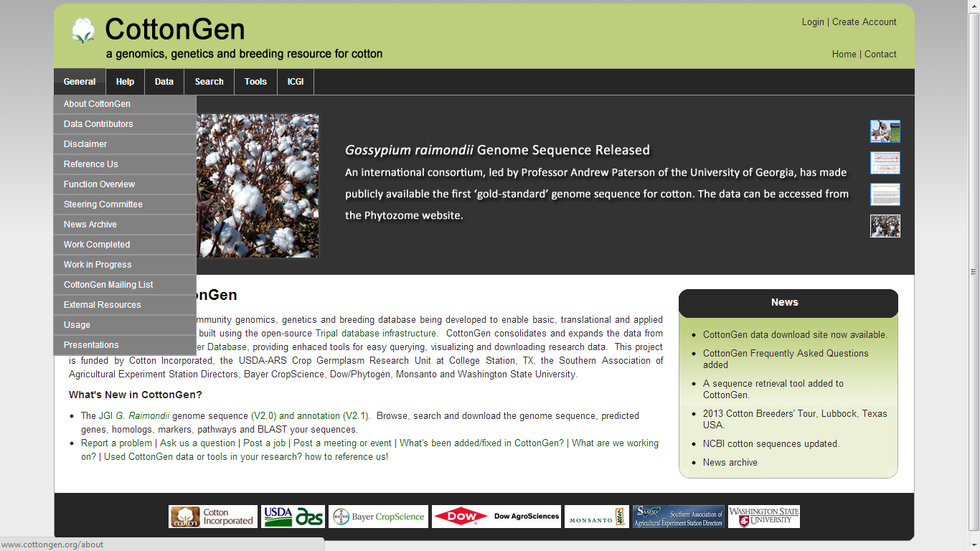
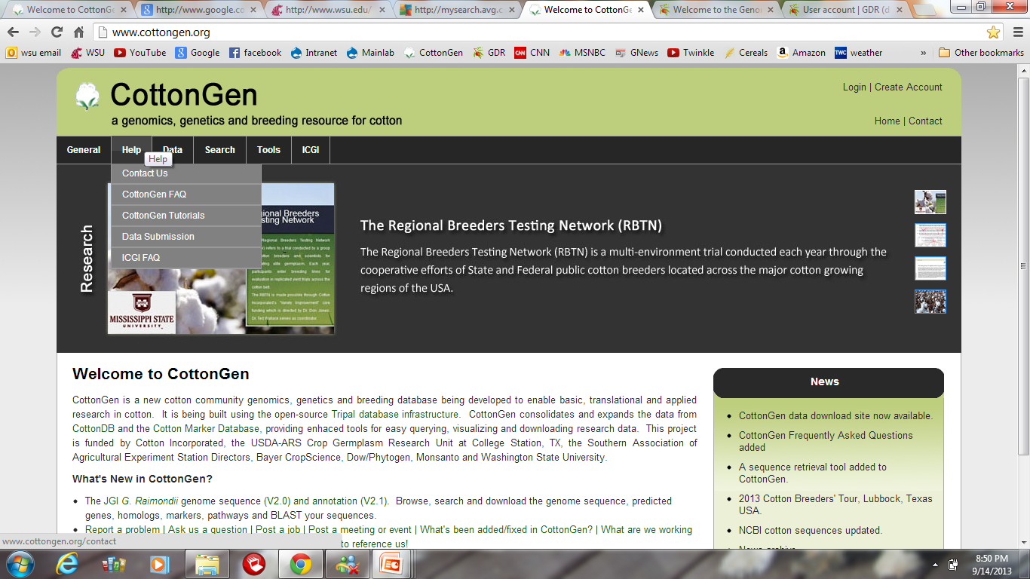
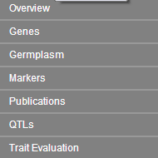
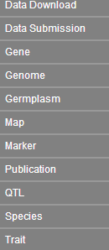
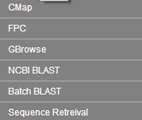
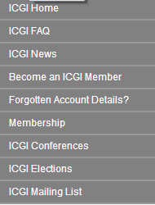
CottonGen Navigation Bar

Slide 14
Current Data
  Markers - 23,935 genetic markers
  Maps - 49 maps with over 34,559 loci
  QTLs – 988 QTLs for 25 traits
  Polymorphism - 2,264 polymorphic SSRs
  Germplasm – 14,959 germplasm records (14 collections)
  Traits - 73,296 trait scores of 6,871 GRIN entries
  Sequences - 610,246 sequence records
  References - Nearly 11,000 references
  CottonGen Gossypium Unigene v1.0
  G. raimondii (D5) genome – BGI & JGI versions

Slide 15
Tools
  CMap – 49 maps
  GBrowse – G. raimondii (BGI & JGI versions)
  FPC – TM-1 contigs from USDA-ARS/TAMU
  BLAST Servers - UniProt and nr Proteins, BGI D-genome sequences, dbEST, unigenes, and CottonGen markers (20 datasets)
  Sequence Retrieval – retrieve sequences in FASTA format

Slide 16
CottonGen Search
Simple Example 1:
  Identify germplasm with
  2.5% span length >= 1

Slide 17
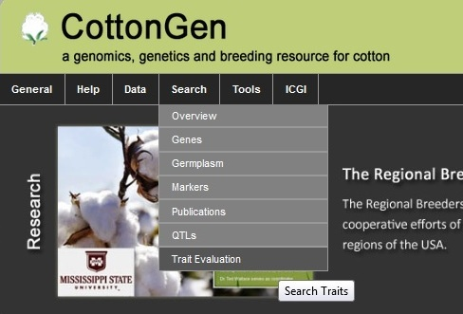
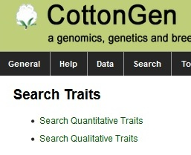
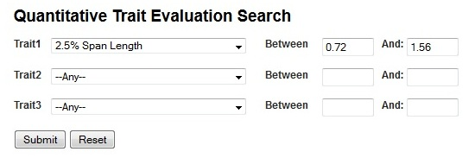
Example 1 Search Steps
From Navigation Bar, click “Search”, then select “Trait Evaluation”
From new window, select “Quantitative Traits”
3. Select “2.5% Span Length”- the
minimum & maximum value will
show up automatically
4. Change the minimum value =1,
then “Submit” query
  Search criteria:
  2.5% span length >= 1

Slide 18
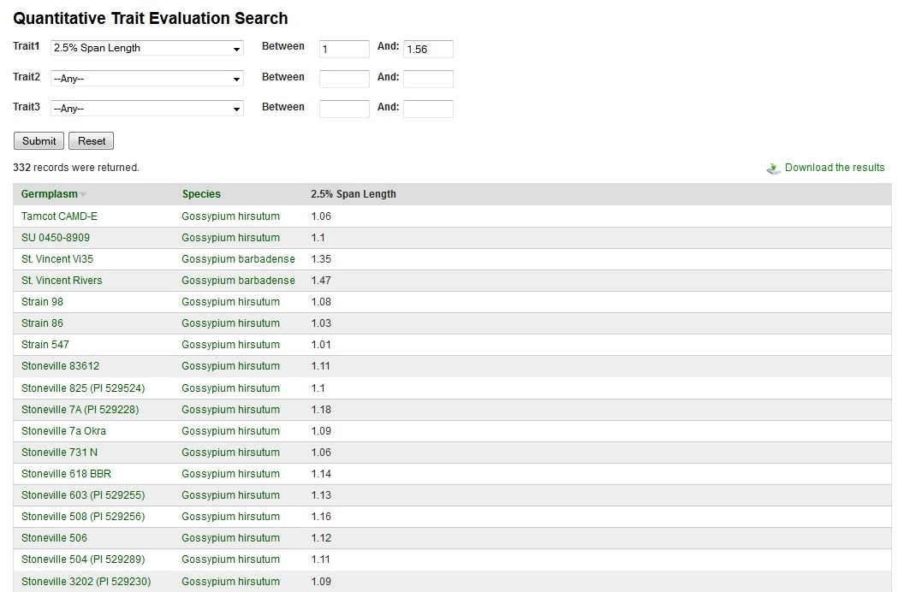
Example 1 Search Result

Slide 19
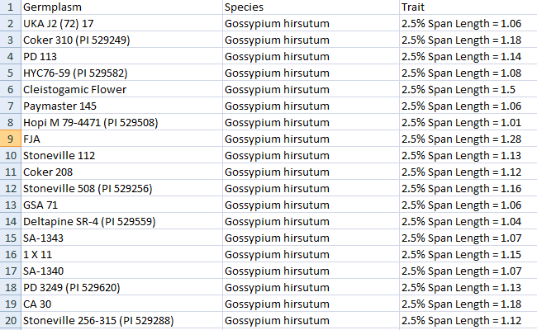
Download Results in Excel

Slide 20
Example 1 Search Result
Select germplasm details

Slide 21
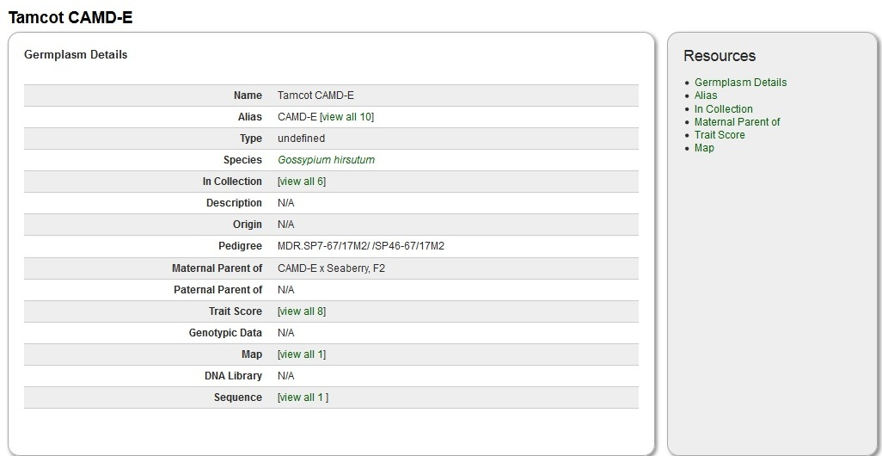
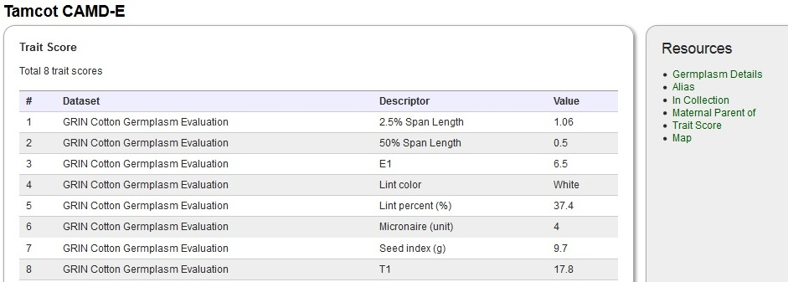
More information from links

Slide 22
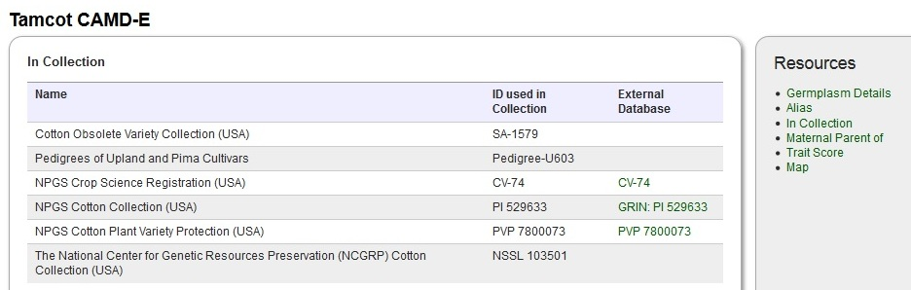
More information from links

Slide 23
CottonGen Search
Example 2:
  Find all germplasm with
  Deltapine 90 in their pedigree

Slide 24
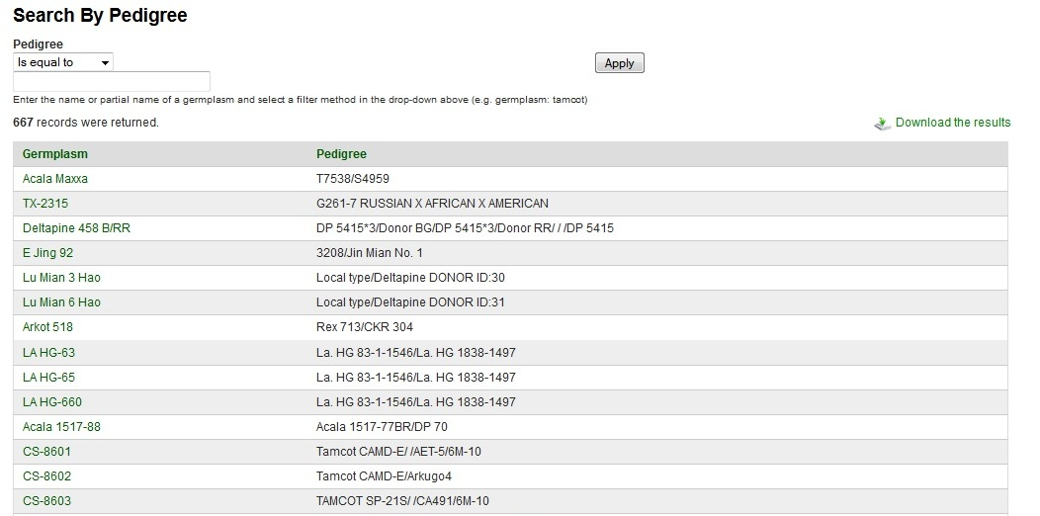
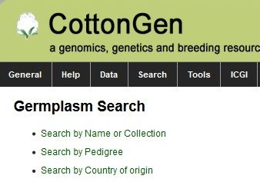
Example 2 Search Steps
Default result is the table of all germplasm which has pedigree

Slide 25
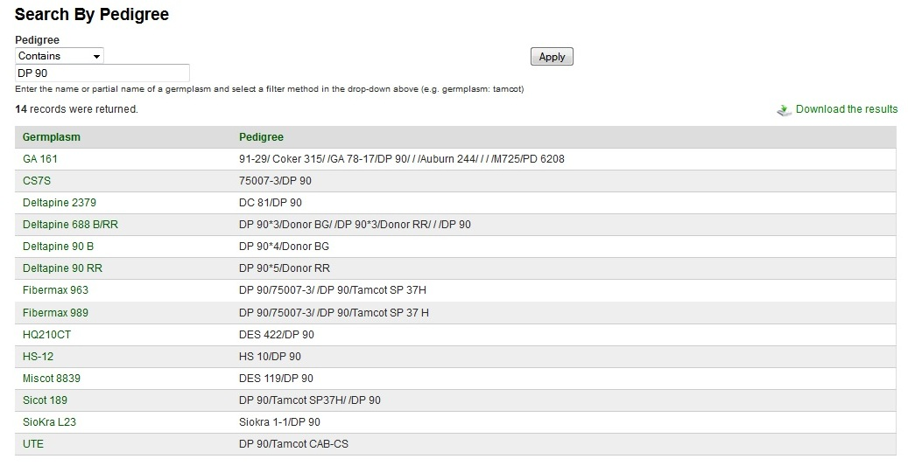
Example 2 Search Result -1
Can we use wild card such as “DP*90”? There are many others not using “DP 90” but “DP90” or “DP Acala 90”, etc.

Slide 26
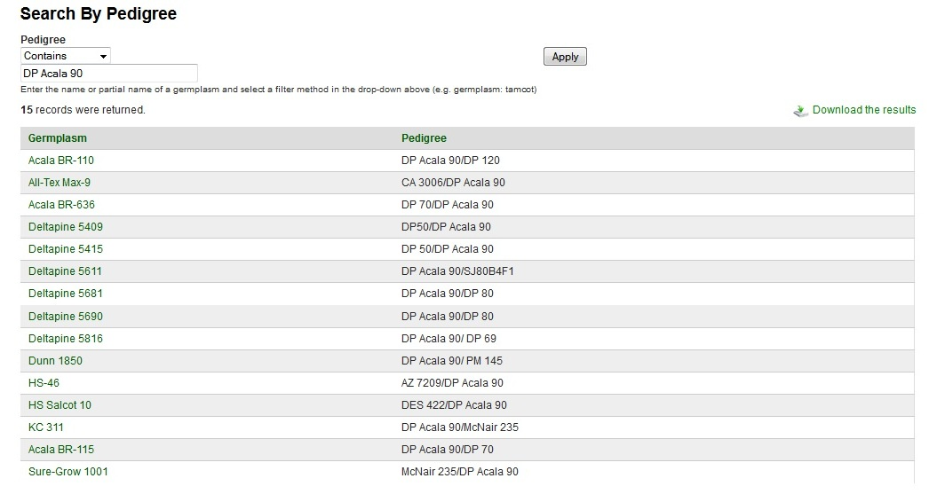
More information from links

Slide 27
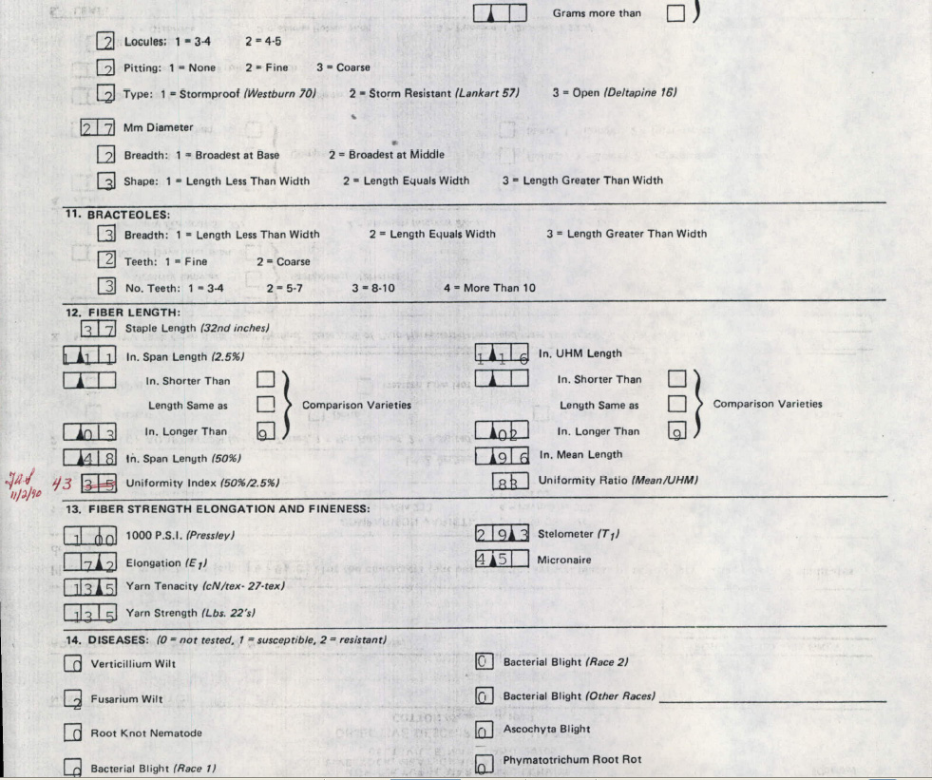
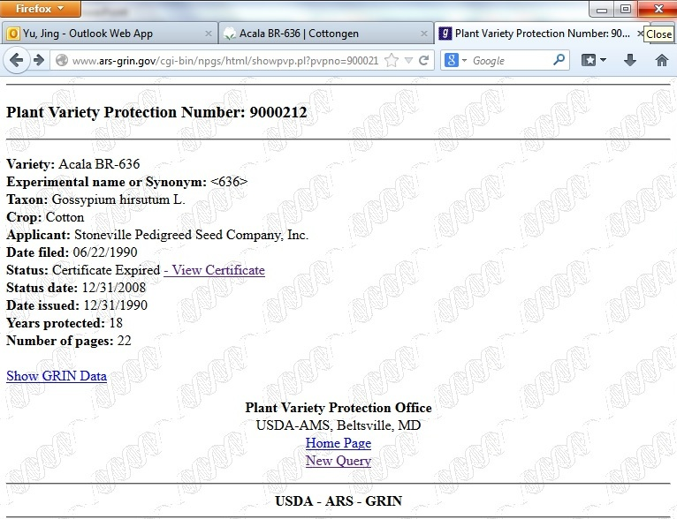
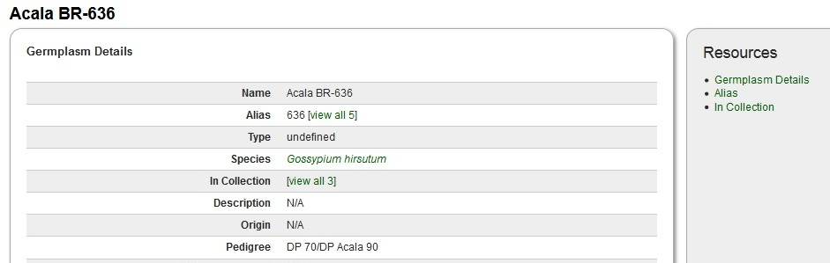
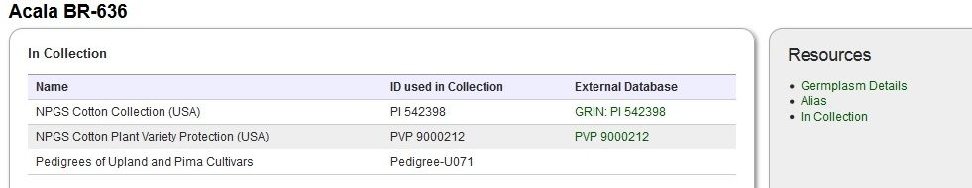
Find out more information by clicks

Slide 28
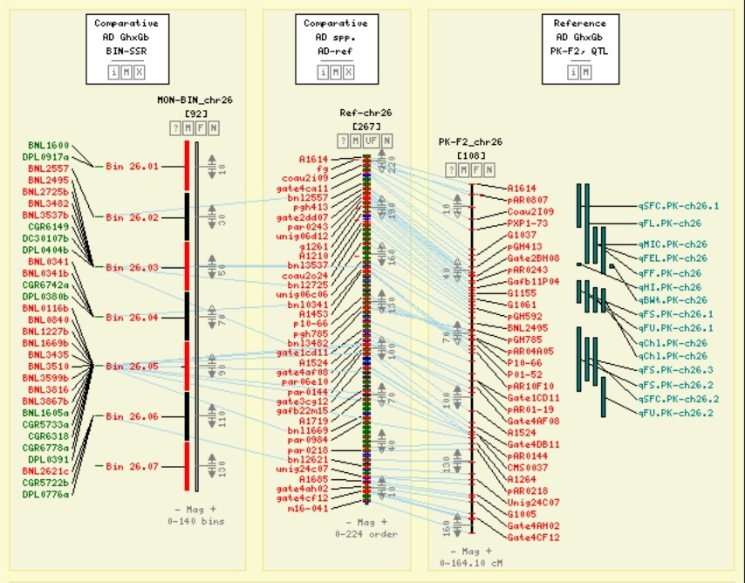
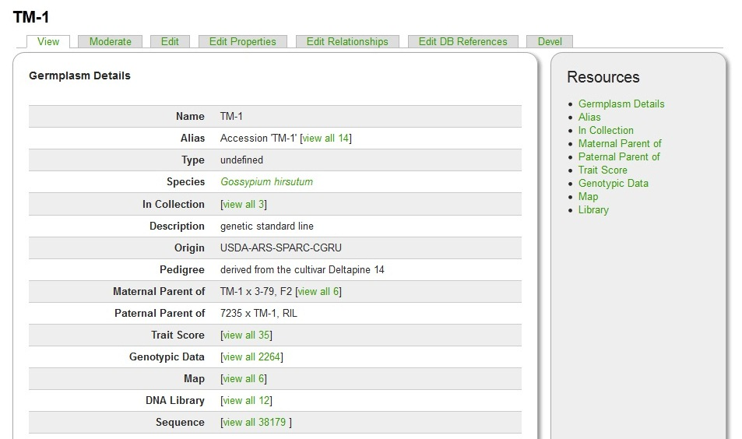
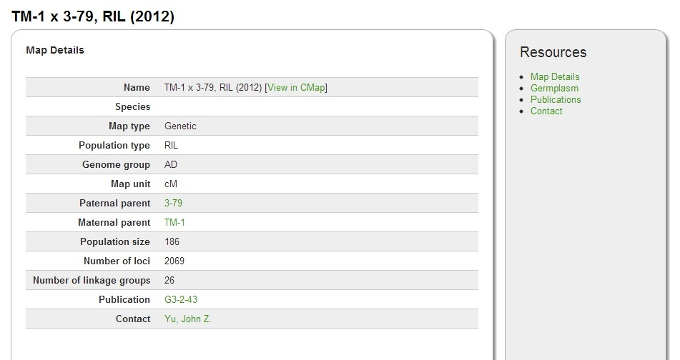
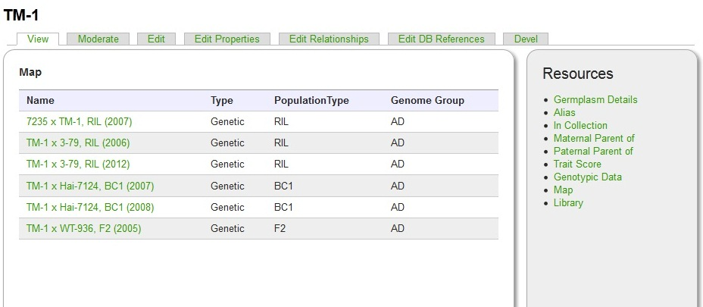

Slide 29
Work in Progress/Future Work
Curation of Uzbekistan (800) and Chinese (3000) germplasm collection data (identity and descriptors).
Adding data (images, evaluation data) from the USDA-ARS Research Project: “Genotypic and Phenotypic Analysis and Digital Imaging of Accessions in the US National Cotton Germplasm Collection”
Develop a comprehensive breeders toolbox to assist in breeding decisions

Slide 30
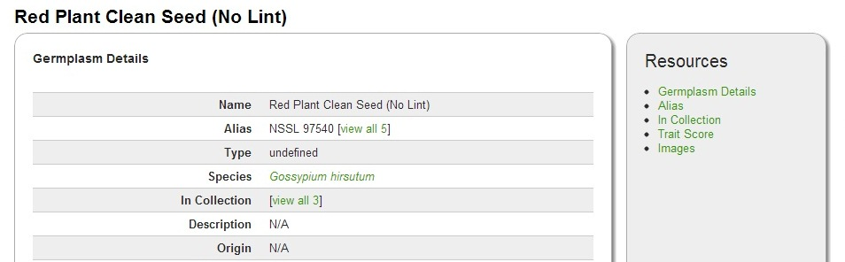
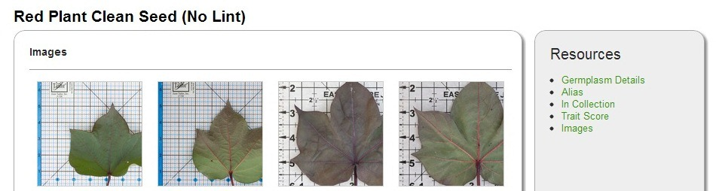
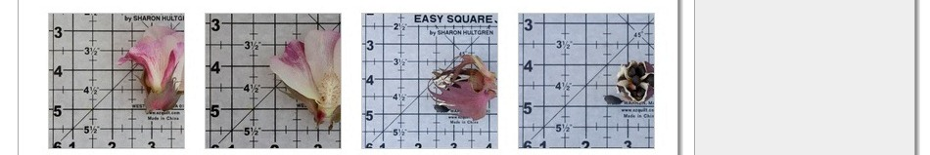
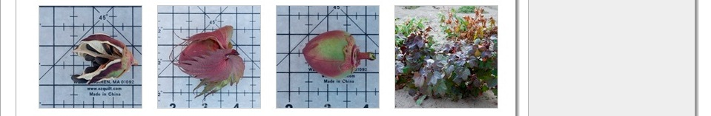
Future work: Sample Image Data

Slide 31
Rosaceae Breeding Tools
Genome Database for Rosaceae, established in 2003
Breeding Toolbox initiated in 2008 with support from Industry for the WA Apple and Sweet Cherry Breeding Programs
Further developed with support from the USDA SCRI program projects RosBREED and tfGDR (2009-2013)

Slide 32
Database and Tools for Breeding Data
Data
  Private data from WA apple breeding program
  Private and public breeding data from RosBreed project (apple, strawberry, peach, sweet cherry, tart cherry)
Interface
  Data Management (Browse, Search and Download)
  Data Conversion (Generate Input files for Pedimap)
  Decision Support
    Cross Assist
    Trait Locus Warehouse
    Marker Converter
Notes:
32

Slide 33
Data Management
Search/download phenotype Data
Search/download genotype Data
Creating website for each breeding program or group

Slide 34
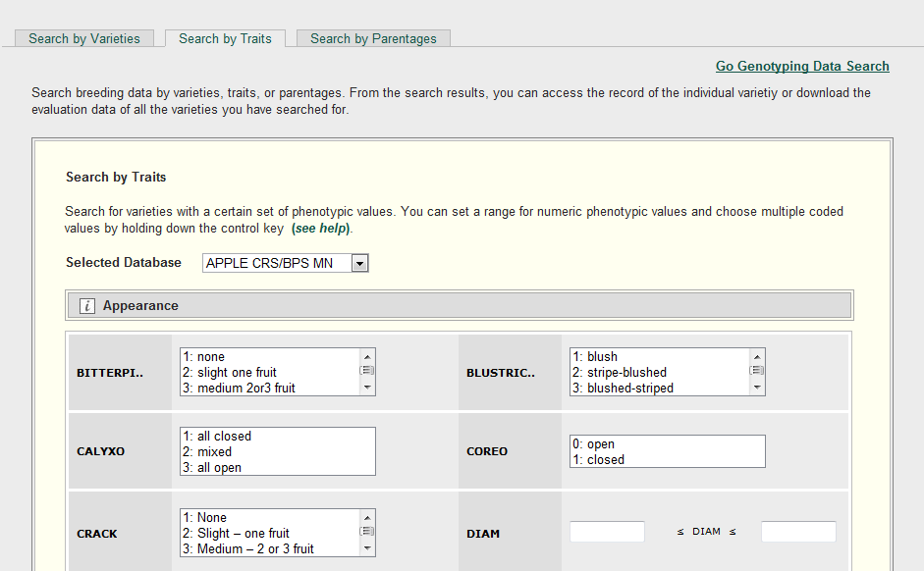
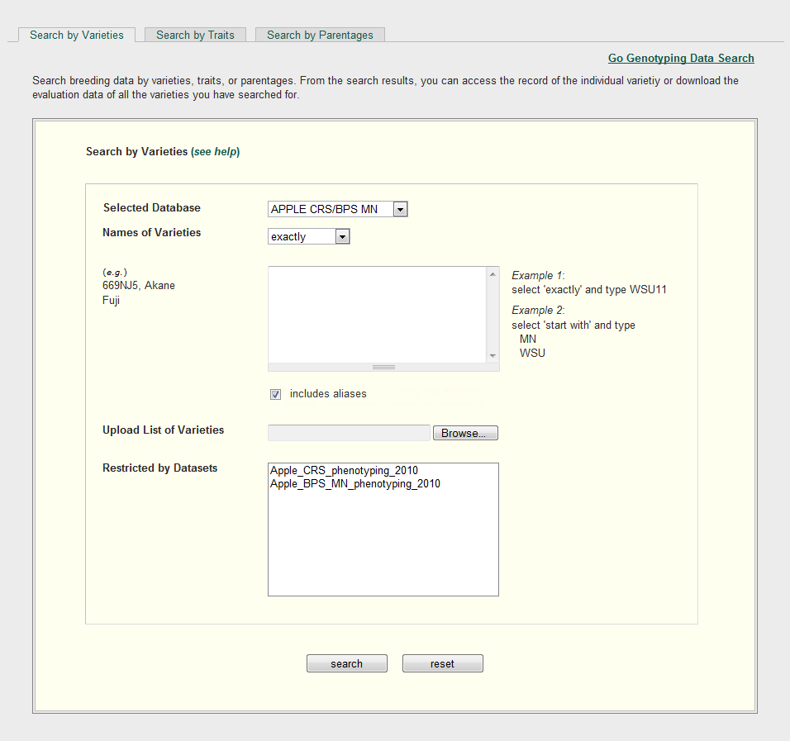
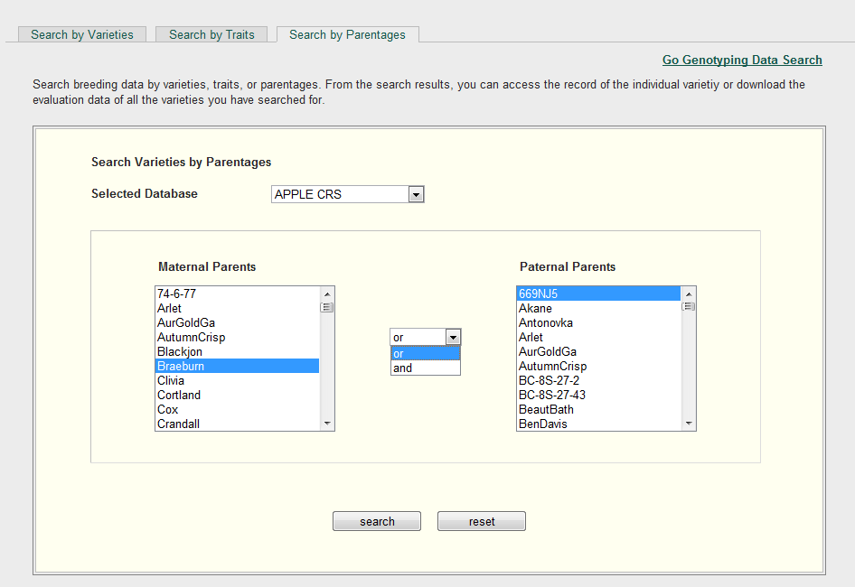
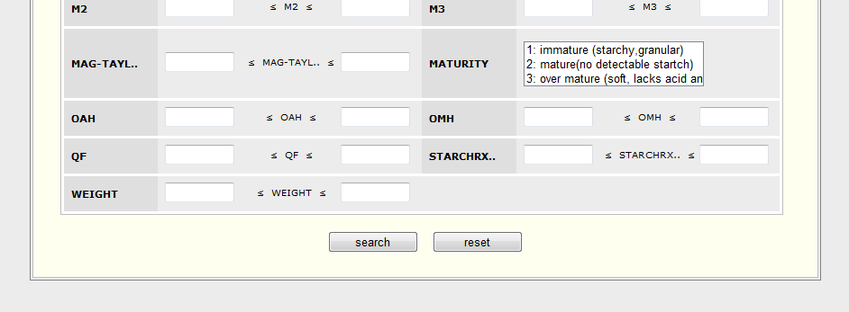
Phenotypic Data Search
Notes:
34

Slide 35
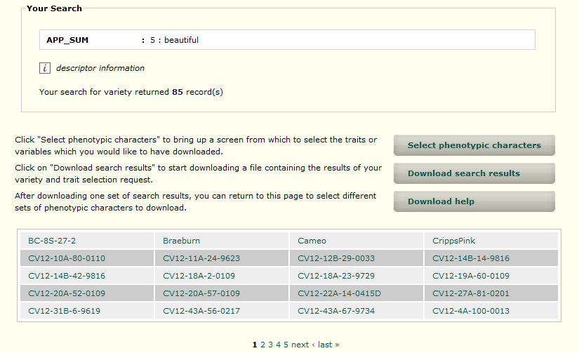
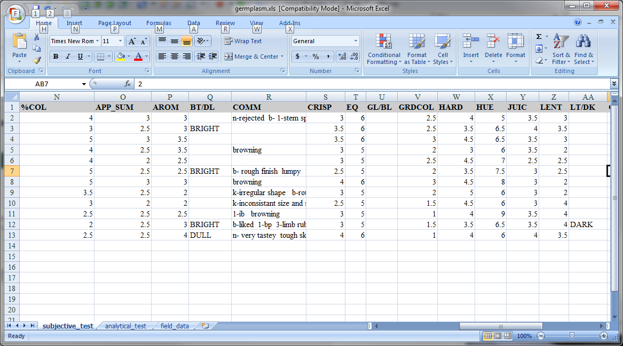
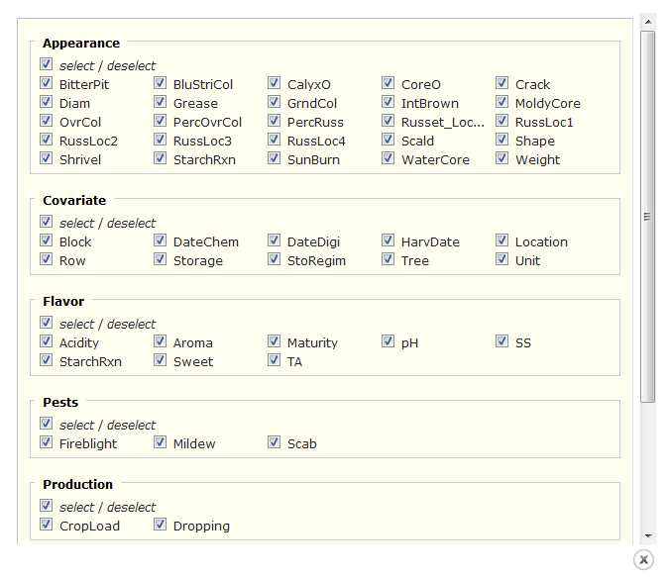
Notes:
35

Slide 36
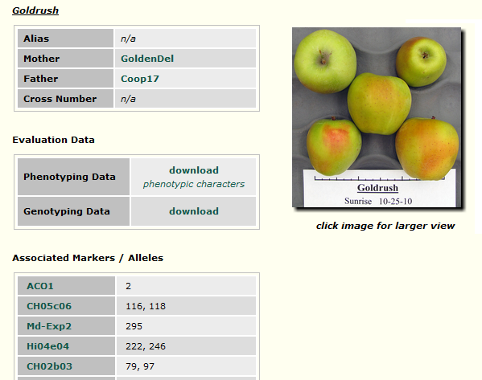
Variety Detail Page

Slide 37
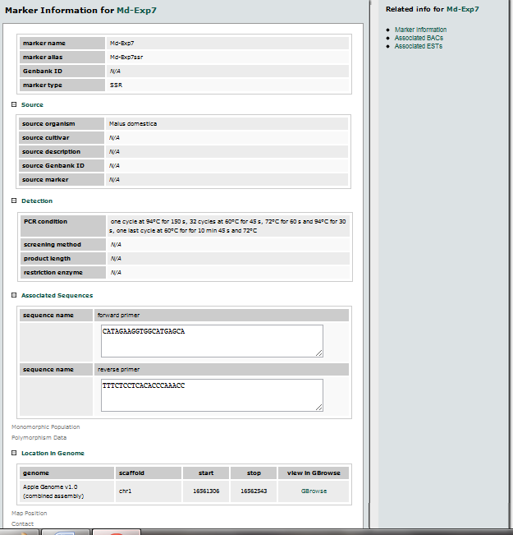
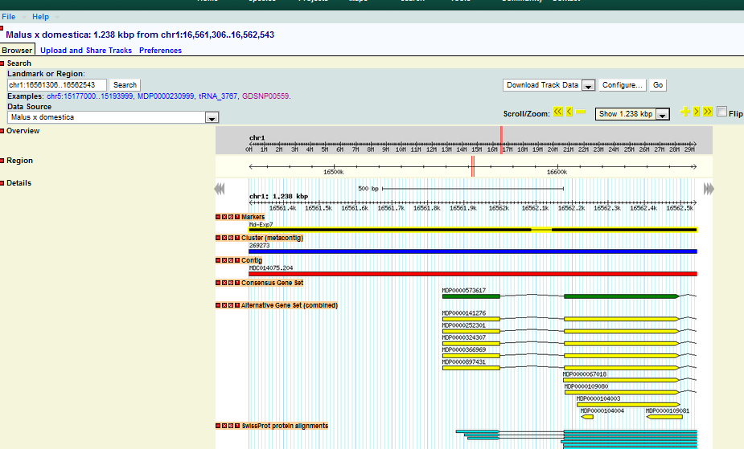
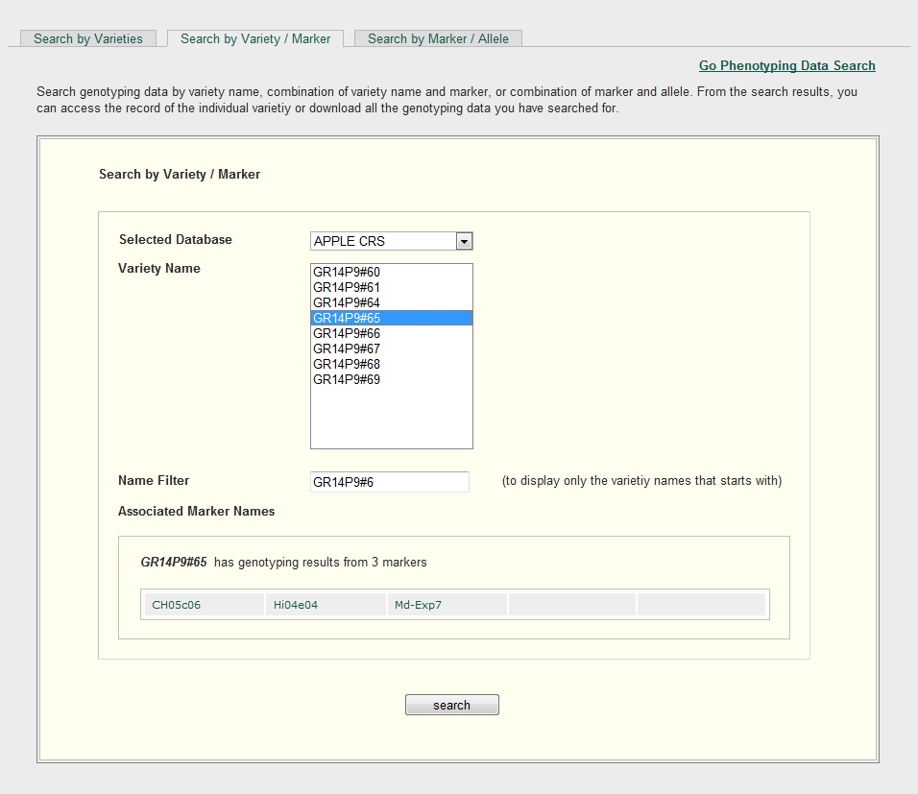


Genotypic Data Search

Slide 38


Homepage of a private breeding program

Slide 39
Data Conversion
Generate Input files for Pedimap, a tool for exploring and visualizing the flow of phenotypes and alleles through pedigrees

Slide 40

Choose Pedigree
Notes:
40

Slide 41

Choose Trait and Modify Values
Notes:
41

Slide 42


Generate a File and View in Pedimap

Slide 43
Decision Support
Cross Assist
Trait Locus Warehouse
Marker Converter

Slide 44
What is Cross Assist?
A web interface to generate a list of parents and the number of seedlings to get the progeny with desired traits
Methods
  “Phenotype” (uses only phenotypic information of individuals in the dataset),
  “+Pedigree” (uses both phenotypic and pedigree information)
  “+Ped+DNA” (uses phenotypic, pedigree information and information provided by DNA-based functional genotypes).

Slide 45

Step 1: Select Method

Slide 46


Step 2: Select target number and trait thresholds

Slide 47


Step 3: Filter results by data completeness, required number of seedlings, and parentage

Slide 48



Trait Locus Warehouse

Slide 49
Marker Converter
Design new markers by exploring the genome around QTLs
QTLs that are anchored to the reference genome can be viewed in GBrowse by clicking Genomic Location.
Click neighboring or co-localized markers to view details of markers and view in GBrowse.
In GBrowse, retrieve sequences around features (genes and markers) of interest using the sequence retrieval tool
GDR-Primer3 tool can be used to design primers with the retrieved sequences.

Slide 50

Search For QTL in Marker Converter

Slide 51

OR
Forward QTLs from Trait Locus Warehouse

Slide 52

Results
Go to GBrowse for genome-anchored QTLs

Slide 53


OR go to QTL/Marker pages

Slide 54

GBrowse
View associated resequencing reads, genes, SNPs and other markers.

Slide 55

View alignments between reads and the reference genome
OR follow directions in ‘RosBREED Resequencing Alignments’ tab
to view the alignments on IGV (Integrative Genomics Viewer)
(http://www.rosaceae.org/species/prunus_persica/genome_v1.0)

Slide 56

Retrieve sequences from selected feature

Slide 57


Sequence Retrieval Tool

Slide 58

Design New Primers in GDR-Primer3

Slide 59
Future Rosaceae Breeders Toolbox Development
Data
  RosBreed QTLs and their genome positions
  More breeding data and DNA based functional genotypes
  More re-sequencing data
Functionality
  Data management: online data submission and editing
  Viewing data on screen and generating report pages
  Decision support tools
    Cross Assist:
      to accommodate more complex situations (selfing, cross compatibility, etc)
      To upload users’ own data
    Further develop more tools

Slide 60
Future Breeding System Development Potential
Development of a complete cotton breeding information database system
Field
Lab
Local BIDS
CottonGen

Slide 61






Acknowledgements
Main Lab team who work on CottonGen
Dr. Jing Yu
Chun-Huai Cheng
Dr. Sook Jung
Dr. Stephen Ficklin
Taein Lee
Dr. Ping Zheng

Slide 62
Acknowledgements
The CottonGen Steering Committee
Industry Funding
  Cotton Incorporated, Bayer CropScience, Dow/Phytogen, Monsanto, Association of Agricultural Experiment Station Directors
Government Funding
  USDA ARS
  USDA NIFA AFRI and SCRI programs (funding Mainlab Tripal, Rosaceae Breeders Toolbox and GenSAS Development)
University Support
  Washington State University, Texas A&M, Clemson University
Community of Cotton Researchers

Slide 63
THANKS FOR YOUR ATTENTION!
Questions?

