Slide 1
CottonGen
An Integrated Web-Database for Cotton Genomics, Genetics and Breeding Data
Jing Yu¹, Sook Jung¹, Chun-Huai Cheng¹, Stephen Ficklin¹, Taein Lee¹, Ping Zheng¹, Don Jones², Richard Percy³, Dorrie Main¹
1. Washington State University, 2. Cotton Incorporated, 3. USDA-ARS
2013 PAG Computer Demo
San Diego, California

Slide 2
Topics
Introduction
  What is CottonGen
  Database structure and Infrastructure
  CottonGen’s 1st Year’s Achievements
Demo of CottonGen
  Database Overview
  Data, Tools, Searches
Future Work

Slide 3
What is CottonGen?
A new cotton community database to further enable
basic, translational and applied cotton research.
Built using the new open-source, user-friendly, Tripal database infrastructure used by several other databases
Consolidate and expand CottonDB and CMD to include transcriptome, genome sequence and breeding data

Slide 4



CottonGen Structure
Content Management System
Drupal modules as web front-end for Chado
Chado
Generic Database schema
Notes:
Databases using Tripal: GDR, Citrus, Cacao, Vaccinium and the Cool Season Food Legume,
Chado:
- A relational database schema that underlies many GMOD installations
- Representing many of the general classes of data frequently encountered in modern biology
- Designed to handle complex representations of biological knowledge
- One of the most sophisticated relational schemas currently available in molecular biology
disadv: New user must spend some time becoming familiar with its fundamentals
Drupal:
- A publishing platform with thousands of free designs and plug-ins for rapid site assembly
- A well-documented, flexible, limitless scalable Application Programming Interface
- Easy to create and manage user’s own website

Slide 5
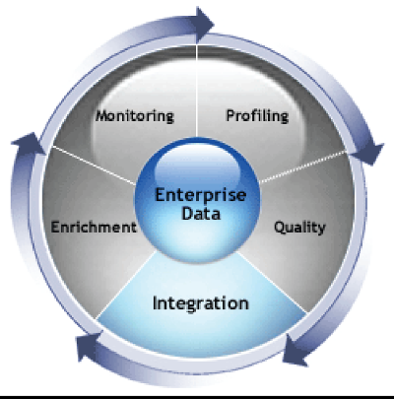
Integrated Data Facilitates Discovery!
Genomics
Genetics
Basic Science
Structure and evolution of genome, gene function, genetic variability, mechanism underlying traits
Translational Science
QTL /marker discovery,
genetic mapping,
Breeding values
Integrated Data & Tools
Diversity
Germplasm
Breeding
Applied Science
Utilization of DNA information in breeding decisions
Notes:
5

Slide 6
CottonGen’s First Year
Setting Queries
Web page development
Add Tools
CottonDB data in Chado
CottonGen
Released
Develop ICGI website
Tripal instance created
CottonDB on WSU servers

Slide 7
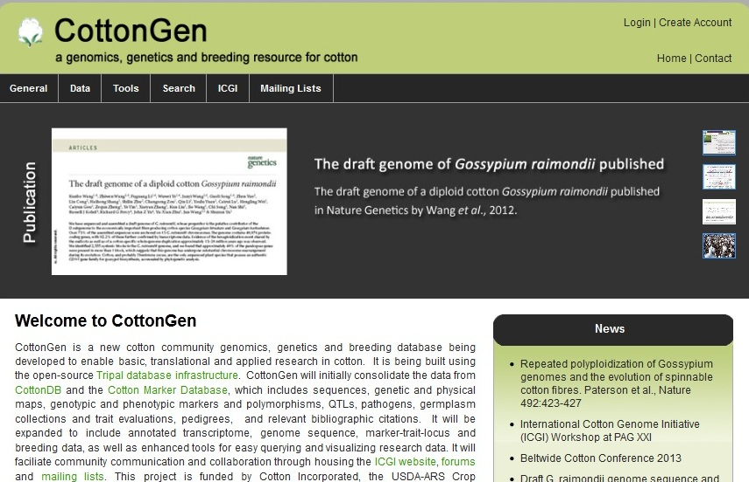
CottonGen Homepage
www.cottongen.org

Slide 8
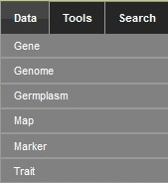
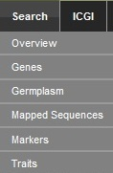
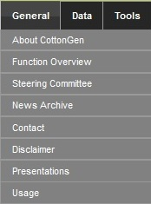
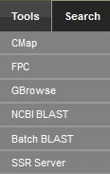
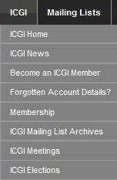
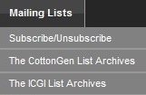
CottonGen Homepage

Slide 9
Data
  Markers - Over 23,000 genetic markers
  Maps - 50 maps with over 43,000 loci
  QTLs - 304 QTLs and 200 QTL trait data
  Polymorphism - 2,264 polymorphic SSRs
  Germplasm - Nearly 15,000 germplasm records
  Traits - 73,296 trait scores of 6,871 GRIN entries
  Sequences - Nearly 550,000 sequence records
  References - Nearly 11,000 references
  CottonGen Gossypium Unigene v1.0 (09/16/12)
  The Chinese BGI-CGP D-genome

Slide 10
Tools with implemented data
  CMap - Currently has 50 maps
  GBrowse - The Chinese BGI D-genome
  FPC - Data from USDA-ARS/TAMU
  BLAST Servers - UniProt and nr Proteins, BGI D-genome sequences, db_ests, unigenes, and CottonGen markers
  SSR Server – Identify Microsatellites and primers in sequences

Slide 11
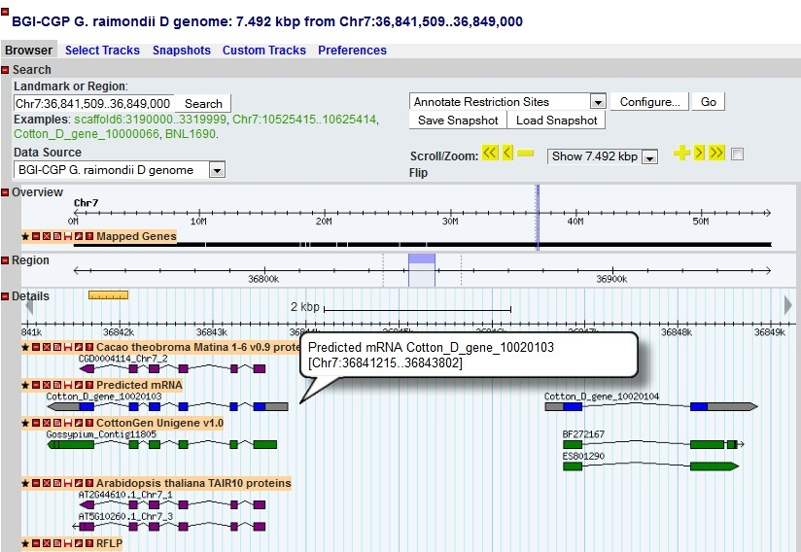
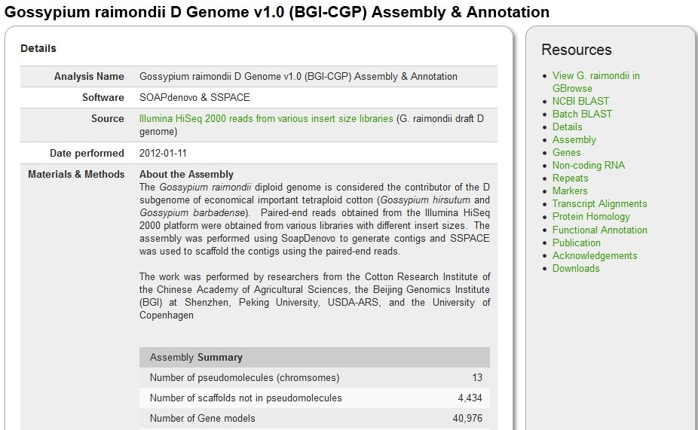
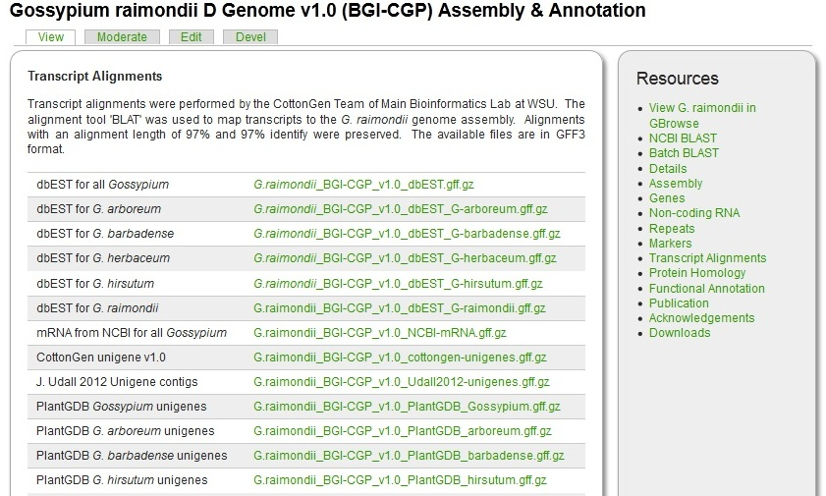
Genome Details Page

Slide 12
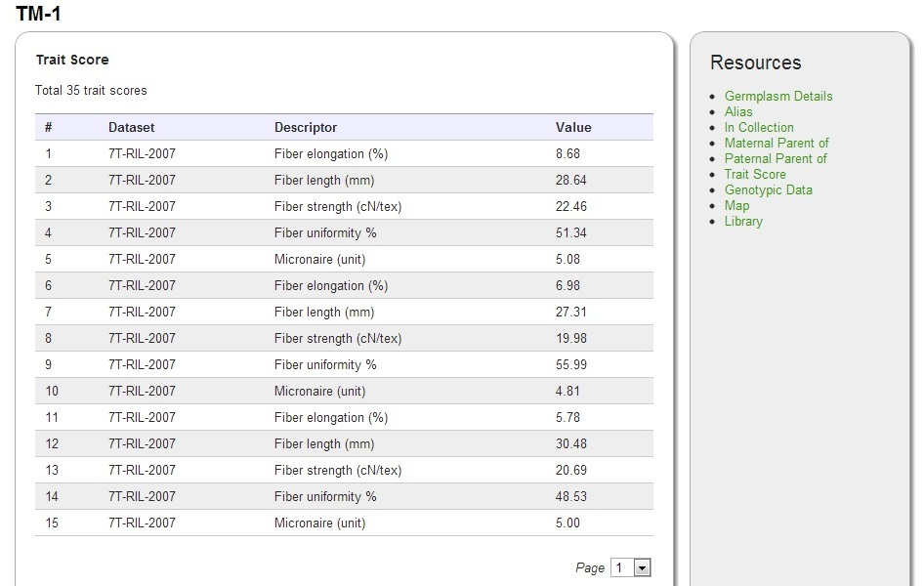
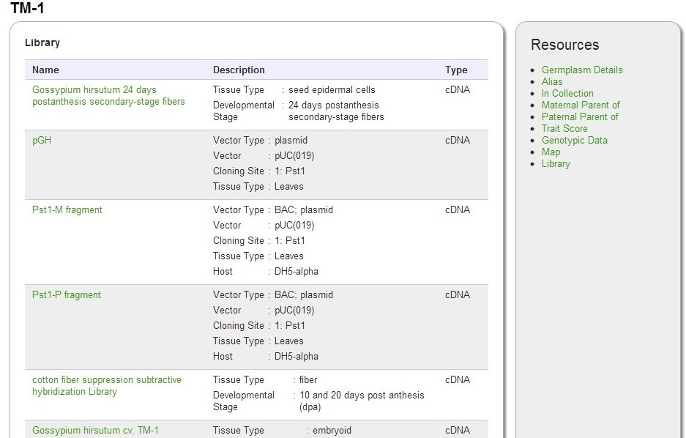
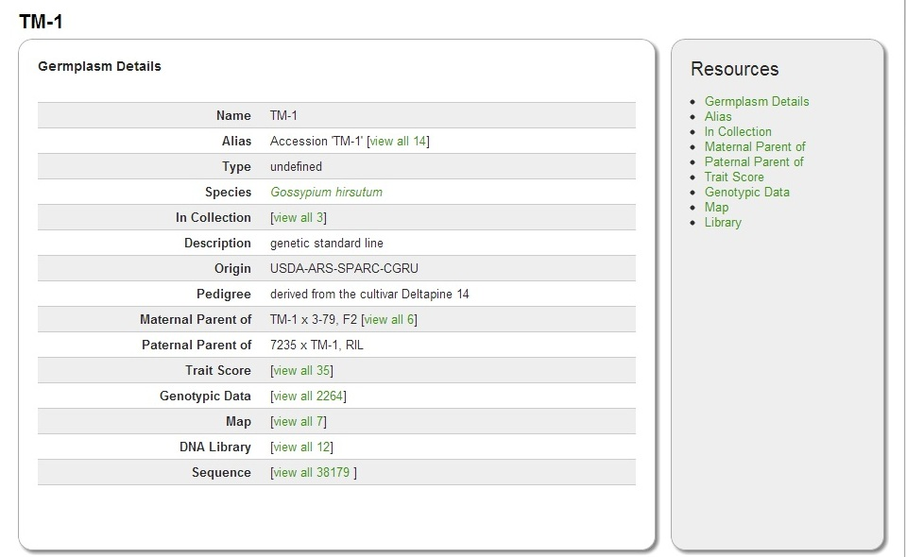
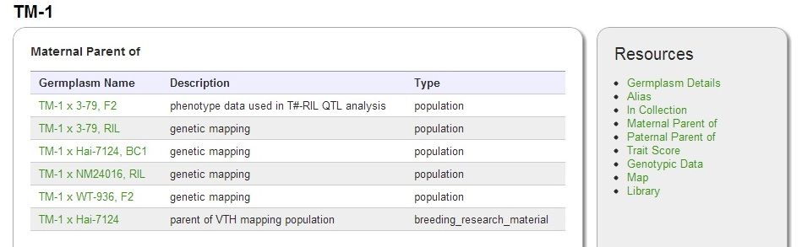
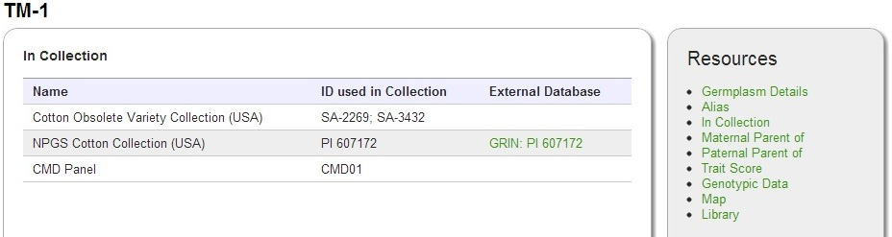
Germplasm

Slide 13
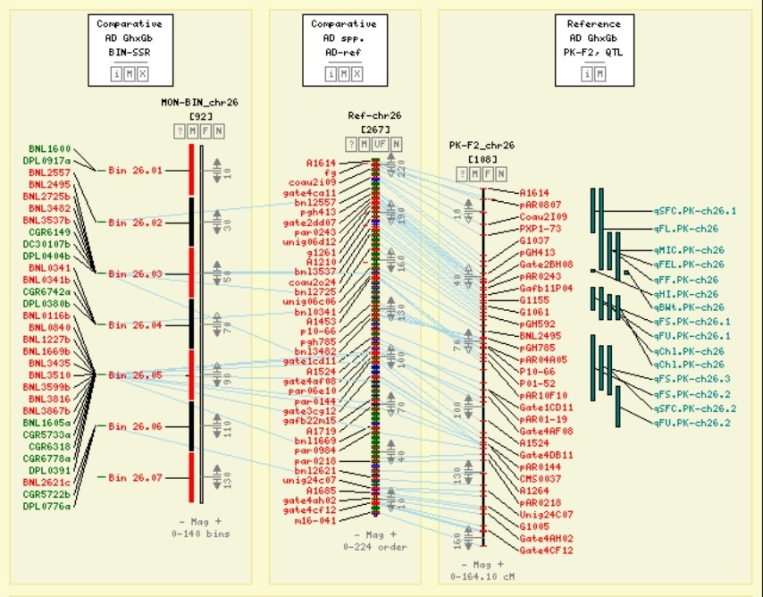
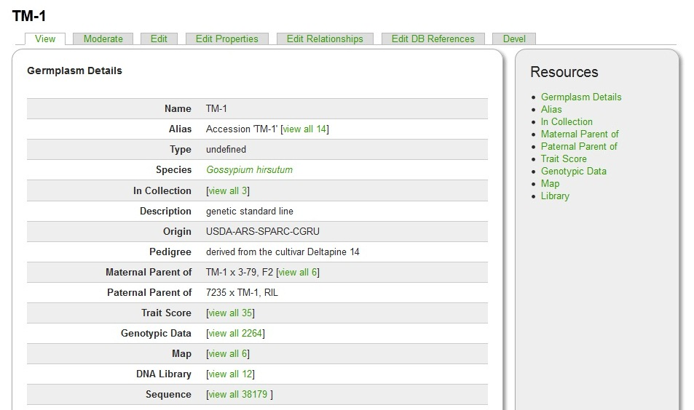
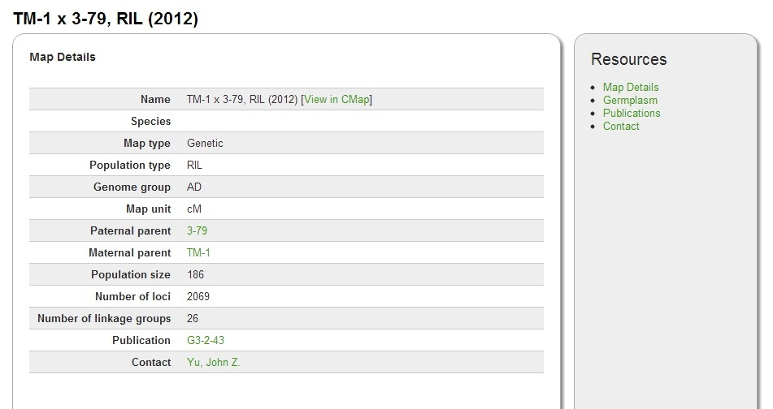
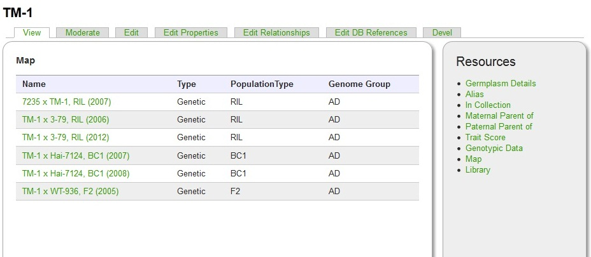

Slide 14
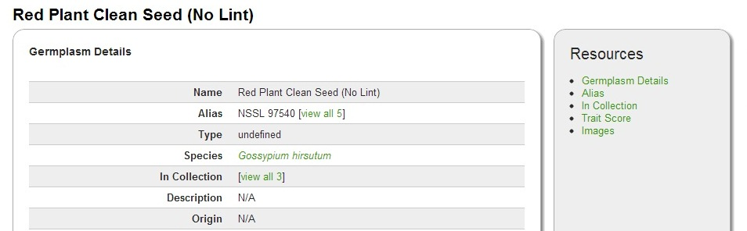
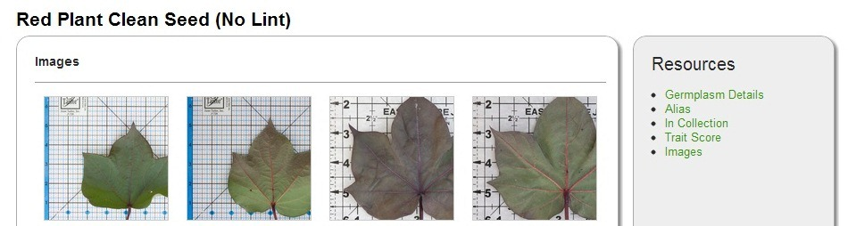
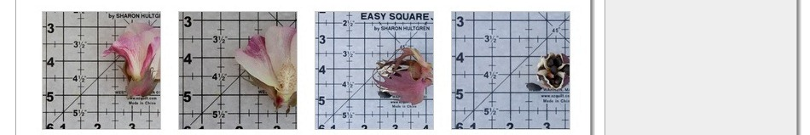
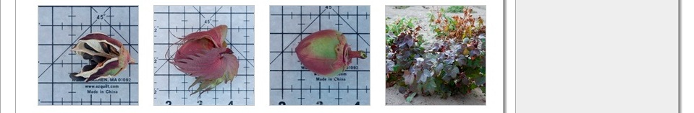
Image Data

Slide 15
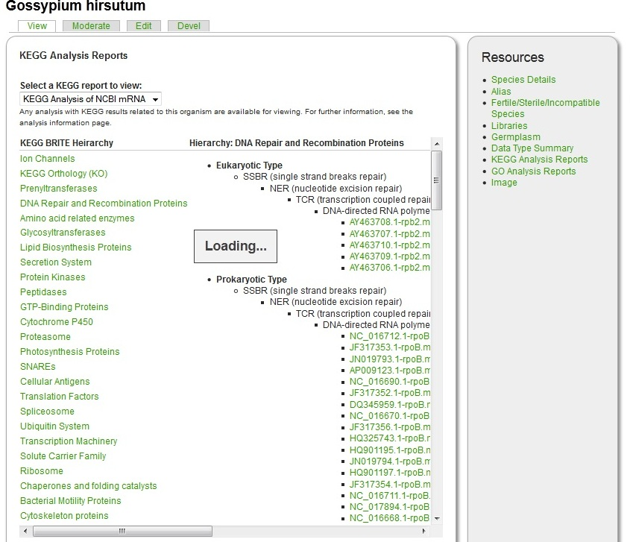
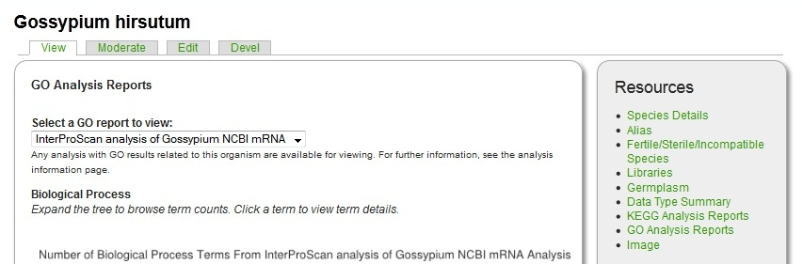
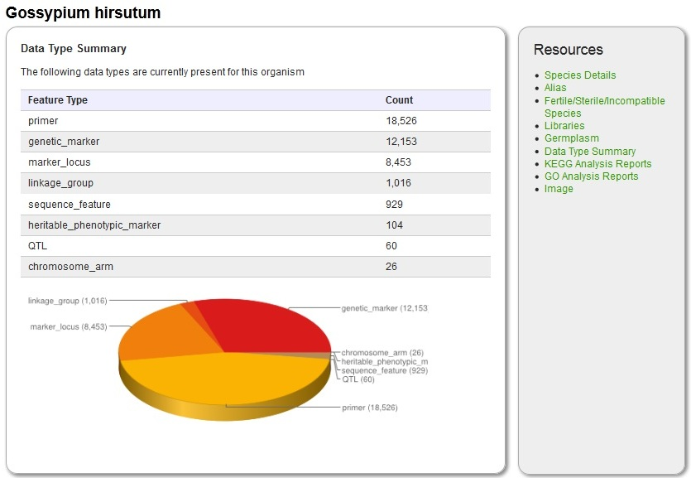
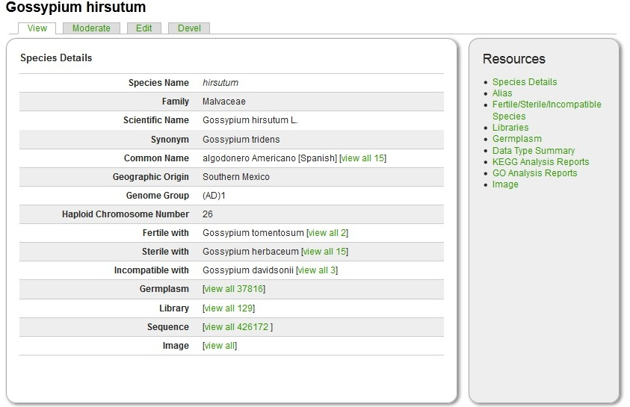
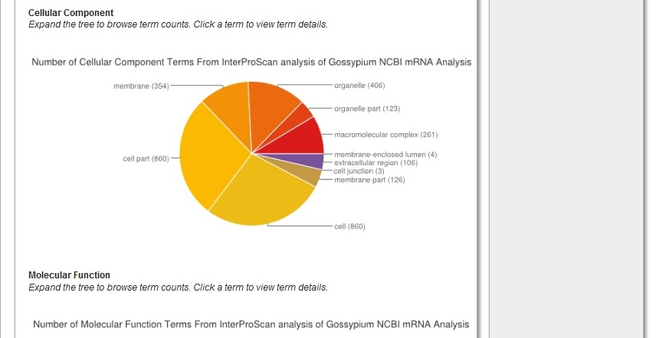
Species

Slide 16
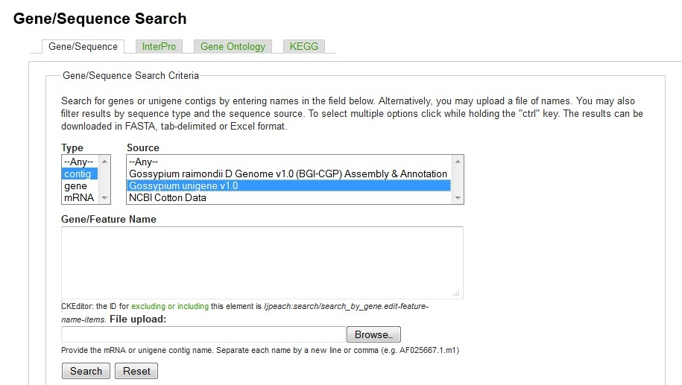
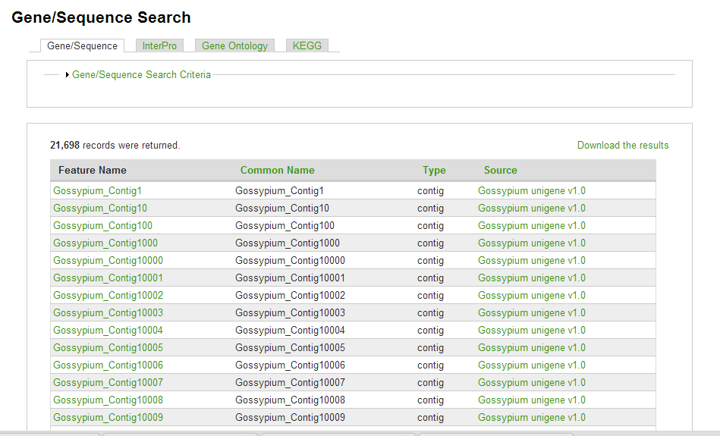
Gene/Sequence Search

Slide 17
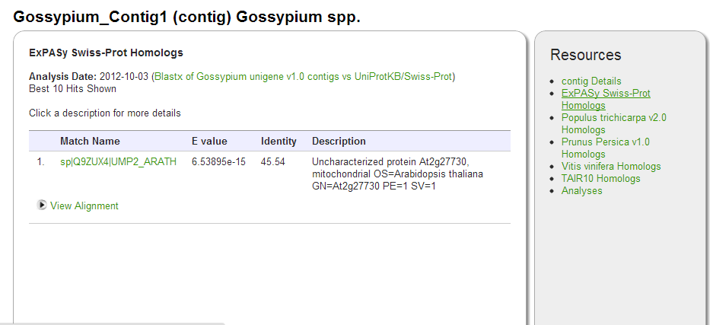
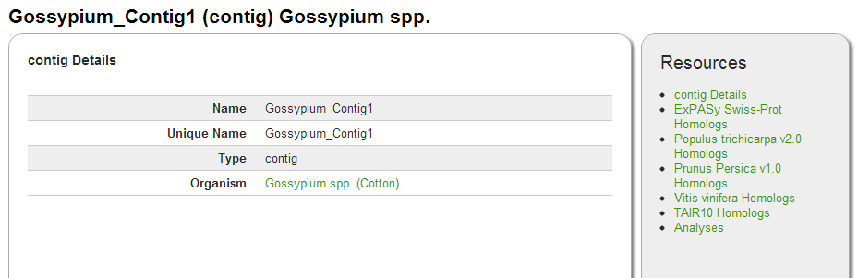
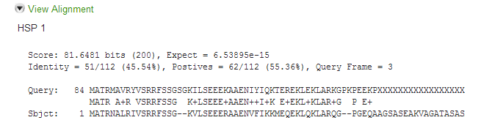
Gene/Sequence Page

Slide 18
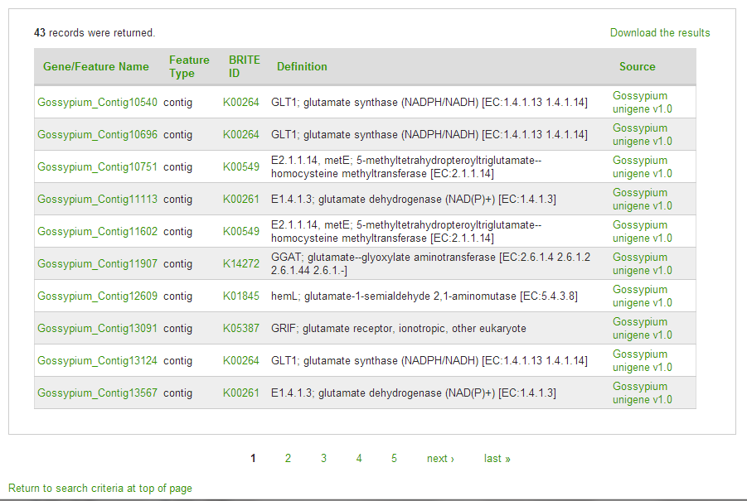
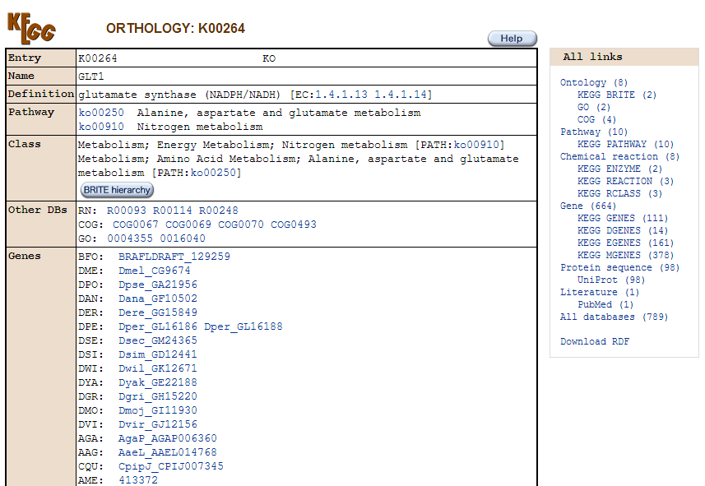
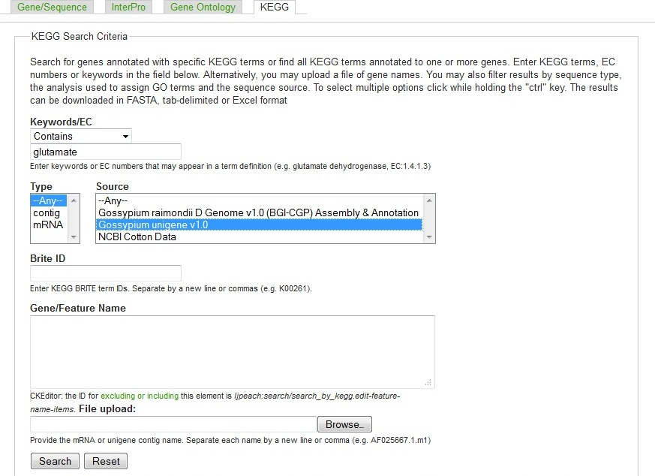
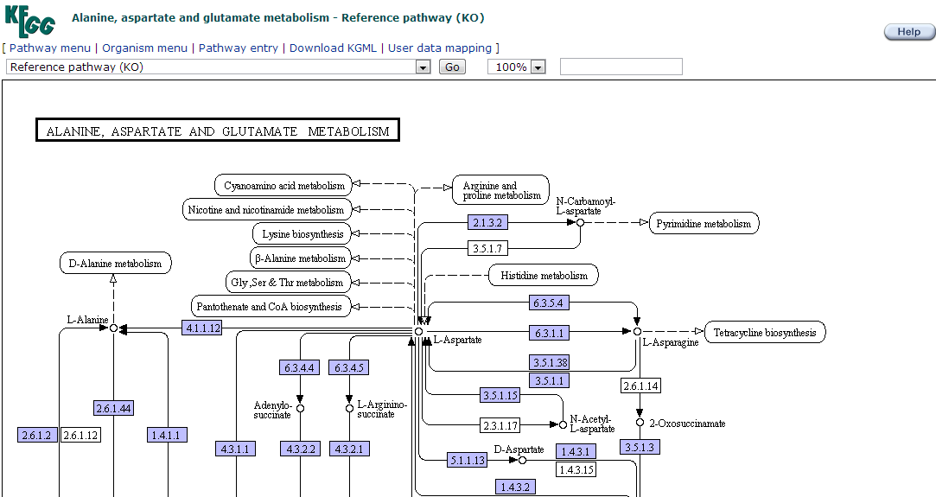
Gene/Sequence Search cont.

Slide 19
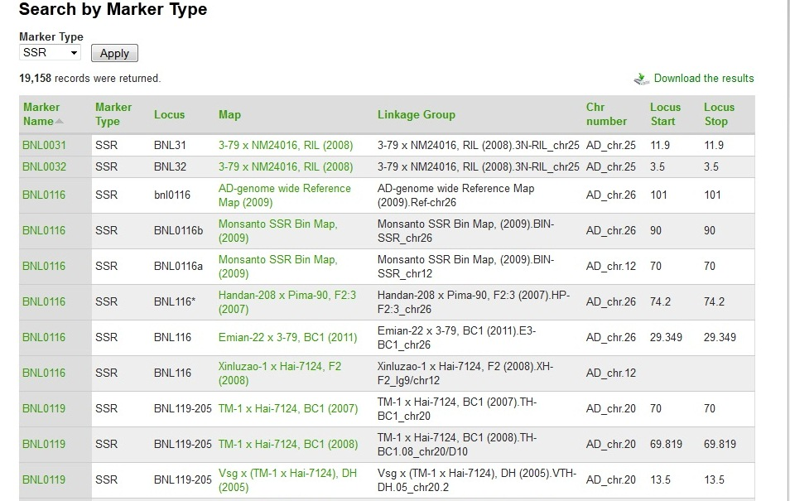
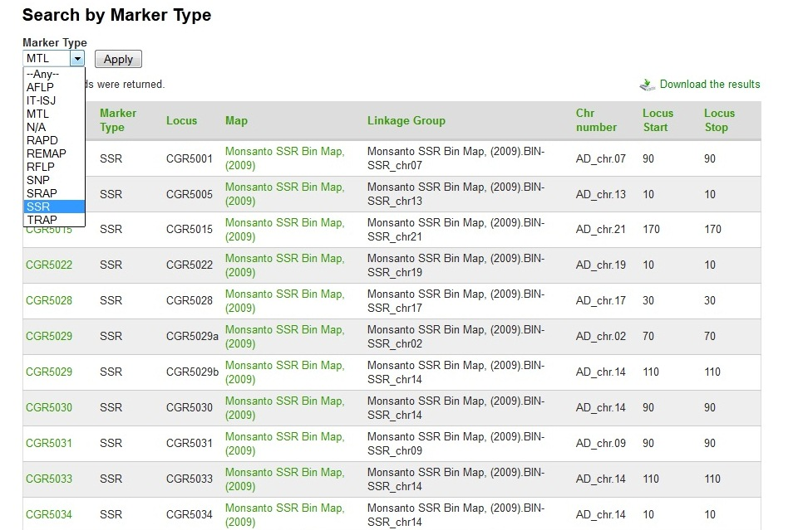
Marker Search

Slide 20
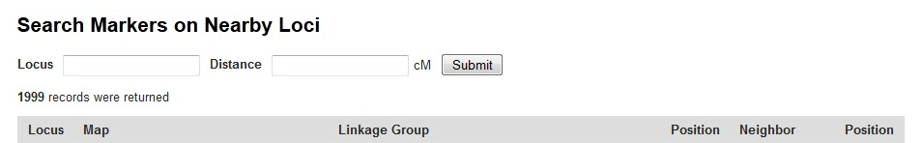
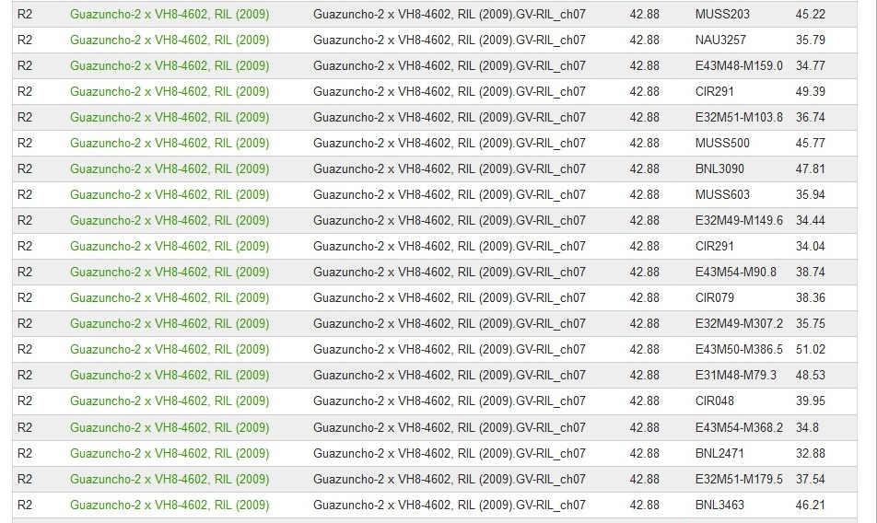

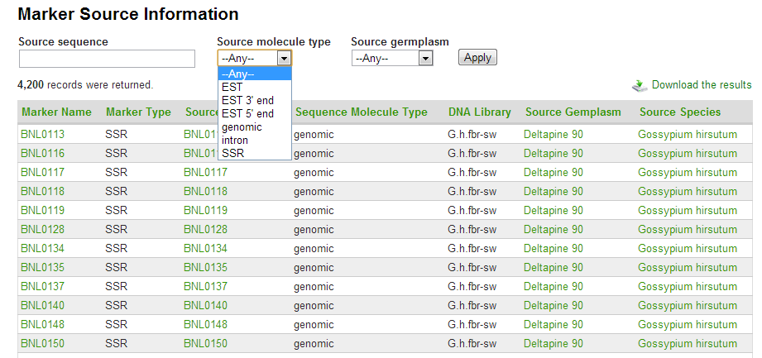
Marker Search

Slide 21
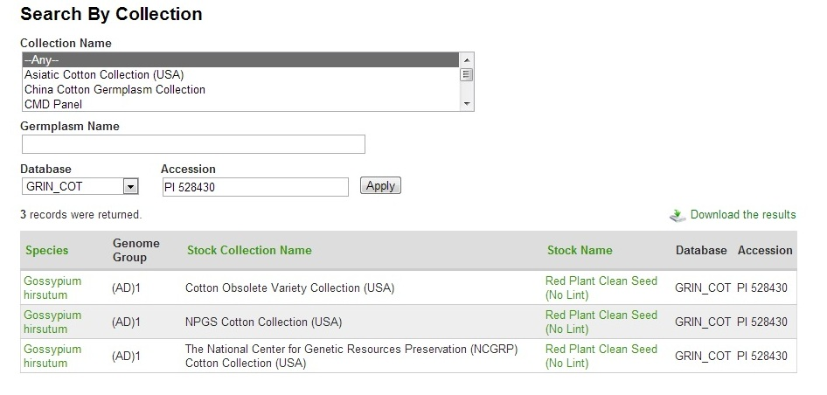
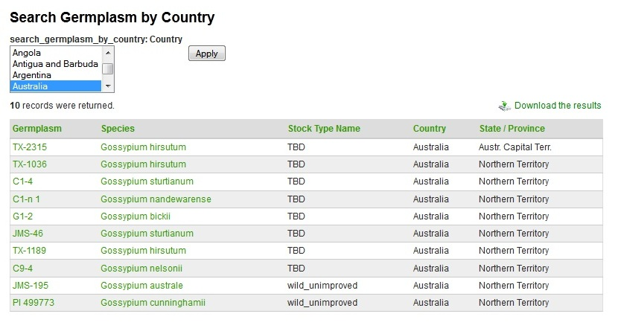
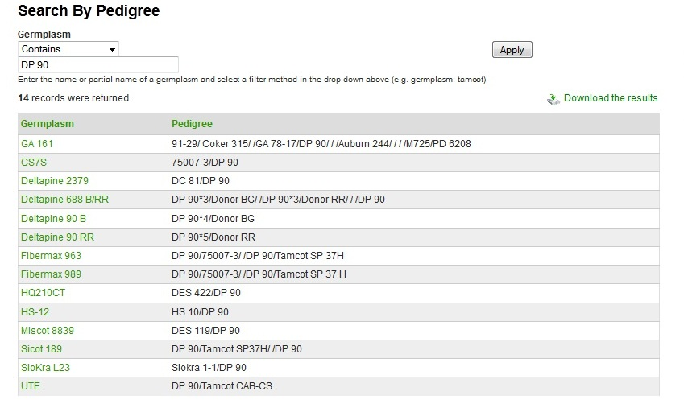
Germplasm Search

Slide 22
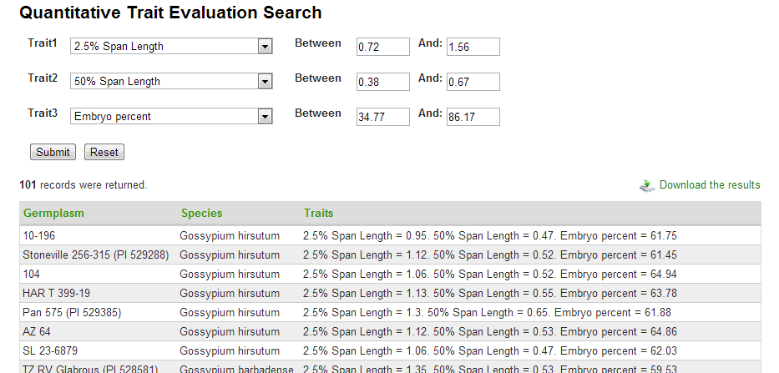
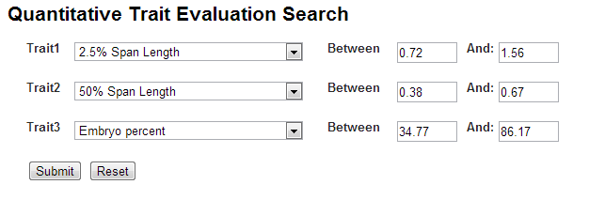
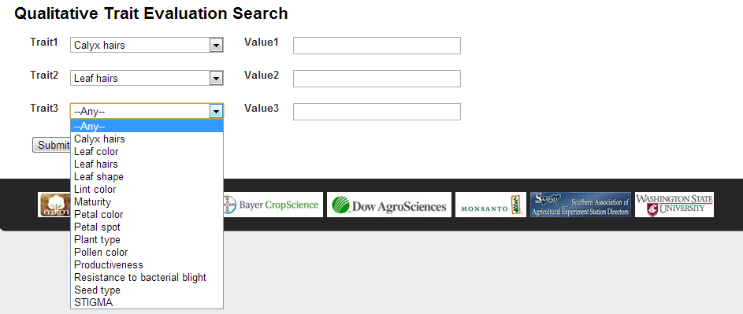
Trait Search

Slide 23
Future Work
Complete transfer of CottonDB and CMD data to CottonGen
Implement and develop new Drupal interfaces to browse, query and download data according to user requirements
Add annotated genome sequence, transcriptome, genotype and phenotype data
Implement GenSAS, a genome annotation community annotation tool.
Develop a breeders toolbox to assist in breeding decisions

Slide 24
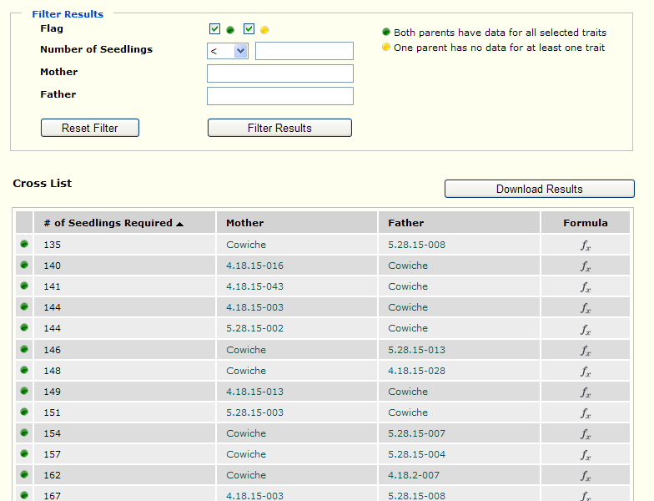



Cross Assist
Generates a list of parents and the number of seedlings to get the progeny with desired traits

Slide 25
Acknowledgements
Main Lab Bioinformatics Team
  Dorrie Main
  Sook Jung, Chun-Huai Cheng, Stephen Ficklin and Taein Lee
Industry Funding
  Cotton Incorporated, Bayer CropScience, Dow/Phytogen, Monsanto, Association of Agricultural Experiment Station Directors
Government Funding
  USDA ARS
  USDA NIFA AFRI and SCRI programs (funding Mainlab Tripal and GenSAS Development)
University Support
  Washington State University, Texas A&M, Clemson University
Community of Cotton Researchers

Slide 26
THANKS FOR YOUR ATTENTION!
Questions?

