Slide 1
CottonGen Development of an integrated Genomics, Genetics and Breeding Database for the Cotton Research Community
Jing Yu¹, Sook Jung¹, Chun-Huai Cheng¹, Stephen Ficklin¹, Taein Lee¹, Ping Zheng¹, Don Jones², Richard Percy³, Dorrie Main¹
1. Washington State University, 2. Cotton Incorporated, 3. USDA-ARS
2012 ICGI Conference Raleigh, North Carolina

Slide 2
Topics
Introduction
What is CottonGen
Infrastructure
Demo of CottonGen
Genome
Future Work

Slide 3
What is CottonGen?
A new cotton community database to further enable basic, translational and applied cotton research.
Built using the new open-source Tripal database infrastructure used by several other databases
Consolidate and expand CottonDB and CMD to include transcriptome, genome sequence and breeding data
CottonDB still available for easy transition

Slide 4
CottonGen Structure
Content Management System
Drupal modules as web front-end for Chado
Chado
Generic Database schema
Notes:
Databases using Tripal: GDR, Citrus, Cacao, Vaccinium and the Cool Season Food Legume,
Chado:
- A relational database schema that underlies many GMOD installations
- Representing many of the general classes of data frequently encountered in modern biology
- Designed to handle complex representations of biological knowledge
- One of the most sophisticated relational schemas currently available in molecular biology
disadv: New user must spend some time becoming familiar with its fundamentals
Drupal:
- A publishing platform with thousands of free designs and plug-ins for rapid site assembly
- A well-documented, flexible, limitless scalable Application Programming Interface
- Easy to create and manage user’s own website

Slide 5
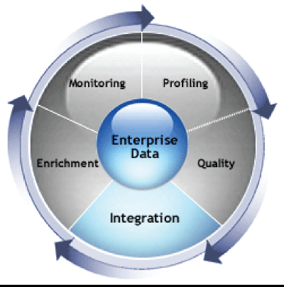
Integrated Data Facilitates Discovery
Genomics
Genetics
Basic Science
Structure and evolution of genome, gene function, genetic variability, mechanism underlying traits
Translational Science
QTL /marker discovery,
genetic mapping,
Breeding values
Integrated Data & Tools
Diversity
Germplasm
Breeding
Applied Science
Utilization of DNA information in breeding decisions
Notes:
5

Slide 6
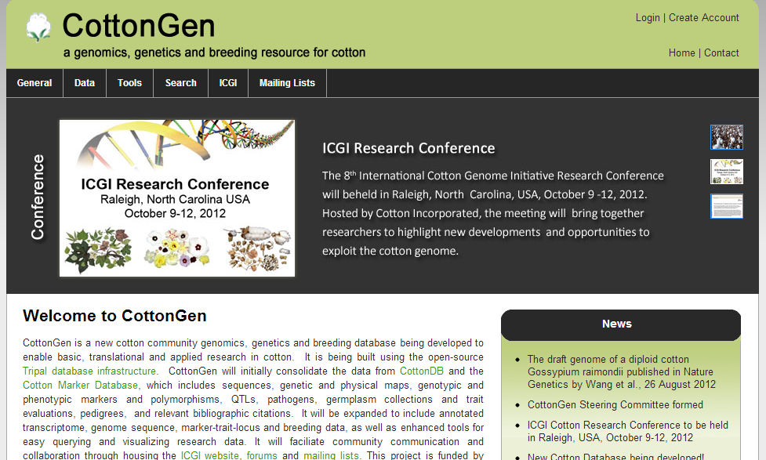
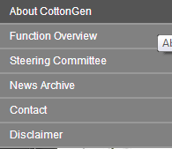
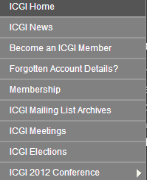
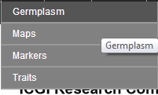
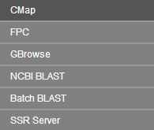
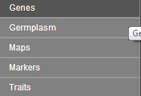
CottonGen Homepage

Slide 7
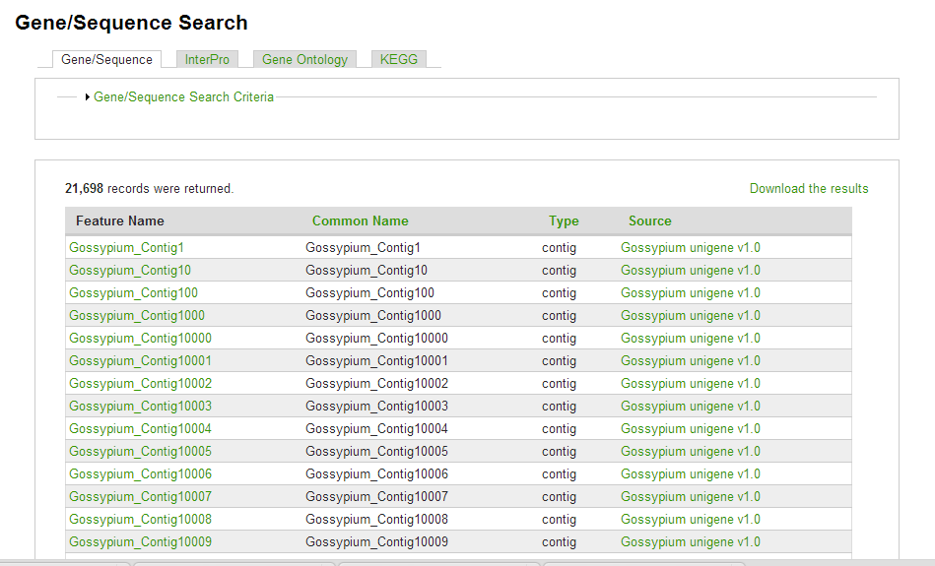
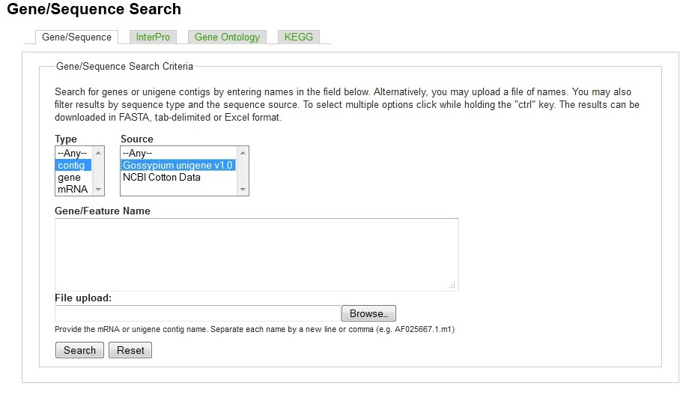
Gene/Sequence Search

Slide 8
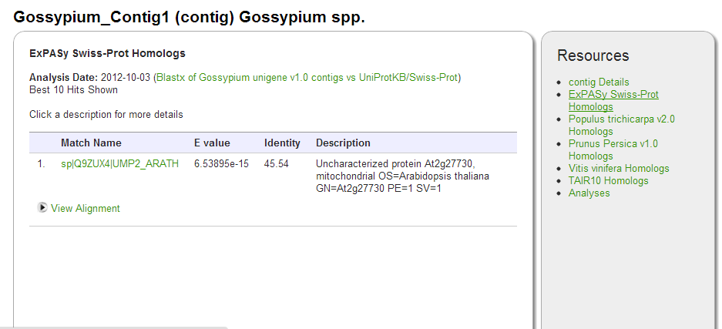
Gene/Sequence Page

Slide 9
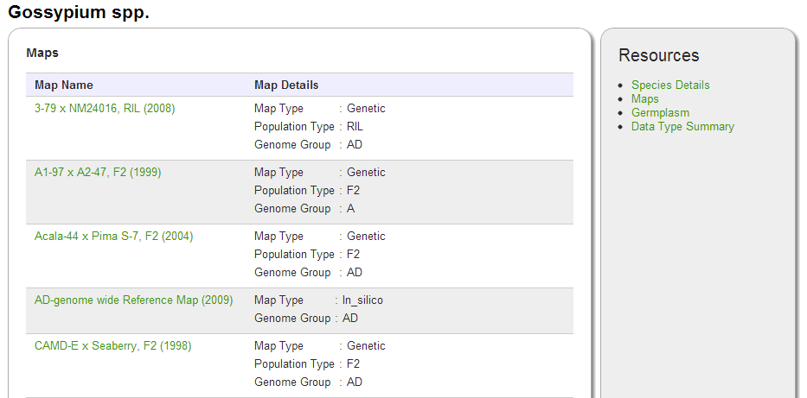
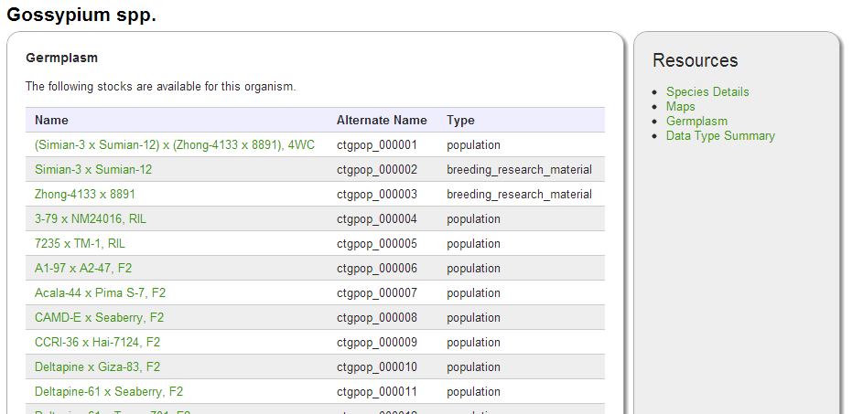
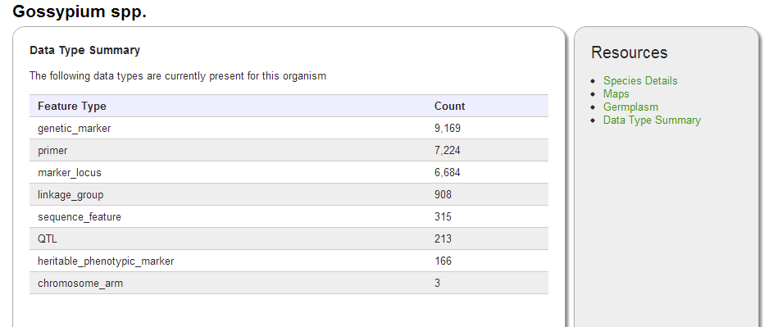
Species Page

Slide 10
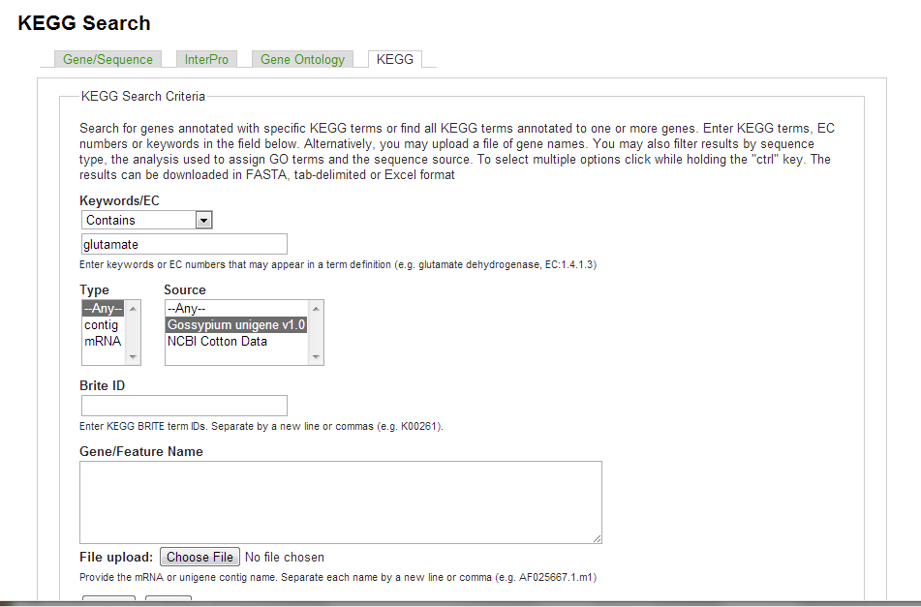
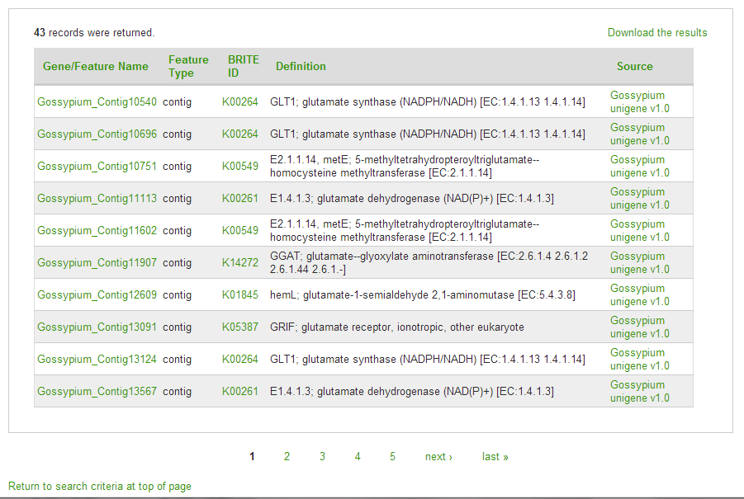
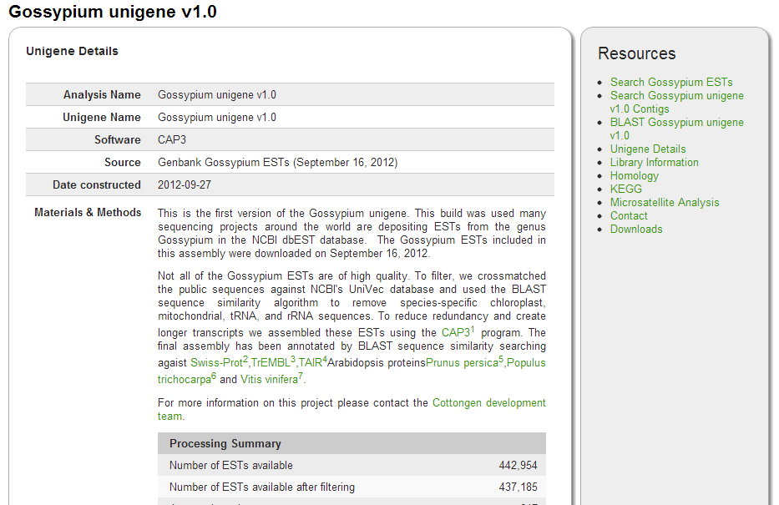
Gene/Sequence Search cont.

Slide 11
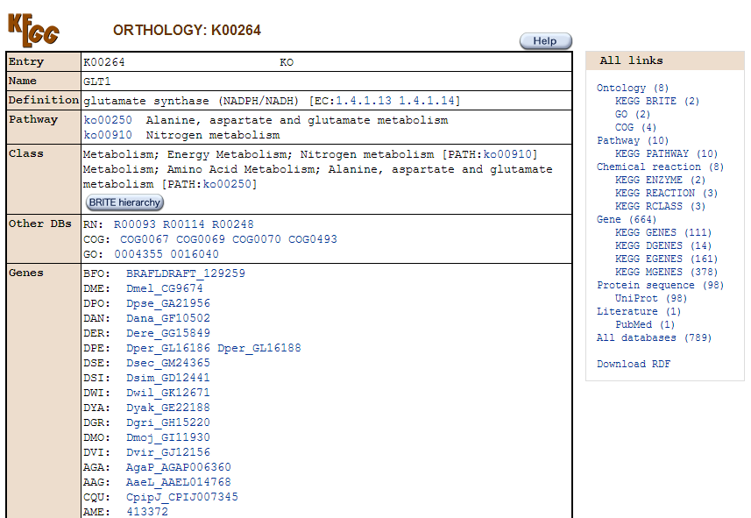
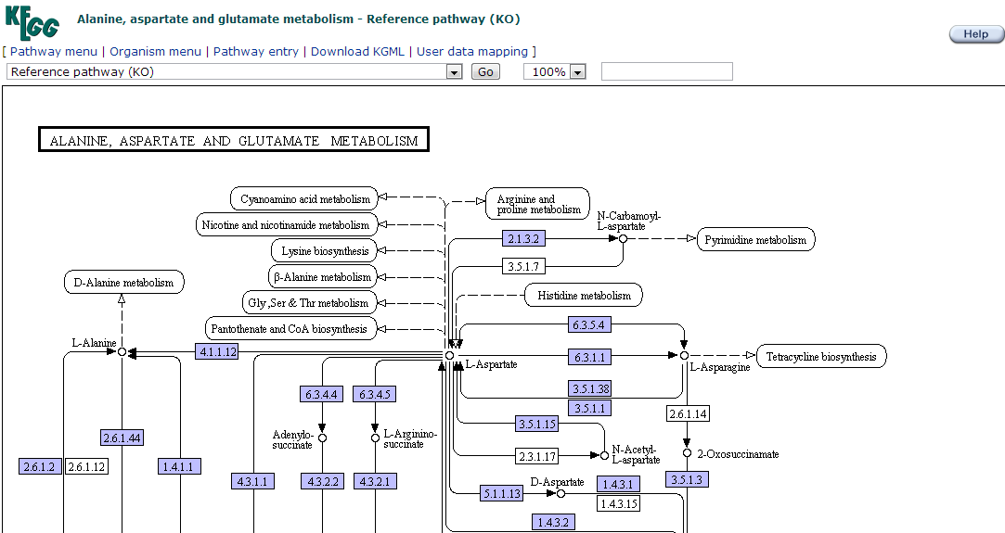
Gene/Sequence Search cont.

Slide 12
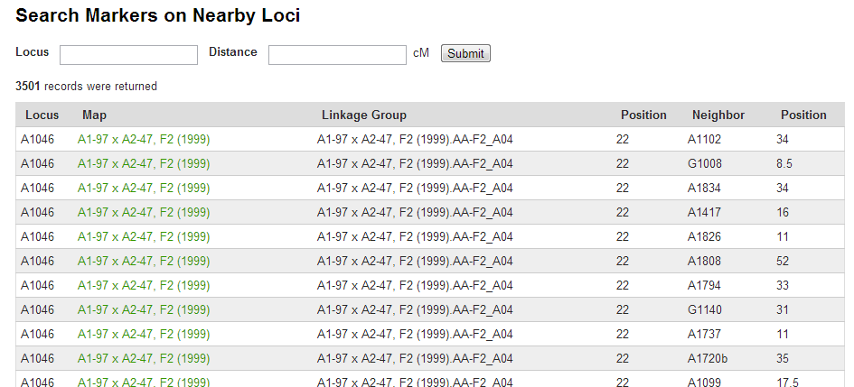
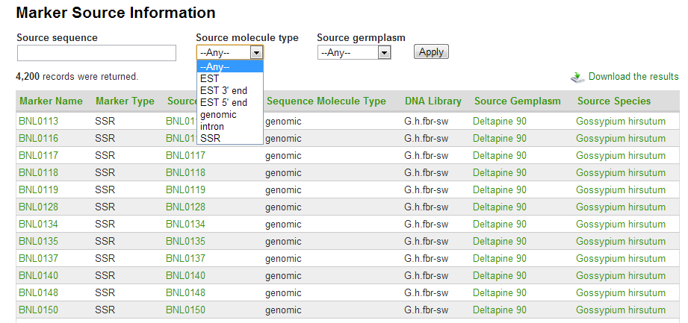
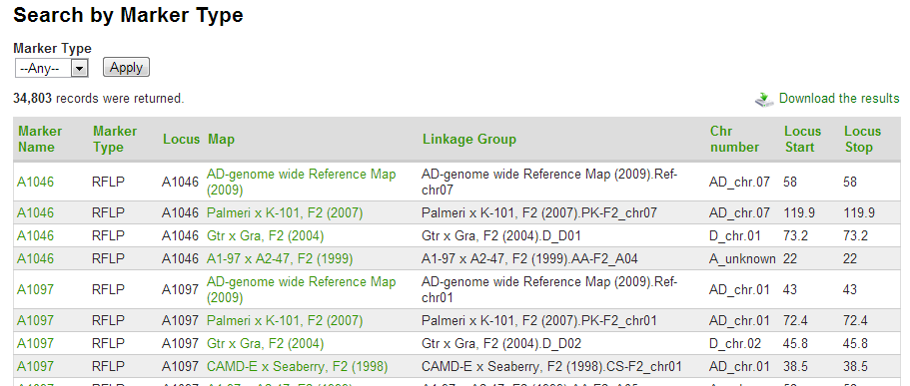
Marker Search

Slide 13
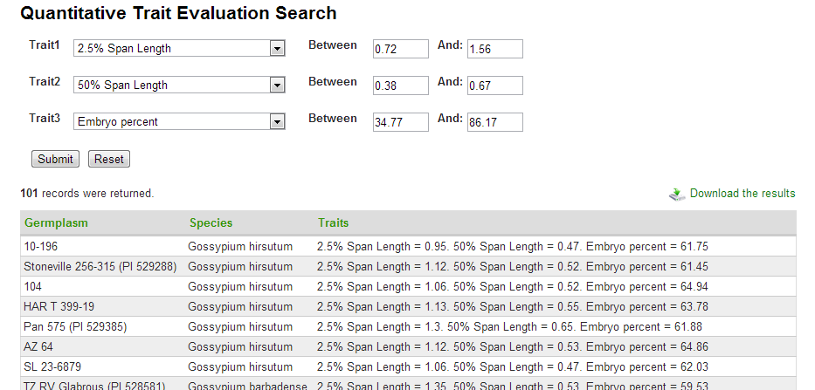
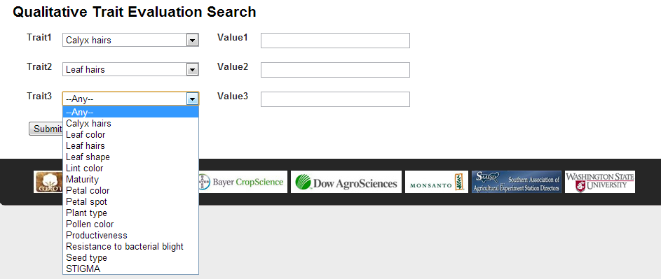
Trait Search

Slide 14
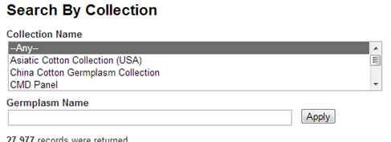
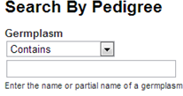
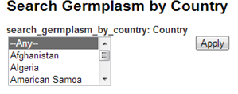
Search Sites for Germplasm Mapped sequences

Slide 15
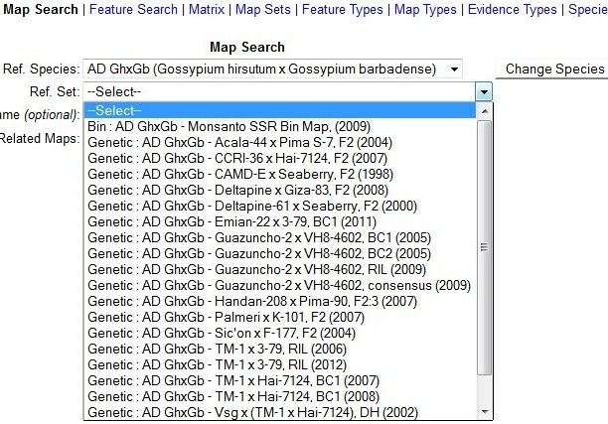
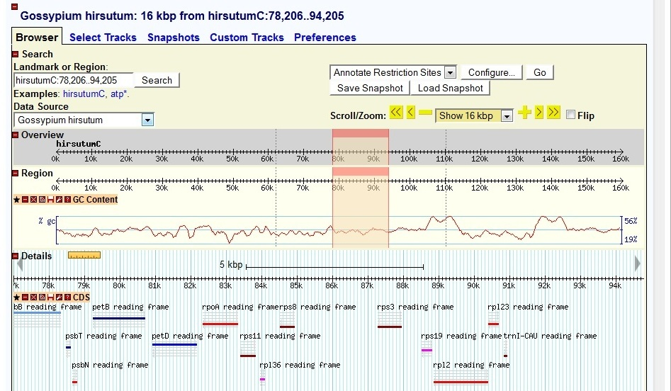
Implemented Tools

Slide 16
Future Work
Finish transferring CottonDB and CMD data to CottonGen
Implement and develop new Drupal interfaces to browse, query and download data according to user requirements
Add annotated genome sequence, transcriptome, genotype and phenotype data
Develop genome annotation community annotation tool

Slide 17
Acknowledgements
Cotton Incorporated
USDA ARS
Bayer CropScience, Dow/Phytogen, Monsanto,
Association of Agricultural Experiment Station Directors
USDA Specialty Crop Research Initiative (funding Tripal Development)
Community of international cotton researchers
Washington State University, Texas A&M, Clemson University

Slide 18
THANKS FOR YOUR ATTENTION!
Questions?

